Slide 1
Yücel Gökdere 201833010
Bartu Gerçek 202037302

Slide 2
Effect of Covid-19 pandemic

Slide 3
Tourists’ Travel Risk and Management Perception

Slide 4
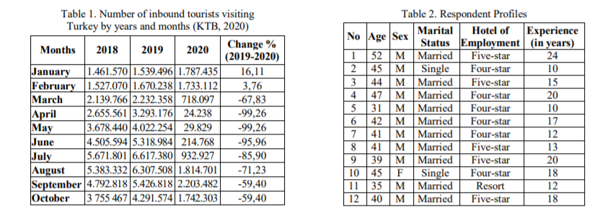
Number of Tourists Visiting Turkey

Slide 5
The Impact of COVID-19 on the Tourism Industry

Slide 6
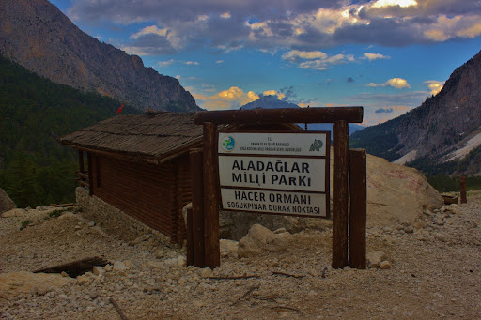
Impact of the pandemic on tourism in national parks
Aladaglar National Park.
Local People

Slide 7
Impacts and implications for the sports industry in the post-COVID-19 era

Slide 8
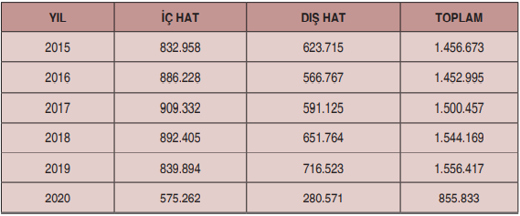
The Effect of the Covid 19 Airline Companies

