Slide 1
Economic Crisis
Sabiha Miray Ay
Büşra Pervin Yılmaz
Yunus Emre Kaymak
January 2022

Slide 2
Introduction
The Concept of Economic Crisis
The Concept of Economy
Social science
Consumption, Production, Sharing, distribution, development, and economic growth
Negative development, Recession, and Depression
Macro Point, Micro Point

Slide 3
Examining The Economic Crisis
Economic Crisis Arise from:
Falling consumer demand
High unemployment
Falling living standards
Reduced investment by firm

Slide 4
Features of Economic Crisis
Inadequate business forecasting and prevention systems
Sufficient information to decide on the steps that need to be taken to overcome, and
Requiring urgent intervention
Non-prediction of the crisis
Creating tension in decision makers
Causing fear and panic
Process of problems and hard decision
Economic imbalances
Increasing competitive conditions
Political and economic events

Slide 5
Causes of Economic Crisis
Political, economic, technological and ecological spheres
Globalization
Liberalization of foreign trade
The collapse of socialism and the market potential of countries undergoing a transition to a market economy.

Slide 6
Measures to be Taken Against Economic Crisis
Macro Measures
Micro Measures
Macroeconomic stability
Political stability
Financial and monetary discipline
Tax System
A flexible exchange rate system
Total quality management
Strategic management, synergistic management, management of human resources
Re-engineering

Slide 7
Types of Economic Crises
External Debt Crises
Currency Crises
Banking Crises and Financial Crises

Slide 8
Some Important Economic Crises
The Swedish Economic Crisis (1990-1994)
British Northern Rock Rescue Package (2007)
Tulipomania (1637)
1929 Wall Street Crash
Great Depression 1929
Global Financial Crisis 2008

Slide 9
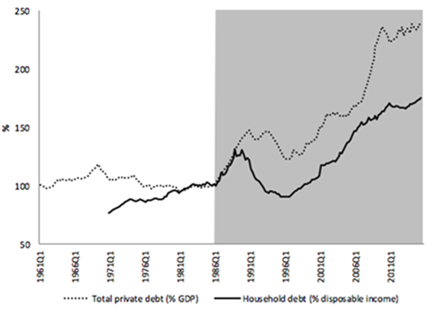
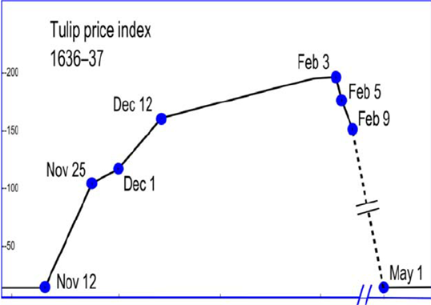
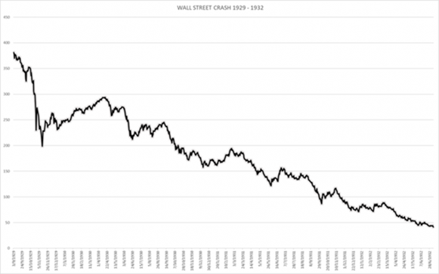
Graphs of Economic Crises
The Swedish Economic Crisis
Tulipomania
1929 Wall Street Crash

Slide 10
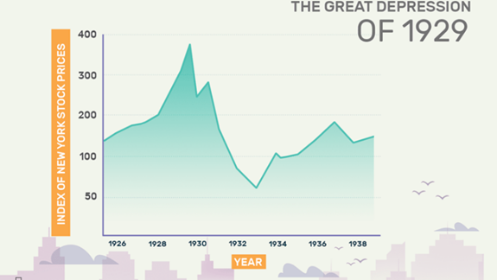
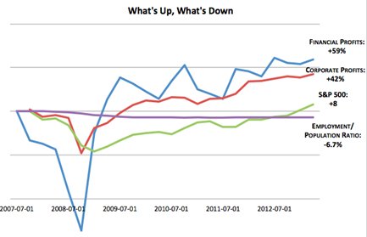
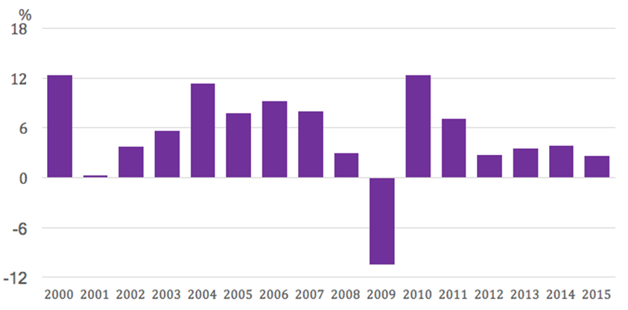
Graphs of Economic Crises
Great Depression 1929
Global Financial Crisis 2008
Global Trade Growth

Slide 11
CONCLUSION
*Rising unemployment rate
*reduction of income
*Increasing injustice of income decoupling between social classes
*Increasing poverty
*As a result of all this, people’s standard of living is falling.

Slide 12
Thanks For Listening Us

