Slide 1
CHAPTER 8
INDEX NUMBERS

Slide 2
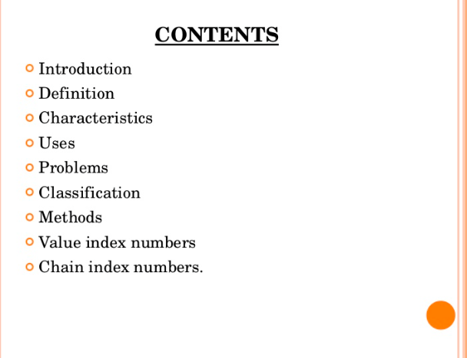

Slide 5
An index number is a method of evaluating variations in a variable or group of variables in regards to geographical location, time, and other features. The base value of the index number is usually 100, which indicates price, date, level of production, and more.

Slide 7
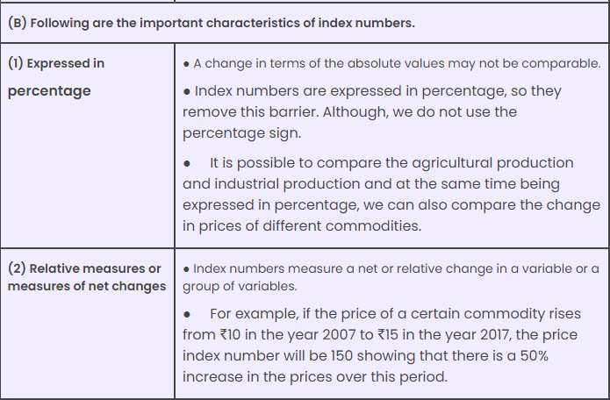

Slide 8
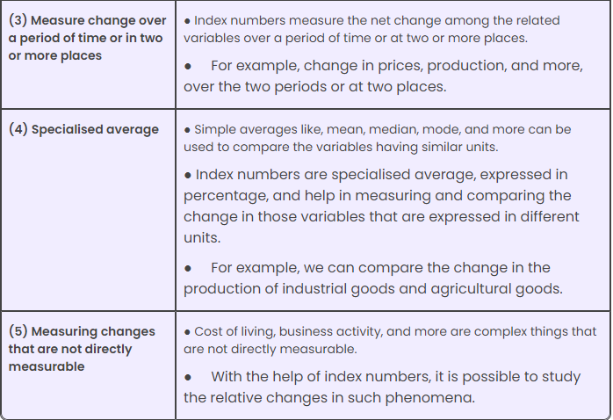

Slide 11
What are the advantages of index numbers?
Help in formulating policies: Most of the economic and business decisions and policies are guided by the index numbers. To make any policy related to the industrial or agricultural production, the government refers to their respective index numbers.
Help in study of trends: Index numbers help in the study of trends in variables like, export-import, industrial and agricultural production, share prices, and more.
Helpful in forecasting: Index numbers not only help in the study of past and present behaviour, they are also used for forecasting economic and business activities.
Facilitates comparative study: To make comparisons with respect to time and place especially where units are different, index numbers prove to be very useful. For example, change in ‘industrial production’ can be compared with change in ‘agricultural production’ with the help of index numbers.

Slide 12
(5) Measurement of purchasing power of money to maintain standard of living: Index numbers, such as cost inflation index help in measuring the purchasing power of money at different times between different regions. Such analysis helps the government to frame suitable policies for maintaining or raising the standard of living of the people.
(6) Act as economic barometer: Index numbers are very useful in knowing the level of economic and business activities of a country. So, these are rightly known as economic barometers.

Slide 13
PROBLEMS INVOLVED IN THE CONSTRUCTION OF INDEX NUMBERS
(1) Purpose of index numbers
(2) Selection of base period
(3) Selection of commodities
(4) Selection of sources of data
(5) Selection of weights
(6) Selection of an appropriate formula

Slide 14
What are the major limitations of index numbers?
Difficulty in construction of index numbers
Based on sample items, so only approximate indicators
Ignores quality of commodities
Limited use
Useful only for short-term comparison

Slide 15
Karma

Slide 21
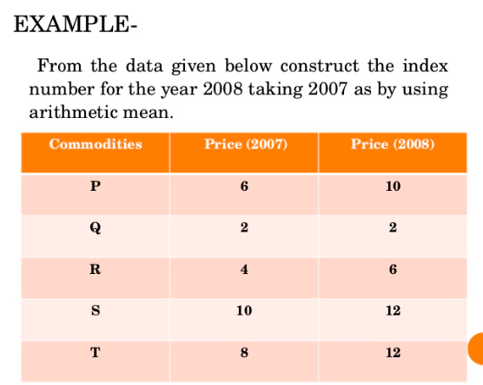

Slide 22
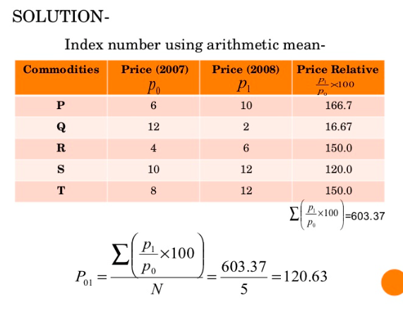
The price increased 20.63% in one year

Slide 26
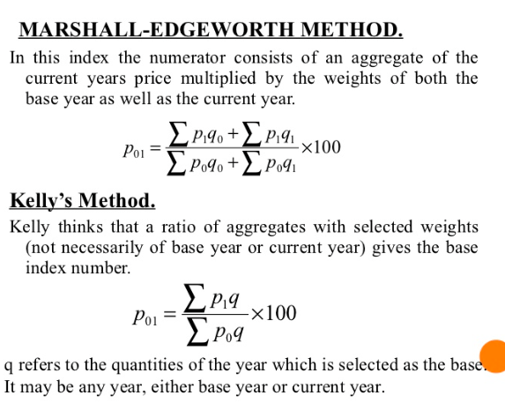

Slide 27
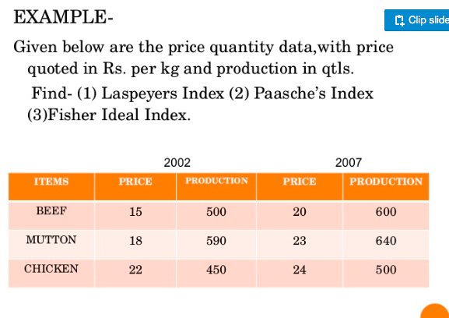

Slide 28
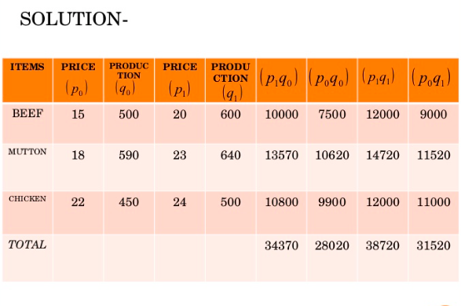

Slide 29
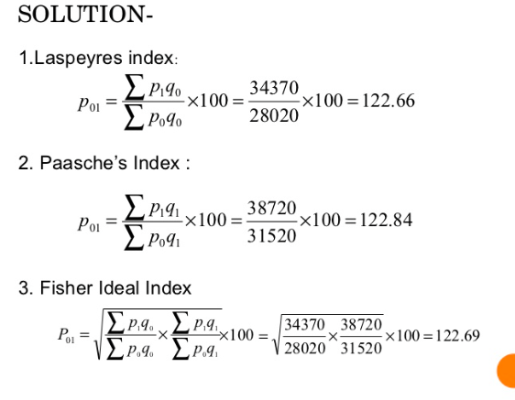

Slide 33
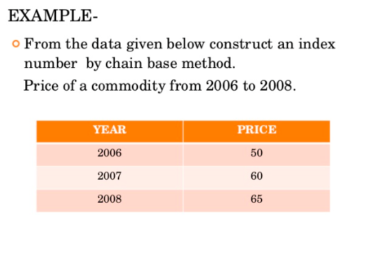

Slide 34
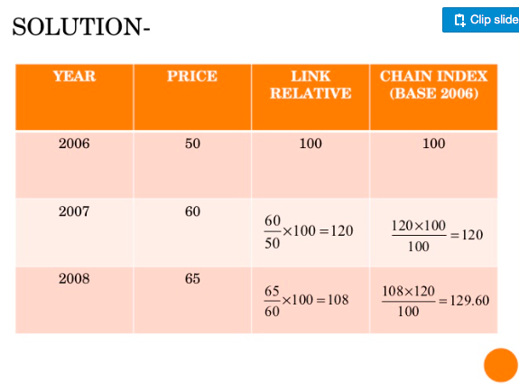

Slide 35
Productivity Indexes

Slide 36
Productivity Definitions and Measurements
Productivity is one measure of the effective use of resources within an organization, industry, or nation.
The classical productivity definition measures outputs relative to the inputs needed to produce them. That is, productivity is defined as the number of output units per unit of input

Slide 37
Productivity Definitions and Measurements
Productivity is one measure of the effective use of resources within an organization, industry, or nation.
The classical productivity definition measures outputs relative to the inputs needed to produce them. That is, productivity is defined as the number of output units per unit of input

Slide 38
Productivity Definitions and Measurements
Sometimes, an inverse calculation is used that measures inputs per unit of output. Care must be taken to interpret this inverse calculation appropriately; the greater the number of units of input per unit of output, the lower the productivity.
For example, traditionally productivity in hospital nursing units has been measured by hours per patient day (HPPD). That requires an inversion of the typical calculations: meaning total hours are divided by total patient days.

Slide 39
In everyday language, the word production, and productivity sometimes are used interchange only. But in business and economics, these words have distinctly different meanings.
Production: means a quantity or amount of output.
Productivity: is a ratio of output divided by input.
Output
Productivity = ---------------------
Input

Slide 40
20 laborers made 320 chairs in 40 hour-week, their production was 320 chairs.
In order to calculate the productivity we need to calculate labor-hour.
Labor-hour= Number of laborers X Hours
Labor-hour= 20 laborers X 40 hour-week = 800 labor hours
320 chairs
Labor Productivity= ---------------------- = 0.4 chair per labor-hour
800 Labor hours

Slide 41
The ratio of output to all input factors is called Total Factor Productivity.
The labor-Hour Equivalent Productivity Index
Suppose that 800 labor-hours were expended in the current period to make 400 chairs.
400 chairs
Current Period Productivity= ------------------------ = 0.5 chair per labor-hour
800 Labor-hours

Slide 42
Suppose that 1000 labor-hours would have been expended to make the same number of chairs, 400, in a base period.
400 chairs
Base Period Productivity = --------------------------= 0.4 chair per labor-hour
1000 labor-hours
Finally, we compute the simple chair Productivity index for the current period.

Slide 43
Simple Chair Productivity Index for the Current Period=
Current Productivity 0.5
--------------------------------------- X 100 = ----------- X 100 = 125
Base Period Productivity 0.4
The index 125 means that the output of chairs per labor-hour increased
(125-100=) 25 percent.
We can compute the index number 125 in a different manner:

Slide 44
Base period labor-hours to produce 400 chairs
--------------------------------------------------------------- X 100
Current period labor to produce 400 chairs
1000
The ratio is ------------- X100 = 125
800

Slide 45
Labor-Hour Equivalent (LHE) Productivity Index =
Base period labor-hours required to make period n quantity
-------------------------------------------------------------------------------- X 100
Period n labor-hours expended to make period n quantities

Slide 46
Example:
In 1977, the base period, Fine Woods Company’s unite labor requirement were 2 labor-hours per chair, 4 labor-hours per table, and 3 labor-hours per bookcase.
In 1980, Fine Woods expended 50.000 labor-hours to produce 21000 chairs, 3000 tables, and 2000 bookcases. Compute the 1980 productivity index.

Slide 47
To make the 1980 number of chairs, 21000, in 1977 would have required
21000 X 2 = 42000 Labor-hours
3000 X 4 = 12000 Labor-hours
2000 X 3 = 6000 Labor-hours
-------------------------
60000 labor-hours
60000
Labor-hour equivalent = -------------- X 100 = 120
50000
Therefore, 1980 productivity was 20% above the base period (1977) level.

Slide 48
EXAMPLE
In 1978, Delta’s unit labor requirements were, in labor-hours per unit, 1 hour per valve, 0.5 hour per whistle and 2 hours per gauge. In 1980 Delta expended 500000 labor-hours in producing 120000 valves, 80000 whistle and 200000 gauges. Compute Delta’s productivity index for 1980 with 1978 as base by the Labor-hour Equivalent formula.

Slide 49
1978
1 X 120000 = 120000
0.5 X 80000 = 40000
2 X 200000 = 400000
-------------------
560000
560000
Labor-hour equivalent = ------------- X 100 = 112
500000

Slide 50
The Constant Dollars Per Labor-Hour Productivity Index:
Suppose the Dollar value of output for an industry was 31.230 million Dollars in 1975 and 49.160 million in 1980. The price index for the products made by the industry (1970 as 100) was 143.1 in 1975 and 174.4 in 1980. We can express 1975 output in constant Dollars.

Slide 51
100
1975 constant dollar output = Dollar value of output 1975 (----------------------)
Price Index 1975
100
= 31.230 (---------) = 21.824 Dollars
143.1
100
1980 constant dollars output = 49.160 (---------) = 28.188 Dollars
174.4

Slide 52
Constant dollars per labor-hour
(Productivity Index) =
Constant dollars of output per labor-hour in period n
------------------------------------------------------------------------ X 100
Constant dollars of output per labor-hour in base period
Calculate the productivity index by using the formula

Slide 53
 | Item | Year
 |  | 1975 | 1980
a | Dollar value of output million | 31.230 | 49.160
b | Price index 1970 as 100 | 143.1 | 174.4
c | Constant dollar output 〈a.(100/b)〉 | 21.824 | 28.188
d | Labor-hours worked million | 2.040 | 2.285
e | Constant dollar output per labor-hour (c/d) | 10,70 | 12,34
f | Productivity index 1975 as base | 100 | 115,3
12,34
---------- X 100 = 115,3
10,70

Slide 54
Example:
Merger Inc. is a conglomerate (holding) owning 27 manufacturing plants that make a wide variety of products from 1978 to 1980. Merger’s total value added rose from 842 million dollars to 1221 million, while labor-hours worked from 35.6 million to 38.7 million. The price index for products made by Merger (1969 as 100) rose from 169 to 192 in 1980.
Compute Merger’s productivity index for 1980, with 1978 as base.

Slide 55
 | Item | Year
 |  | 1978 | 1980
a | Dollar value of output million | 842 | 1221
b | Price index | 169 | 192
c | Constant dollar output 〈a.(100/b)〉 | 498,22 | 635,94
d | Labor-hours worked million | 35,6 | 38,7
e | Constant dollar output per labor-hour (c/d) | 13,99 | 16,43
f | Productivity index 1978 as base | 100 | 117,44

Slide 56
How c calculated?
100
Constant dollar output 1978 = 842 X ----------- = 498,22 dollars
169
100
Constant dollar output 1980 = 1221 X ----------- = 635,94 dollars
192

Slide 57
Constant dollars per labor-hour
(Productivity Index) =
Constant dollars of output per labor-hour in 1980
------------------------------------------------------------------------ X 100
Constant dollars of output per labor-hour in 1978
16,43
Productivity Index= ---------- X 100 = 117,44
13,99

