Slide 1
CHAPTER 7
Variations

Slide 2
The coefficient of variation represents the ratio of the standard deviation to the mean, and it is a useful statistic for comparing the degree of variation from one data series to another, even if the means are drastically (şiddetle) different from each other.

Slide 3
Variation Coefficient
(σ/μ)x100
V.C. =
From the population
From the Sample

Slide 4
The higher the CV, the greater the dispersion in the variable. The CV for a model aims to describe the model fit in terms of the relative sizes of the squared residuals and outcome values.
The lower the CV, the smaller the residuals relative to the predicted value. This is suggestive of a good model fit.

Slide 5
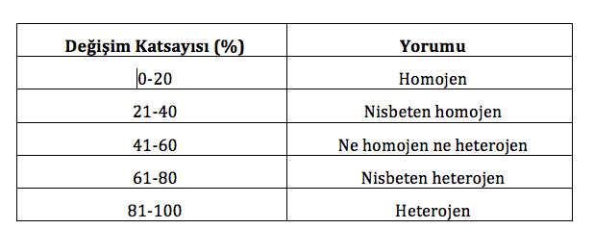
Variation Coefficient
Interpretation
Homogenous
Relatively homogenous
No homogenous nor heterogeneous
Relatively Heterogeneous
Heterogeneous

Slide 6
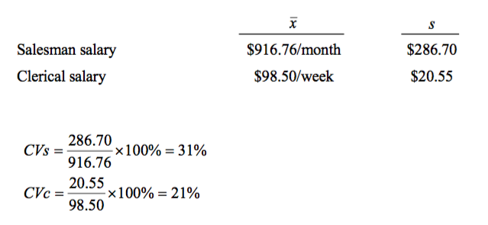
Both are relatively homogenous. But Clerical salary is more homogenous than salesman salary.

Slide 8
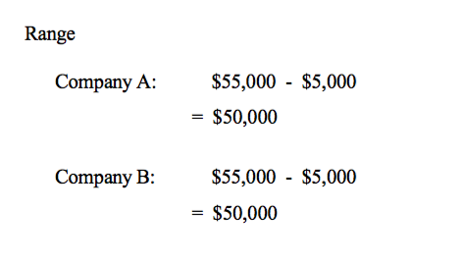

Slide 9
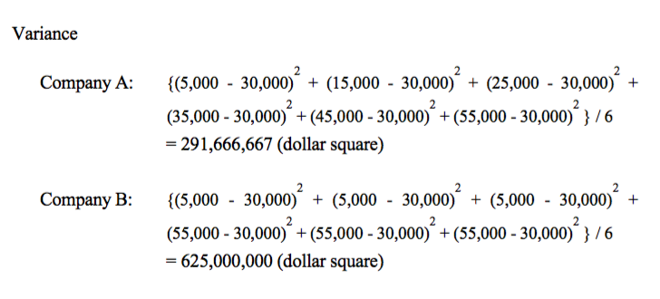

Slide 10
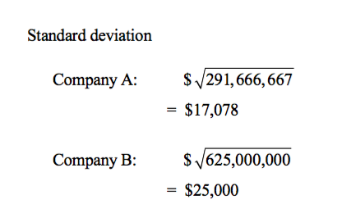

Slide 11
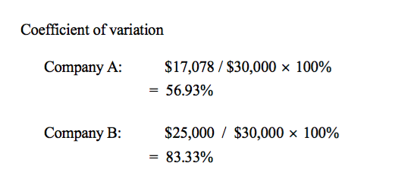
While the celery in Company A is neither homogenous nor heterogeneous, the celery of company B is heterogeneous.

Slide 12
Descriptive statistics
Univariate Statistics
Statistical Methods
Bivariate Statistics
Multivariate Statistics

Slide 13
Means
Standard Deviation & Variances
Kurtosis & Skewnsess
Descriptive statistics
Variation Coefficient
Cross Tabulation and Percentages

Slide 14
Kurtosis (Basıklık)
is any measure of the "peakedness" of the probability distribution of a real-valued random variable. Kurtosis is a descriptor of the shape of a probability distribution.
There are various interpretations of kurtosis, and of how particular measures should be interpreted; these are primarily peakedness (width of peak), tail weight, and lack of shoulders (distribution primarily peak and tails, not in between).

Slide 15
Kurtosis is a measure of whether the data are peaked or flat relative to a normal distribution. That is, data sets with high kurtosis tend to have a distinct peak near the mean, decline rather rapidly, and have heavy tails.
Data sets with low kurtosis tend to have a flat top near the mean rather than a sharp peak. A uniform distribution would be the extreme case.

Slide 16
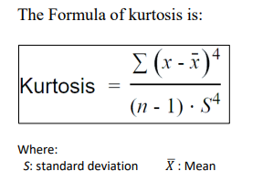
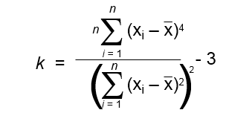

Slide 17
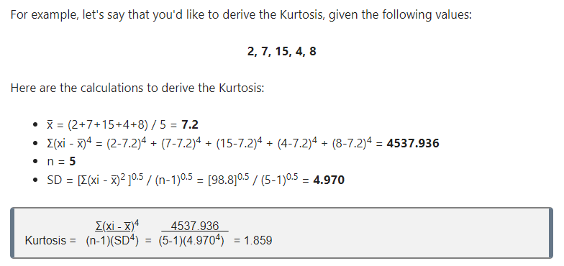

Slide 18
Kurtosis measures whether your dataset is heavy-tailed or light-tailed compared to a normal distribution.
Positive Peaked Distribution
Negative flat Distribution

Slide 19
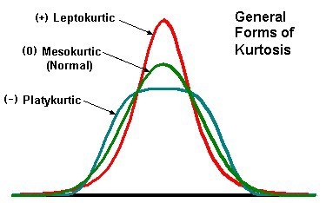
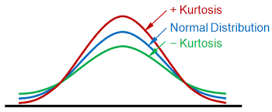

Slide 20
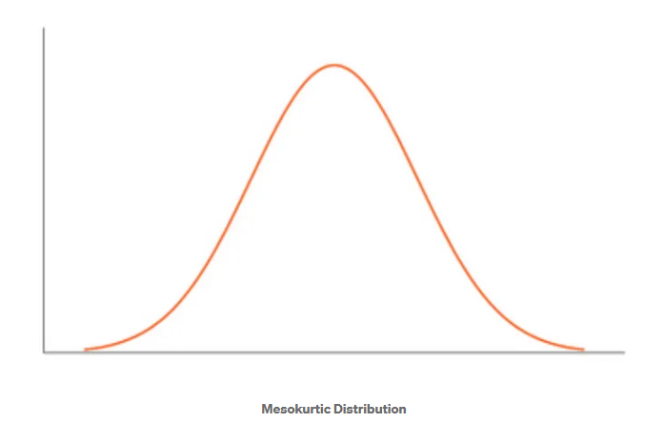
Types of Kurtosis
There are 3 types of Kurtosis:
Mesokurtic (Normal) — For the symmetric type of distribution, the Kurtosis value will be close to Three. We call such types of distributions as Mesokurtic distribution. Its tails are similar to Gaussian Distribution.

Slide 21
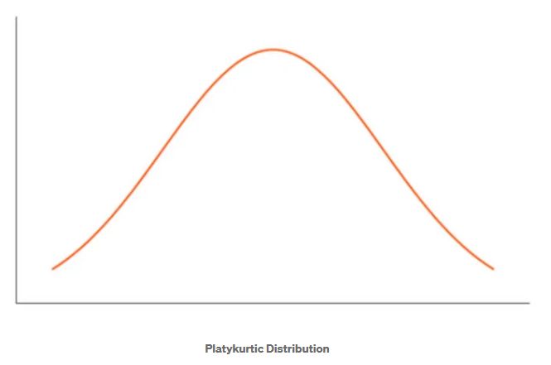
2. Platykurtic (Negative) — If there is a low presence of extreme values compared to Normal Distribution, then lesser data points will lie along the tail. In such cases, the Kurtosis value will be less than Three. We call such types of distributions as Platykurtic Distribution. It will have a thinner tail and a shorter distribution in comparison to Normal distribution.

Slide 22
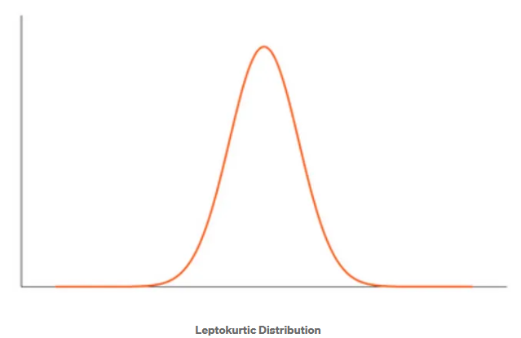
3. Leptokurtic — If there are extreme values present in the data, then it means that more data points will lie along with the tails. In such cases, the value of K will be greater than Three. Here, Tail will be fatter and will have longer distribution. We call such types of distributions as Leptokurtic Distribution.

Slide 23
The Skewness
For a normal distribution is zero, and any symmetric data should have a skewness near zero. Negative values for the skewness indicate data that are skewed left and positive values for the skewness indicate data that are skewed right.
By skewed left, we mean that the left tail is long relative to the right tail. Similarly, skewed right means that the right tail is long relative to the left tail. Some measurements have a lower bound and are skewed right. For example, in reliability studies, failure times cannot be negative.

Slide 24
Skewness measures the asymmetry in the normal distribution graph. Skewness is a statistical number that tells us if a distribution is symmetric or not.
A distribution is symmetric if the right side of the distribution is similar to the left
side of the distribution. If a distribution is symmetric, then the Skewness value is 0.
i.e., If a distribution is Symmetric (normal distribution): median= mean= mode,
(Skewness value is 0)
If Skewness is greater than 0, then it is called right-skewed or that the right tail is
longer than the left tail.
If Skewness is less than 0, then it is called left-skewed or that the left tail is longer than the right tail.

Slide 25
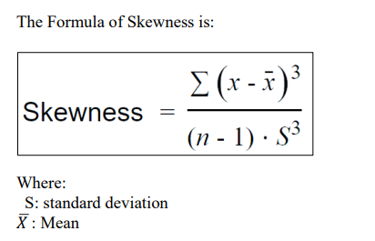
Positive right skewed
Negative left skewed

Slide 26
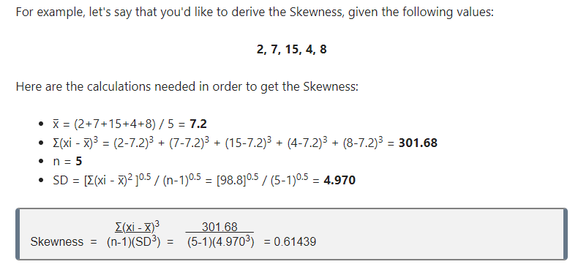

Slide 27
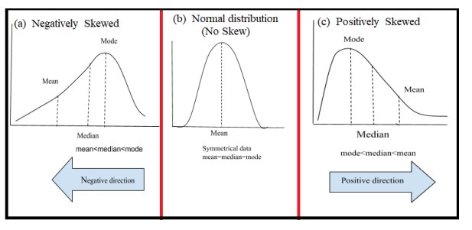

Slide 28
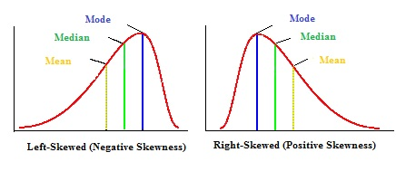

Slide 30
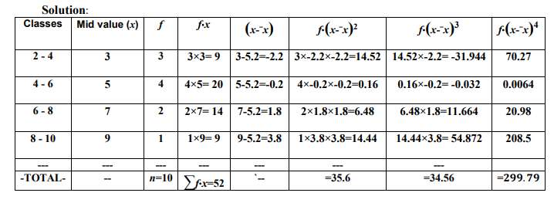

Slide 31
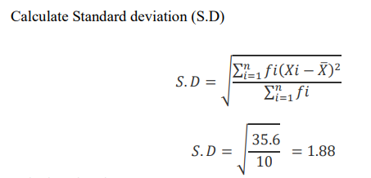

Slide 32
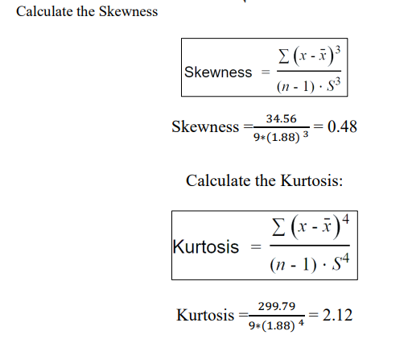

Slide 33
How to calculate Kurtosis and Skewness by Using SPSS

Slide 34
Calculating Positive Peaked Kurtosis

Slide 35
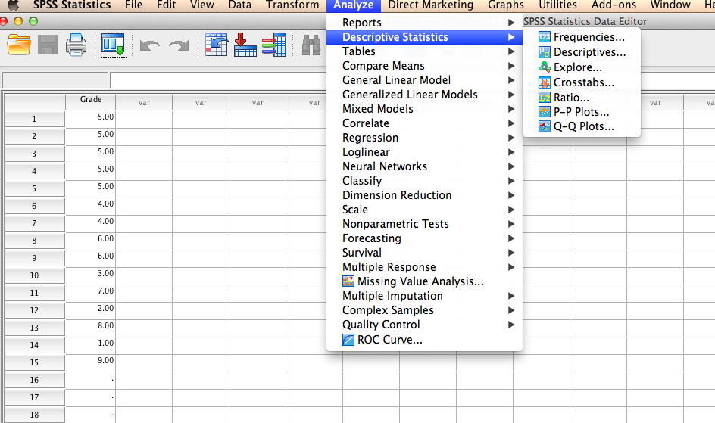

Slide 36
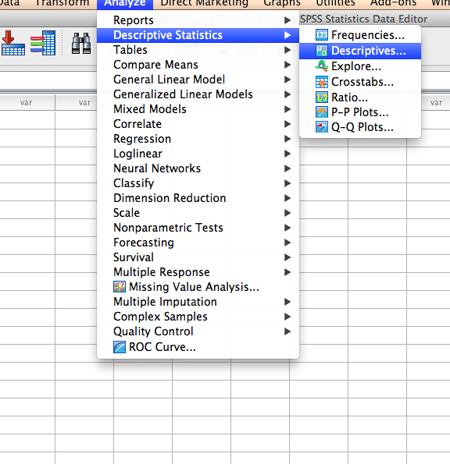

Slide 37
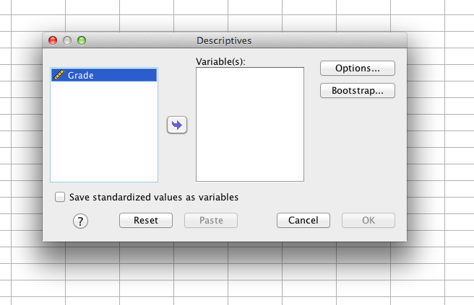

Slide 38
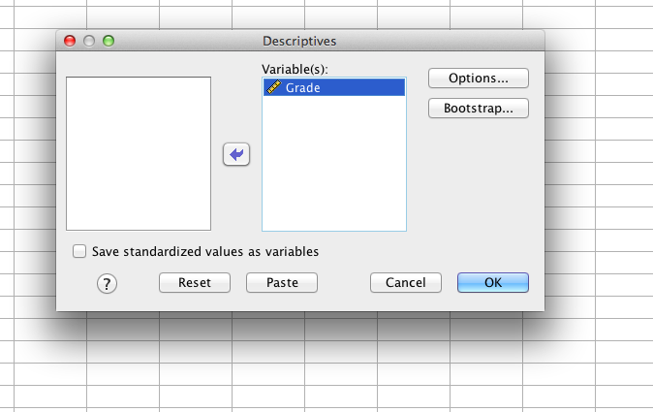

Slide 39
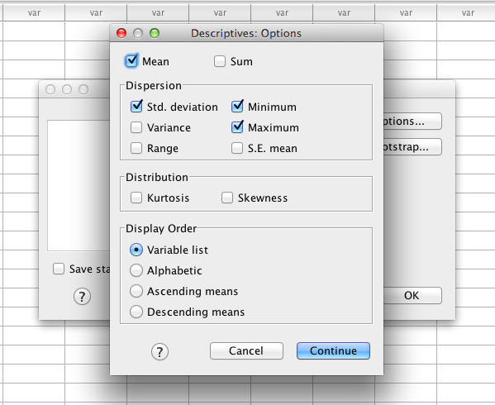

Slide 40
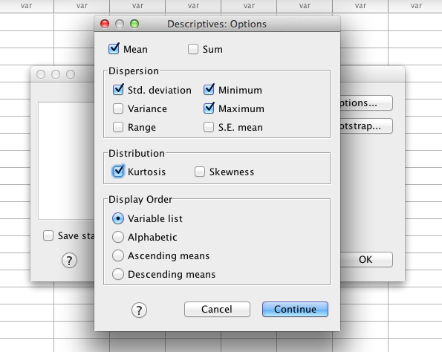

Slide 41
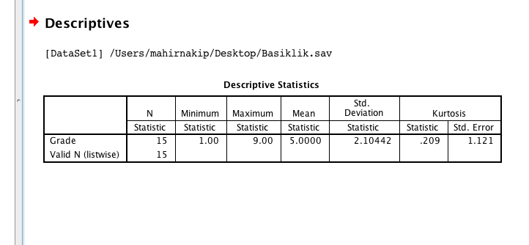

Slide 42
Distribution of Peaked Positive Kurtosis

Slide 43
Calculating Negative Flat Kurtosis

Slide 44
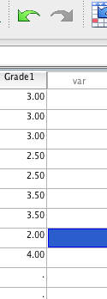

Slide 45
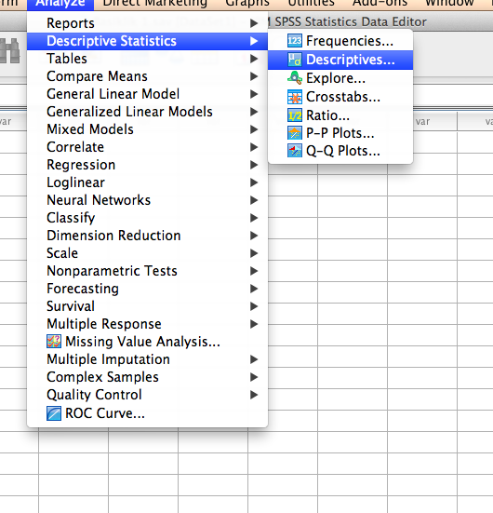

Slide 46
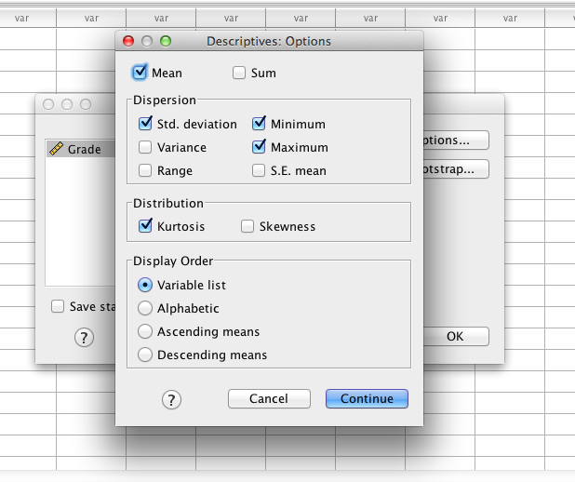

Slide 48
Distribution of Flat Negative Kurtosis

Slide 49
Calculating Skewness

Slide 50
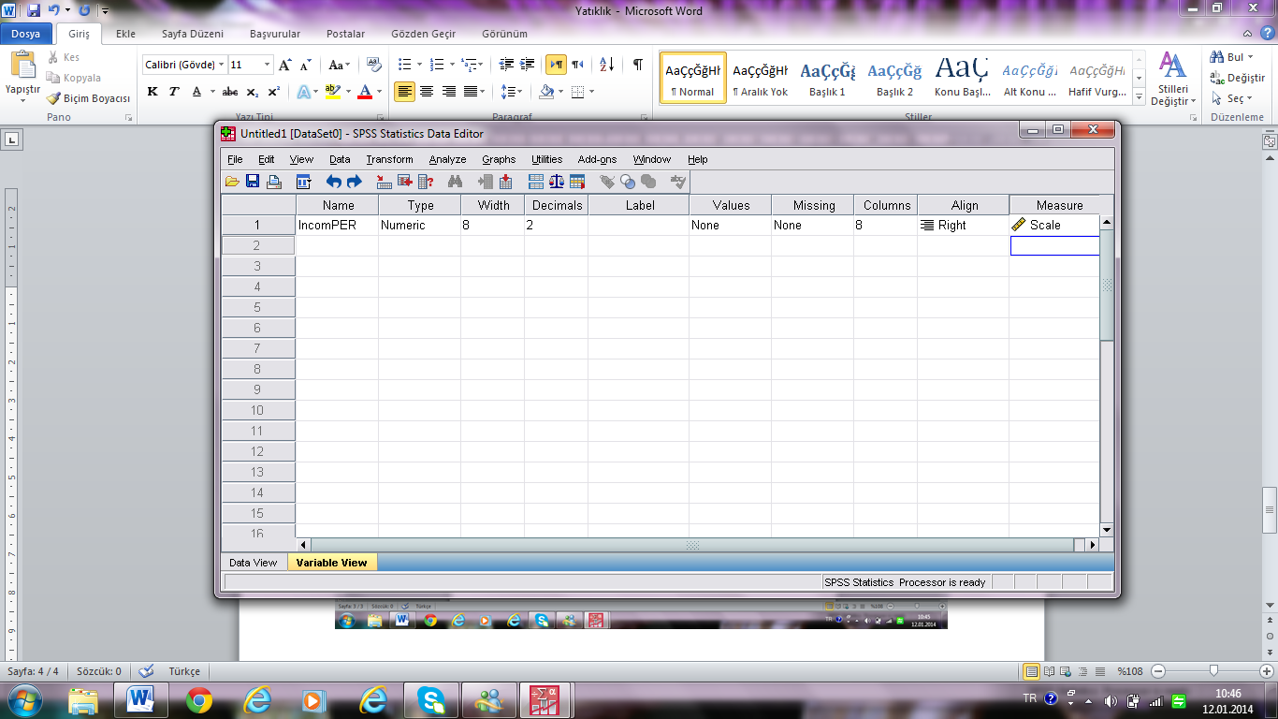

Slide 53
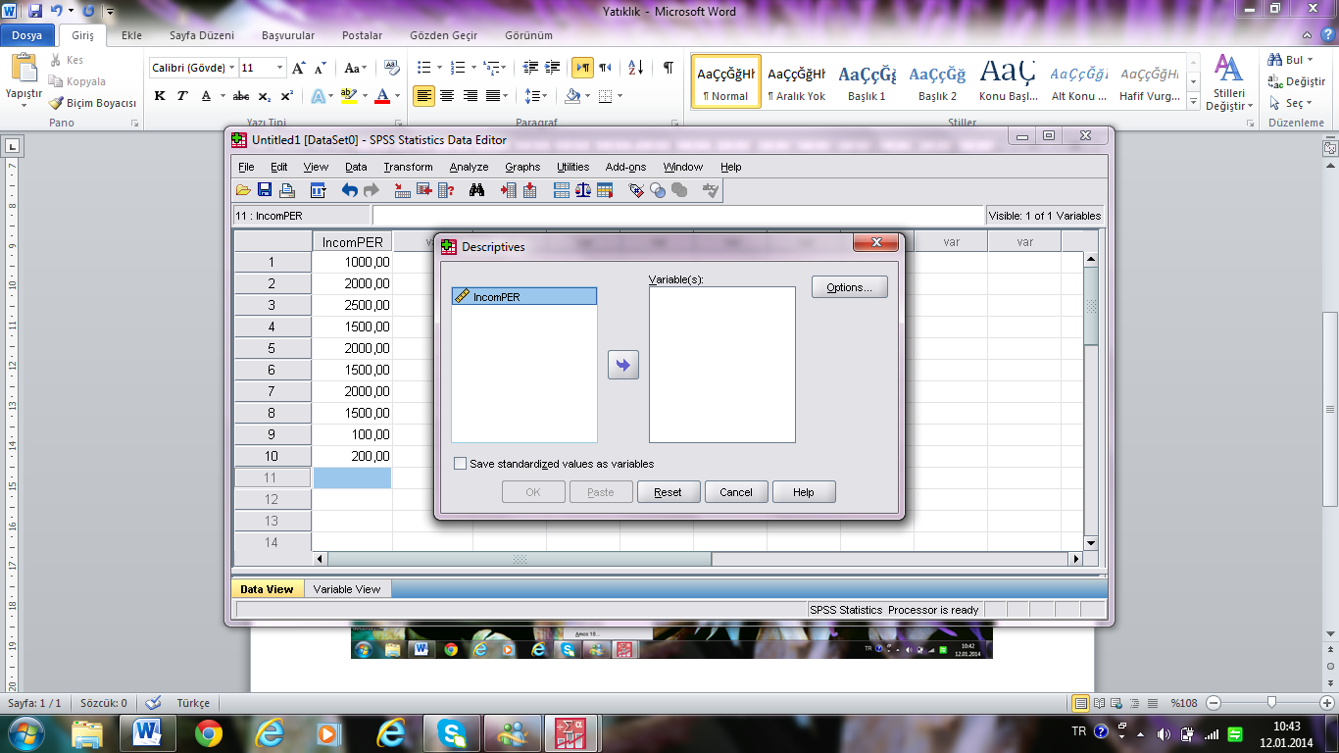

Slide 54
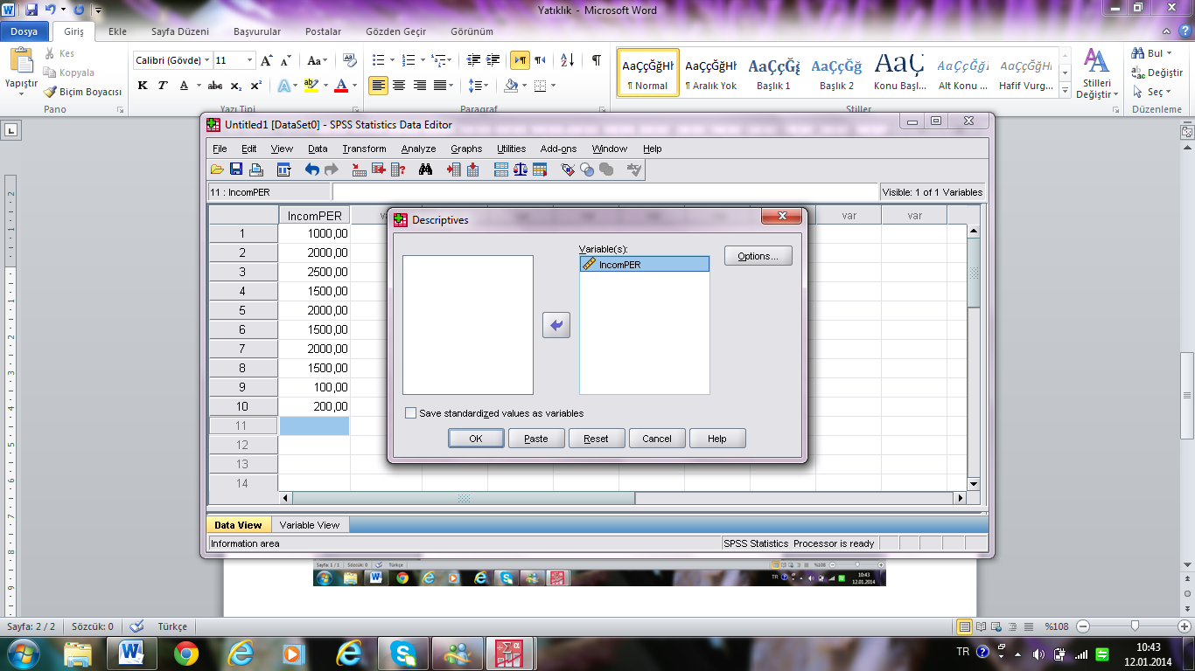

Slide 55
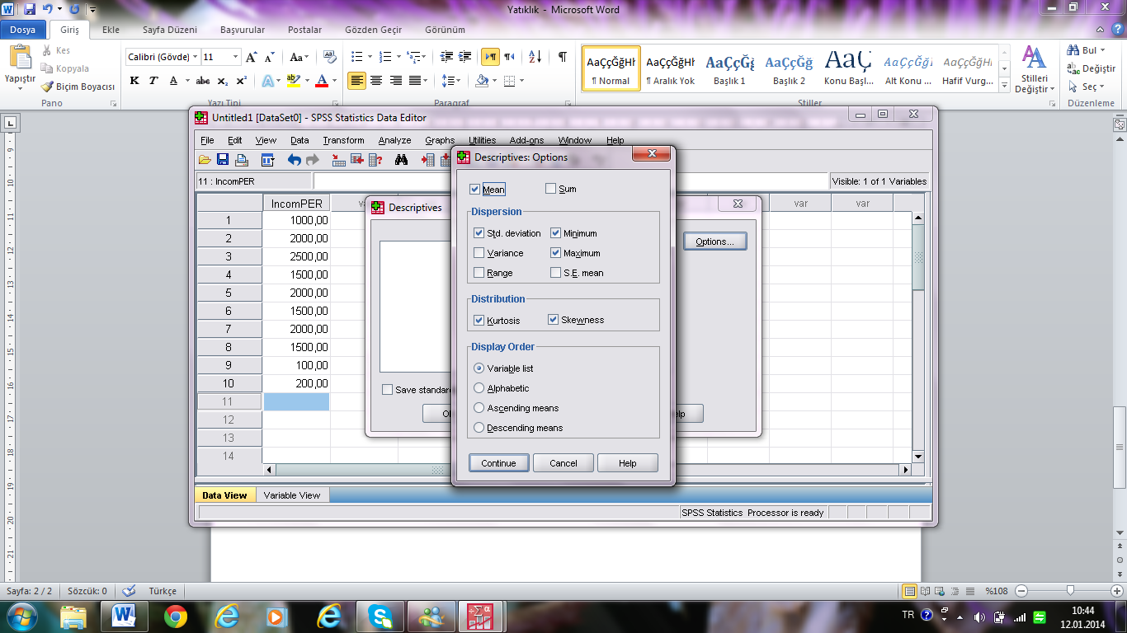

Slide 56
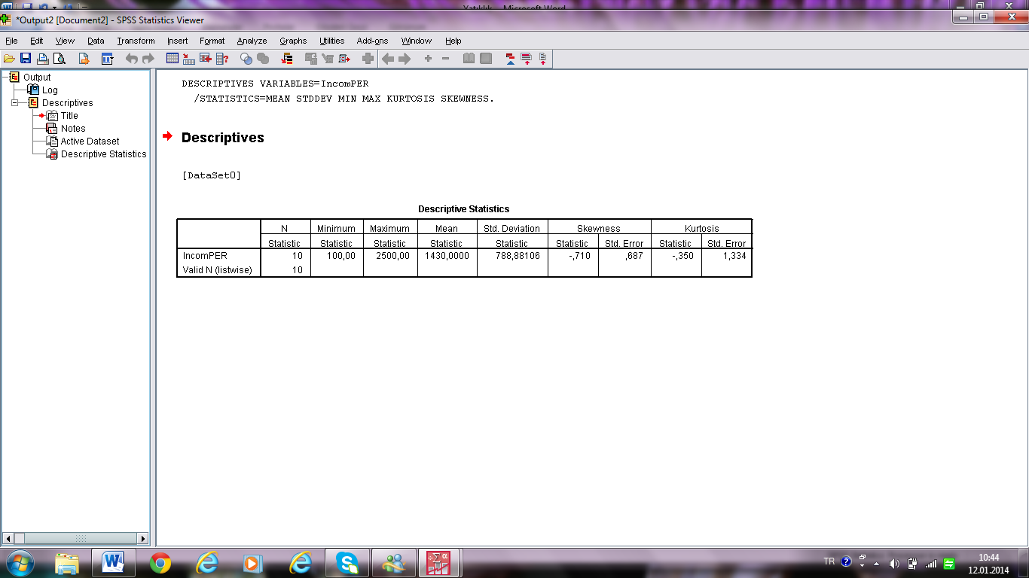

Slide 57
Distribution of Negative left skewed

Slide 58
Y_{i} | $$Yi−\overset{̿}{Y}$$ | $${(Yi−\overline{Y})}^{2}$$ | $${\left(Yi−\overline{Y}\right)}^{3}$$
1000 | -430 | 184.900 | -79.507.000
2000 | 570 | 324.900 | 185.193.000
2500 | 1070 | 1.144.900 | 1.225.943.000
1500 | 70 | 4.900 | 343.000
2000 | 570 | 324.900 | 185.193.000
1500 | 70 | 4.900 | 343.000
2000 | 570 | 324.900 | 185.193.000
1500 | 70 | 4.900 | 343.000
100 | -1330 | 1.768.900 | -2.352.637.000
200 | -1230 | 1.512.900 | -1.860.867.000
∑Y_{i}= 14300 | 0 | 5.601.000 | -913.788.000
$\overline{Y}= \frac{14300}{10}$=1430
$S=\sqrt{\frac{{\left(Yi−\overline{Y}\right)}^{2}}{n−1}}=\sqrt{\frac{5.601.000}{9}}$=788
$$\frac{−913.788.000}{\left(9\right){788}^{3}}=−0.71$$

Slide 59
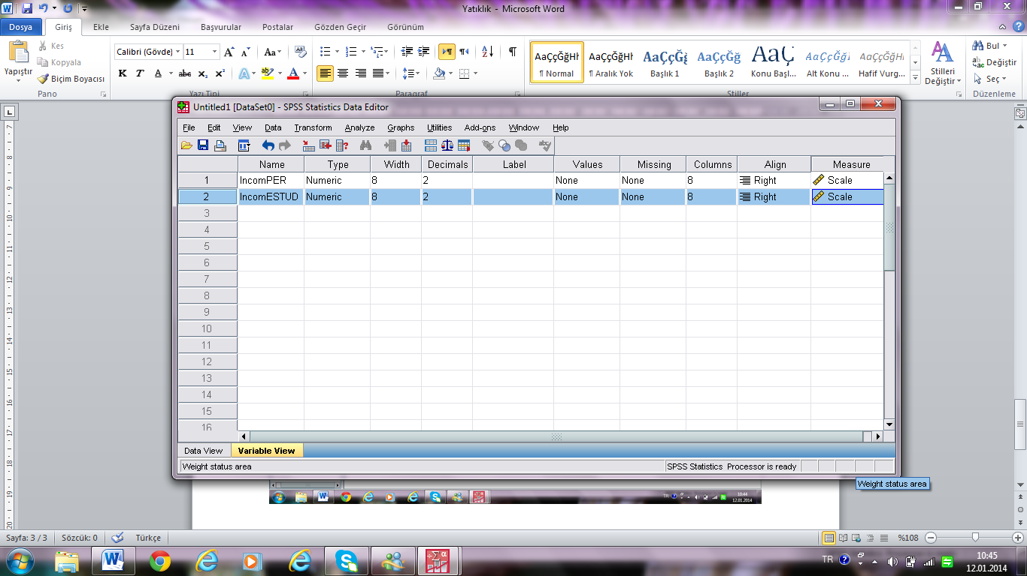

Slide 60
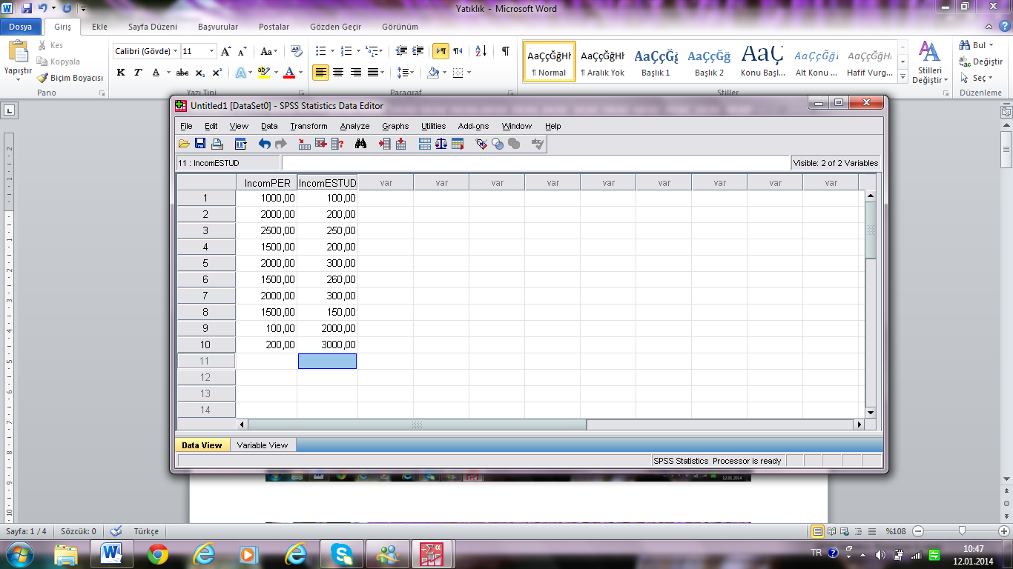

Slide 61
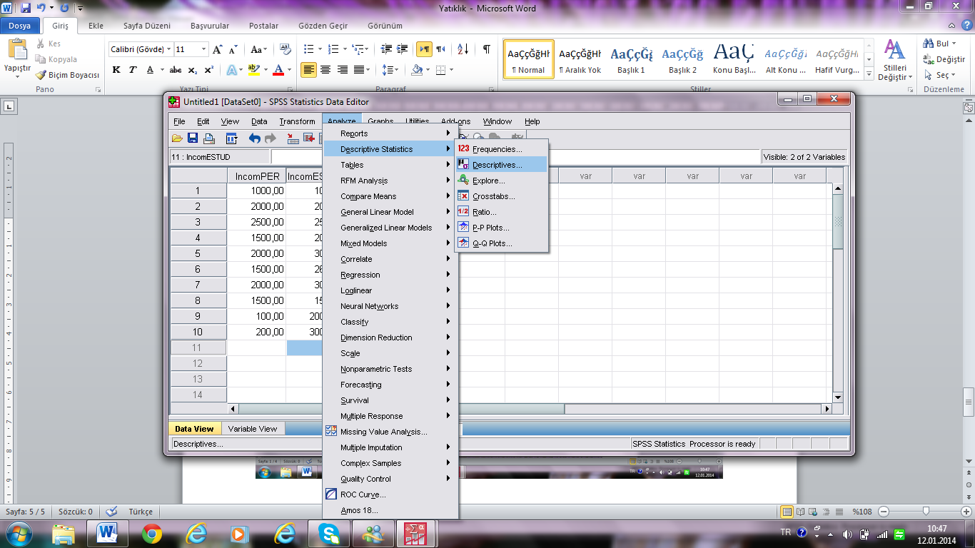

Slide 62
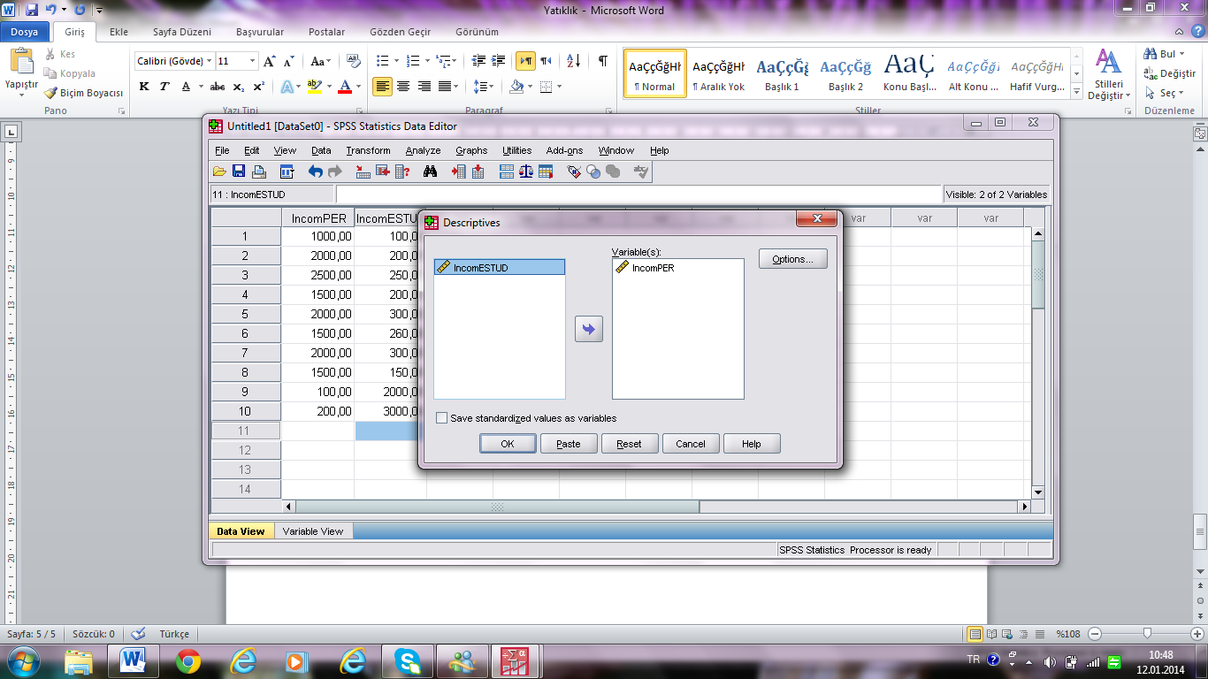

Slide 63
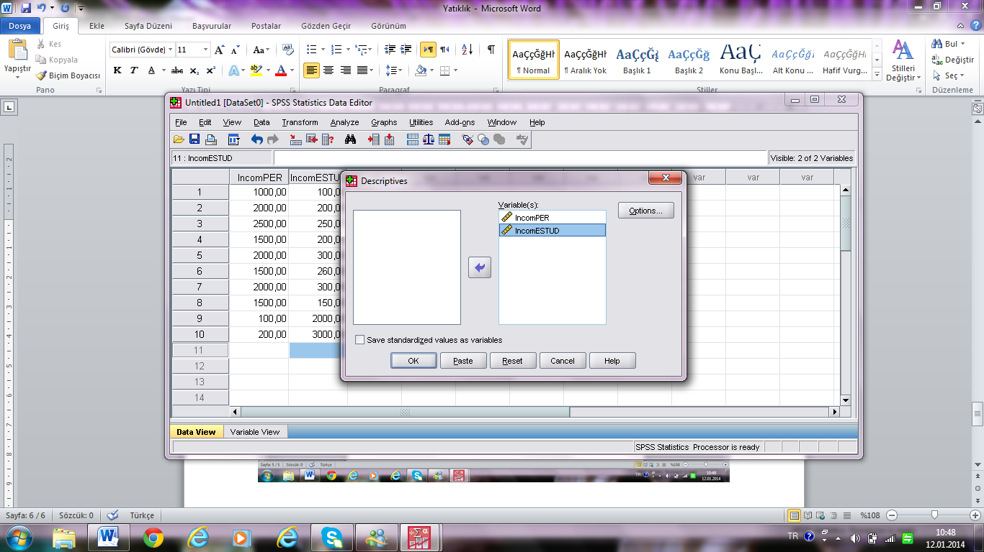

Slide 64
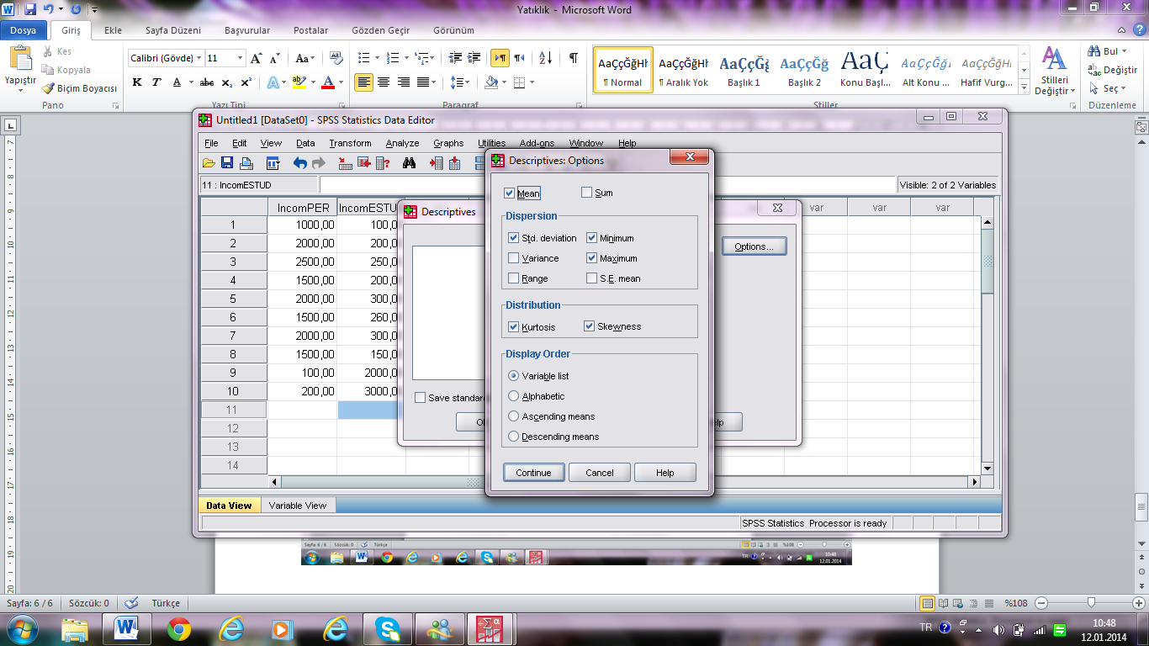

Slide 65
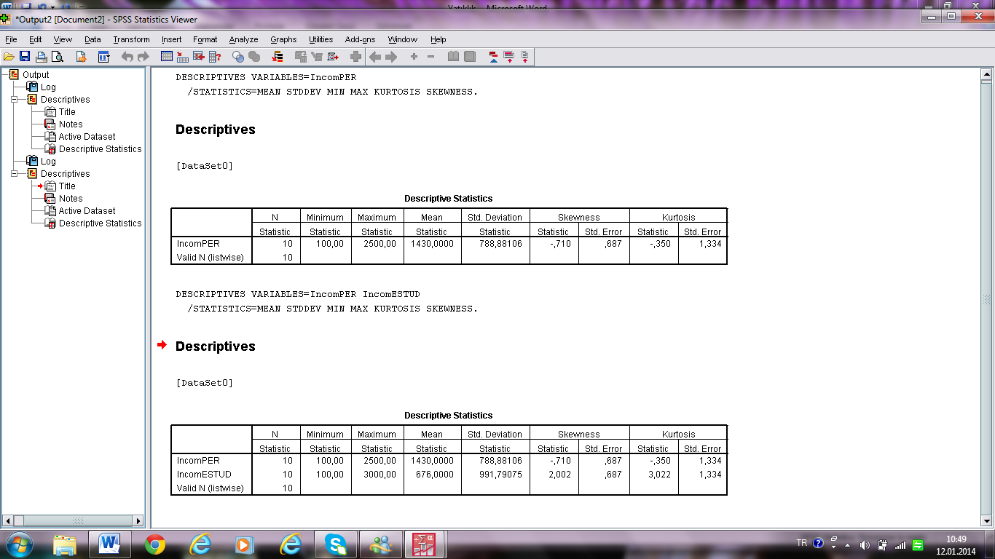

Slide 66
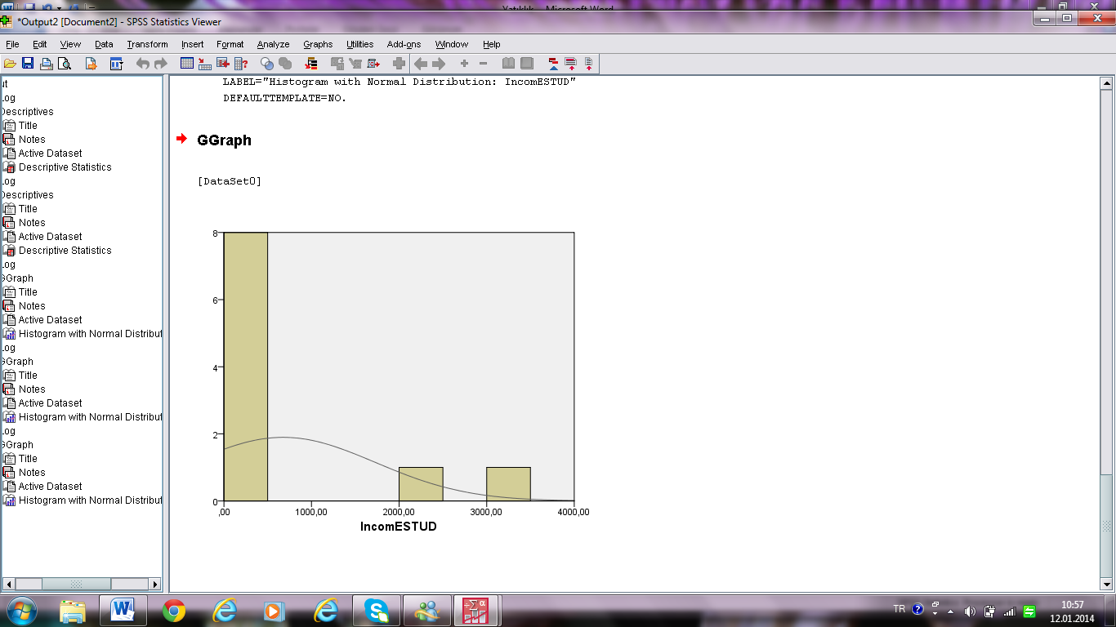
Positive right skewed

Slide 67
How to graph Kurtosis & Skewness

Slide 68
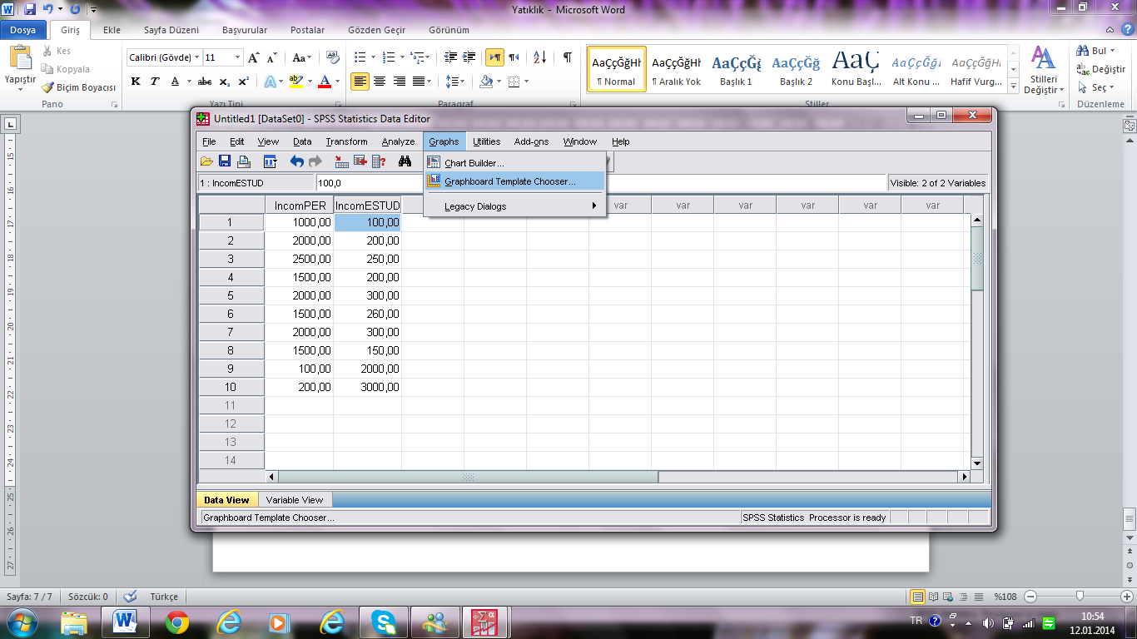

Slide 69
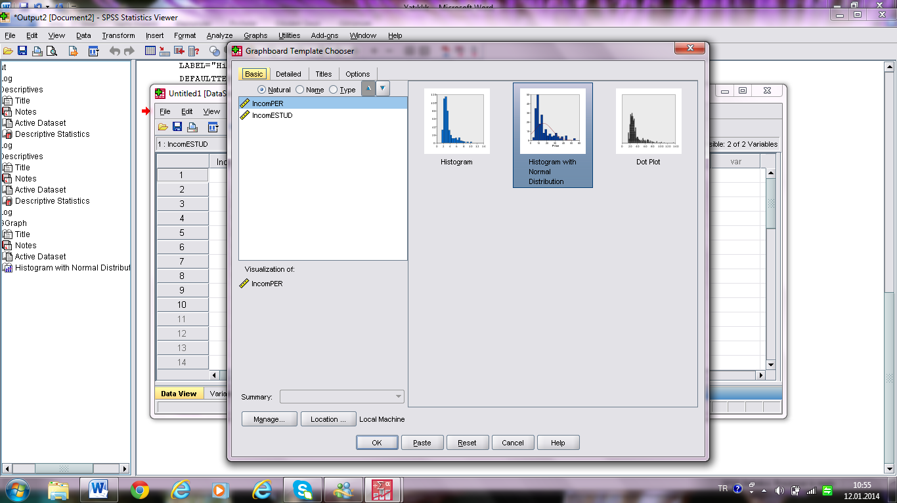

Slide 70
Negative left skewed

Slide 71
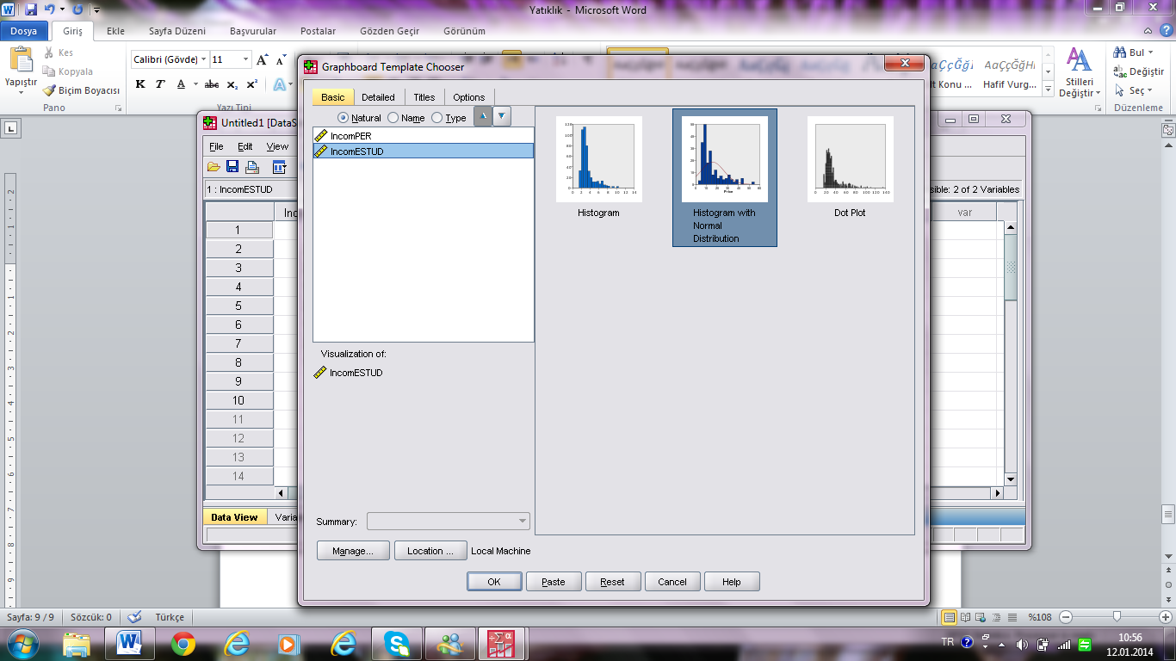

Slide 72
flat Kurtosis Distribution
Positive right skewed

Slide 73
Variation Coefficient
Interpretation
Homogenous
Relatively homogenous
No homogenous nor heterogeneous
Relatively Heterogeneous
Heterogeneous

Slide 74
Positive Peaked Kurtosis
V.C.= (2,10442/5)x100=42
No homogenous nor heterogeneous

Slide 75
Negative Flat Kurtosis
V.C.= (0,61237/3)x100=20
Homogenous

Slide 76
Negative left skewed
V.C.= (788,88/1430)x100=55
No homogenous nor heterogeneous

Slide 77
Positive right skewed
Heterogeneous
V.C.= (991,79/676)x100=100

