Slide 1
CHAPTER 6
Using Descriptive Statistics in Business and Economics

Slide 2
Descriptive statistics are brief descriptive coefficients that summarize a given data set, which can be either a representation of the entire population or a sample of it.
Descriptive statistics are broken down into measures of central tendency and measures of variability or spread. Measures of central tendency (merkezî eğilim) include the mean, median and mode, while measures of variability include the standard deviation or variance, the minimum and maximum variables, and the kurtosis and skewness.

Slide 3
Descriptive statistics, in short, help describe and understand the features of a specific data set, by giving short summaries about the sample and measures of the data.
The most recognized types of descriptive statistics are the mean, median and mode, which are used at almost all levels of math and statistics.
However, there are less-common types of descriptive statistics that are still very important.

Slide 4
All descriptive statistics, whether they be the mean, median, mode, standard deviation, kurtosis or skewness, are either measures of central tendency or measures of variability.
These two measures use graphs, tables and general discussions to help people understand the meaning of the data being analyzed

Slide 5
Measures of central tendency describe the center position of a distribution for a data set.
A person analyzes the frequency of each data point in the distribution and describes it using the mean, median or mode, which measure the most common patterns of the data set being analyzed.

Slide 6
Measures of variability, or the measures of spread, aid in analyzing how spread-out the distribution is for a set of data. For example, while the measures of central tendency may give a person the average of a data set, it doesn't describe how the data is distributed within the set.
Measures of variability help communicate this by describing the shape and spread of the data set. Range, quartiles, absolute deviation and variance are all examples of measures of variability.

Slide 7
Measures of Central Location
The Mean
In the formula in the following definition, we introduce the standard summation notation Σ, where Σ is the capital Greek letter sigma.
In general, the notation Σ followed by a second mathematical symbol means to add up all the values that the second symbol can take in the context of the problem.

Slide 8
Find Σx, Σx², and Σ(x−1)² for the data set 1, 3, 4
Solution:
Σx = 1+3+4=8 Σx² = 1² + 3² + 4² =1+9+16=26
Σ(x−1)² = (1−1)² +(3−1)² +(4−1)² = 02 +22 +32 = 13

Slide 9
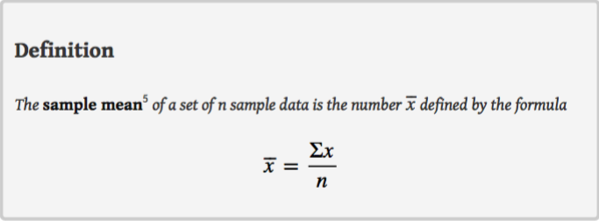

Slide 11
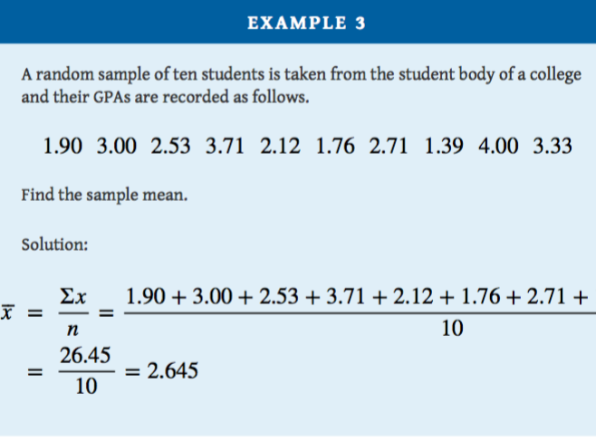
…....

Slide 13
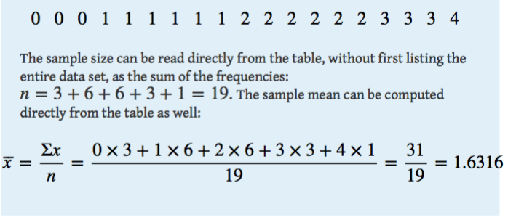

Slide 15
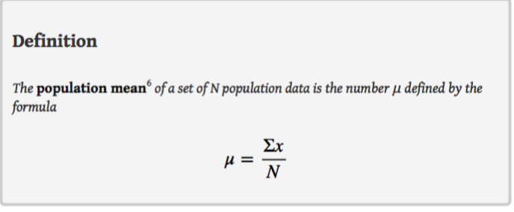

Slide 16
Bell curves are visual representations of normal distribution, also called Gaussian distribution.
Bell curves are useful for quickly visualizing a data set's mean, mode and median because when the distribution is normal, the mean, median and mode are all the same.

Slide 17
The mean of two numbers is the number that is halfway between them. For example, the average of the numbers 5 and 17 is (5 + 17) ∕ 2 = 11, which is 6 units above 5 and 6 units below 17.
In this sense the average 11 is the “center” of the data set {5,17}. For larger data sets the mean can similarly be regarded as the “center” of the data.

Slide 18
Finding a Weighted Mean
You are taking a class in which your grade is determined from five sources: 50% from your test mean, 15% from your midterm, 20% from your final exam, 10% from your computer lab work, and 5% from your homework.
Your scores are 86 (test mean), 96 (midterm), 82 (final exam), 98 (computer lab), and 100 (homework). What is the weighted mean of your scores?

Slide 19
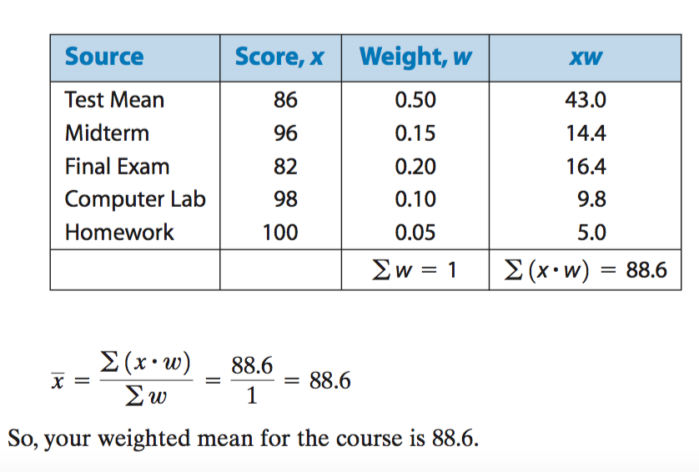

Slide 20
The Median
To see why another concept of average is needed, consider the following situation. Suppose we are interested in the average yearly income of employees at a large corporation.
We take a random sample of seven employees, obtaining the sample data (rounded to the nearest hundred dollars, and expressed in thousands of dollars).

Slide 21
24.8 22.8 24.6 192.5 25.2 18.5 23.7

Slide 22
The presence of the one executive in the sample, whose salary is so large compared to everyone else’s, caused the numerator in the formula for the sample mean to be far too large, pulling the mean far to the right of where we think that the average “ought” to be, namely around $24,000 or $25,000.
The number 192.5 in our data set is called an outlier(aykırı), a number that is far removed from most or all of the remaining measurements. Many times an outlier is the result of some sort of error, but not always, as is the case here. We would get a better measure of the “center” of the data if we were to arrange the data in numerical order,

Slide 23
24.8 22.8 24.6 192.5 25.2 18.5 23.7
18.5 22.8 23.7 24.6 24.8 25.2 192.5
Let’s select the middle number in the list, in this case 24.6. The result is called the median of the data set, and has the property that roughly half of the measurements are larger than it is, and roughly half are smaller. In this sense it locates the center of the data.
If there are an even number of measurements in the data set, then there will be two middle elements when all are lined up in order, so we take the mean of the middle two as the median. Thus we have the following definition.

Slide 24
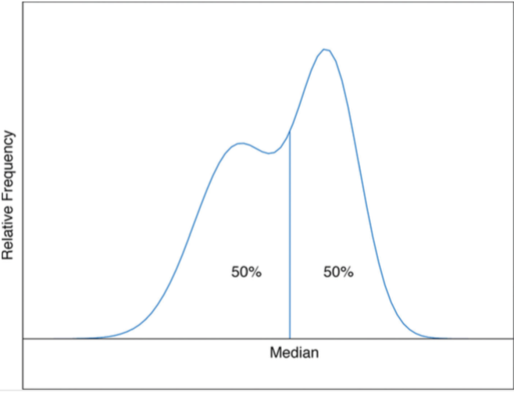

Slide 27
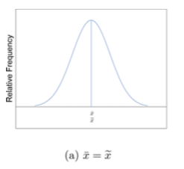
When the distribution is symmetric, as in panels (a) and (b) of Figure 2.8 "Skewness of Relative Frequency Histograms", the mean and the median are equal.

Slide 28
2. When the distribution is as shown in panel (c) of Figure 2.8 "Skewness of Relative Frequency Histograms", it is said to be skewed right. The mean has been pulled to the right of the median by the long “right tail” of the distribution, the few relatively large data values. This is positive distribution

Slide 29
3. When the distribution is as shown in panel (d) of Figure 2.8 "Skewness of Relative Frequency Histograms", it is said to be skewed left. The mean has been pulled to the left of the median by the long “left tail” of the distribution, the few relatively small data values. Negative distribution

Slide 30
The Mode
Perhaps you have heard a statement like “The average number of automobiles owned by households in the United States is 1.37,”. In such a context the following measure for central location might make more sense.
The sample mode of a set of sample data is the most frequently occurring value.

Slide 31
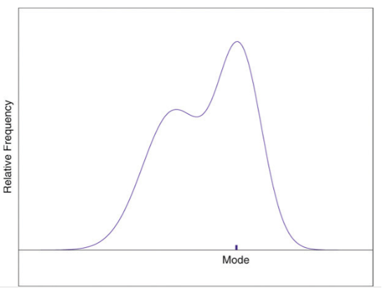

Slide 32
Find the mode of the following data set.
−1 0 2 0
Solution: The value 0 is most frequently observed and therefore the mode is 0.

Slide 33
Compute the mod of this distribution
0 0 0 1 1 1 1 1 1 2 2 2 2 2 2 3 3 3 4
The two most frequently observed values in the data set are 1 and 2. Therefore mode is a set of two values: {1,2}.

Slide 34
Measures of Variability
Look at the two data sets in Table 2.1 "Two Data Sets" and the graphical representation of each, called a dot plot.

Slide 35
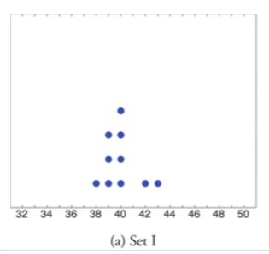

Slide 36
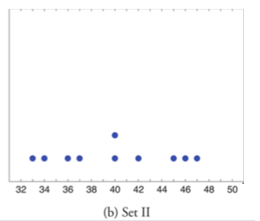

Slide 37
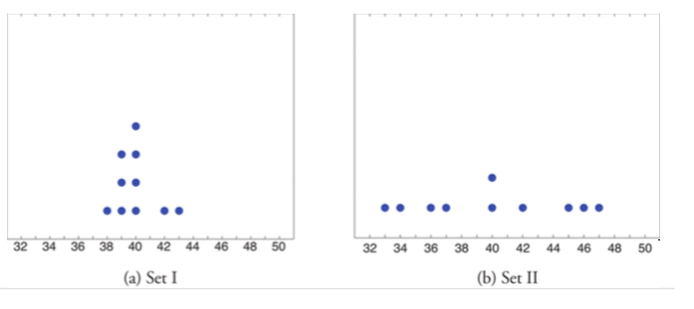
The two sets of ten measurements each center at the same value: they both have mean, median, and mode 40. Nevertheless, a view on the figure shows that they are markedly (belirgin) different.
In Data Set I the measurements vary only slightly from the center, while for Data Set II the measurements vary greatly.

Slide 38
The Variance and the Standard Deviation
The two measures of variability that we will consider are more elaborate (ayrıntılı) and also depend on whether the data set is just a sample drawn from a much larger population or is the whole population itself (that is, a census).
The Standard Deviation is a measure of how spread out numbers are around the mean. Variance is the square of this measure.

Slide 39
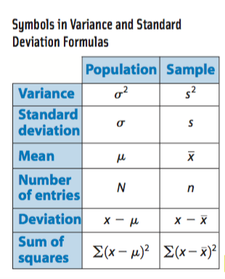

Slide 40
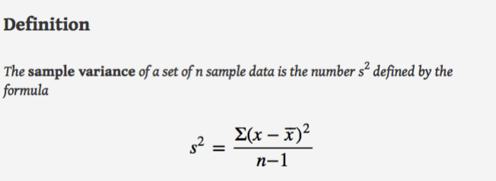

Slide 41
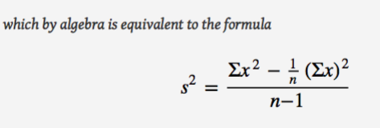

Slide 43
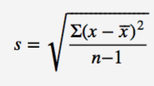
The Standard Deviation
The Variance

Slide 44
Let’s find the variance and standard deviation of this distribution which shows the age of 10 consumers

Slide 45
X
46 | 6 | 36
37 | -3 | 9
40 | 0 | 0
33 | -7 | 49
42 | 2 | 4
36 | -4 | 16
40 | 0 | 0
47 | 7 | 49
34 | -6 | 36
45 | 5 | 25
=40 | 0 | 224

Slide 46
Variance calculated from the sample
Standard deviation calculated from the sample

Slide 47
Interpretation of the result
The ages of the consumers are distributed out around the arithmetical means as much as 4.99 or 5 years.

Slide 48
Calculating The Variance and The Standard Deviation From The Population

Slide 49
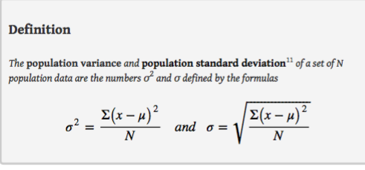
Note that the denominator (payda) in the fraction (kesir) is the full number of observations, not that number reduced by one, as is the case with the sample standard deviation.
Since most data sets are samples, we will always work with the sample standard deviation and variance.

Slide 50
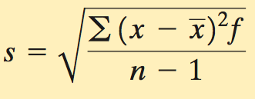

Slide 51
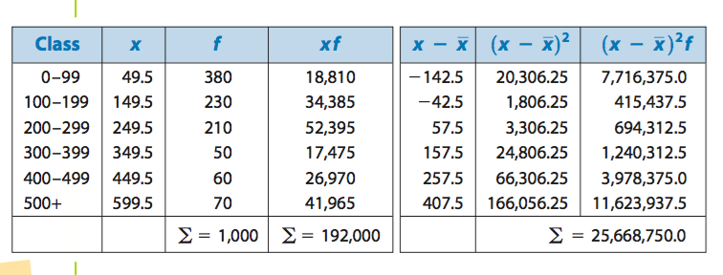

Slide 54
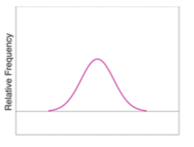
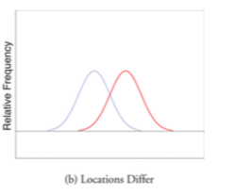
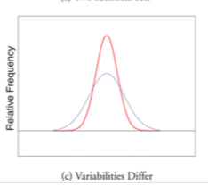
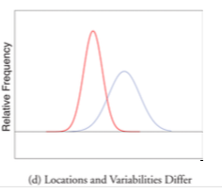

Slide 55
Relative Position of Data

Slide 56
When you take an exam, what is often as important as your actual score on the exam is the way your score compares to other students’ performance.
If you made a 70 but the average score (whether the mean, median, or mode) was 85, you did relatively poorly. If you made a 70 but the average score was only 55 then you did relatively well. In general, the significance of one observed value in a data set strongly depends on how that value compares to the other observed values in a data set.

Slide 57
Percentiles and Quartiles
Yüzdebirlikler ve Dörtlüler
Anyone who has taken a national standardized test is familiar with the idea of being given both a score on the exam and a “percentile ranking” of that score. You may be told that your score was 625 and that it is the 85th percentile.
The first number tells how you actually did on the exam; the second says that 85% of the scores on the exam were less than or equal to your score, 625.

Slide 59
Scores of 10 students in any course are as follows
What percentile is the value 1.39?
What percentile is the value 3.33?
The data written in ascending order are

Slide 60
The only data value that is less than or equal to 1.39 is 1.39 itself. Since 1 is 1∕10 = .10 or 10% of 10, the value 1.39 is the 10th percentile.
Eight data values are less than or equal to 3.33. Since 8 is 8∕10 = .80 or 80% of 10, the value 3.33 is the 80th percentile.

Slide 61
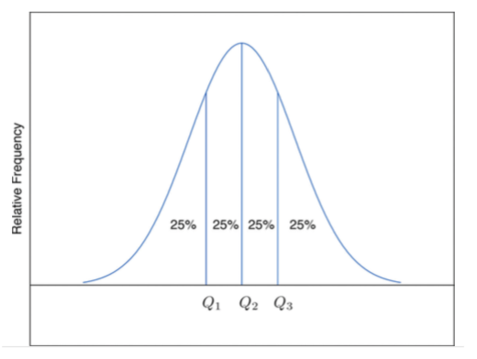
Quartiles

Slide 62
Definition
For any data set:
The second quartile Q2 of the data set is its median.
Define two subsets:
the lower set: all observations that are strictly less than Q2 ;
the upper set: all observations that are strictly greater than Q2 .
The first quartile Q1 of the data set is the median of the lower set.
The third quartile Q3 of the data set is the median of the upper set.

Slide 64
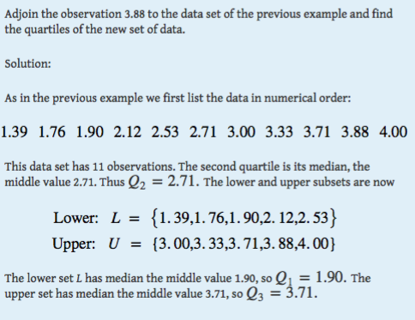

Slide 65
Z-scores
Another way to locate a particular observation x in a data set is to compute its distance from the mean in units of standard deviation.

Slide 67
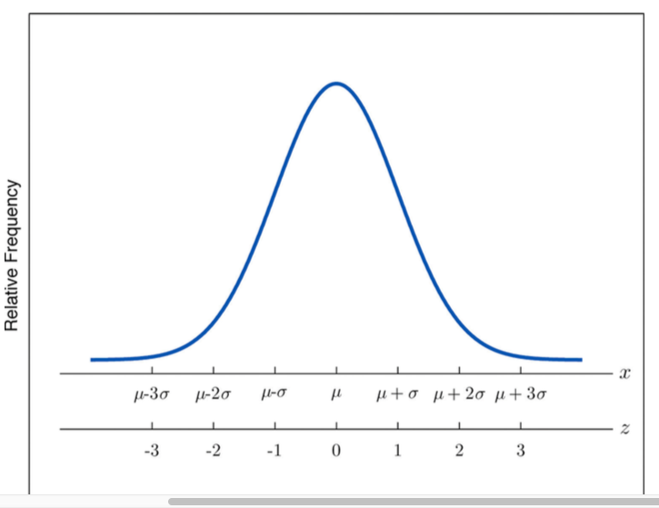

Slide 69
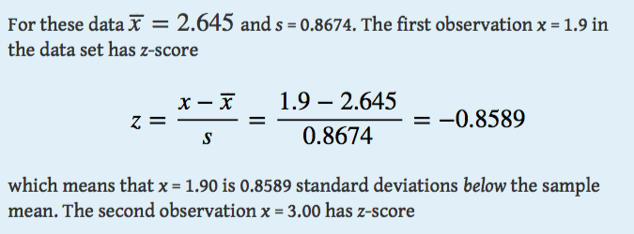

Slide 70
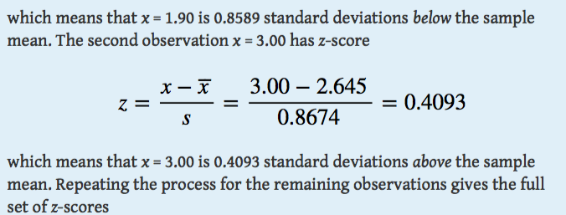

Slide 71
Z Scores
1.90 3.00 2.53 3.71 2.12 1.76 2.71 1.39 4.00 3.33
−0.86 0.41 −0.13 1.23 −0.61 −1.02 0.07 −1.45 1.56 0.79

Slide 72
1.39 1.76 1.90 2.12 2.53 2.71 3.00 3.33 3.71 4.00
= 2.65
-1.45 -0.86 -1.02 -0.61 -0.13 0.07 0.41 0.79 1.23 1.56

Slide 73
1.39 1.76 1.90 2.12 2.53 2.71 3.00 3.33 3.71 4.0
= 2.65
Z = 0
-1.45 -1.02 -0.86 -0.61 -0.13 0.07 0.41 0.79 1.23 1.56

Slide 74
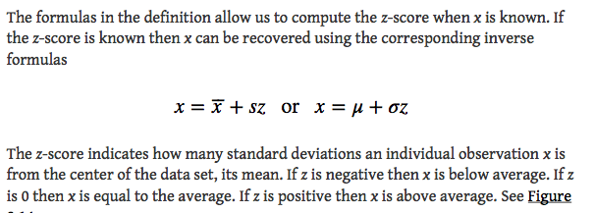

Slide 78
Suppose the mean and standard deviation of the all currently registered students at a college are μ = 2.70 and σ = 0.50. The z-scores of two students, Oğuz and Ayça, are z = −0.62 and z = 1.28, respectively. What are their Great Point Average?
Solution: Using the second formula right after the definition of z-scores
Oğuz :x = μ + z σ = 2.70 + (−0.62) (0.50) = 2.39
Ayça :x = μ + z σ = 2.70 + (1.28) (0.50) = 3.34

