Slide 1
Chapter 4
Range, Width, min-max Values and Graphs

Slide 2
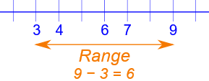
Range:
The Range is the difference between the lowest and highest values.
Example:
In {4, 6, 9, 3, 7} the lowest value is 3, and the highest is 9.

Slide 3
Class Width
Class Width = (x - y) / n
Where,
x = Maximum Value
y = Minimum Value
n = Number of Classes
Calculate class width for 3 data items having a maximum value of 9, minimum value of 5.
Solution:
Class Width = (x - y) / n
= (9 - 5) / 3
= 1.333

Slide 4
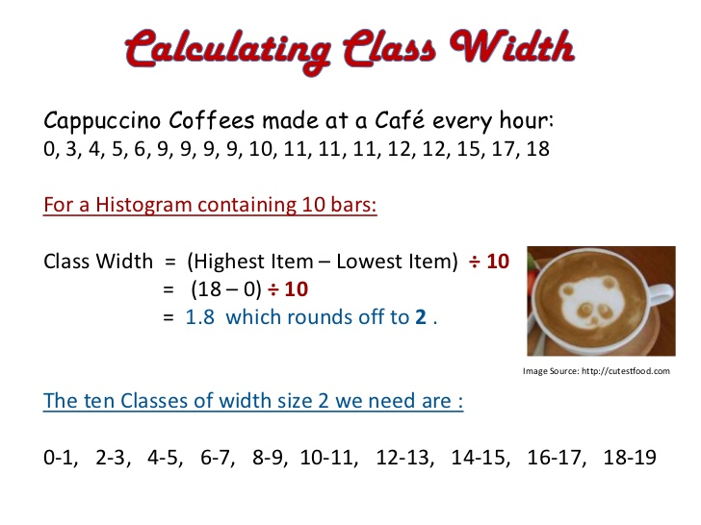

Slide 5
Frequency
In statistics the frequency (or absolute frequency) of an event is the number of times the event occurred in an experiment or study. These frequencies are often graphically represented in histograms.

Slide 6
Histogram
A histogram is a chart that shows frequencies for equal width intervals of values of a metric variable.
A histogram is a graphical representation that organizes a group of data points into user-specified ranges. It is similar in appearance to a bar graph.
The histogram condenses a data series into an easily interpreted visual by taking many data points and grouping them into logical ranges.

Slide 7
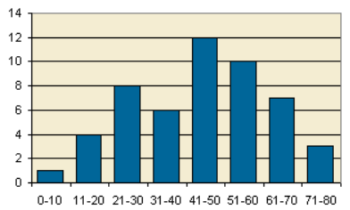
Example of a Histogram:

Slide 8
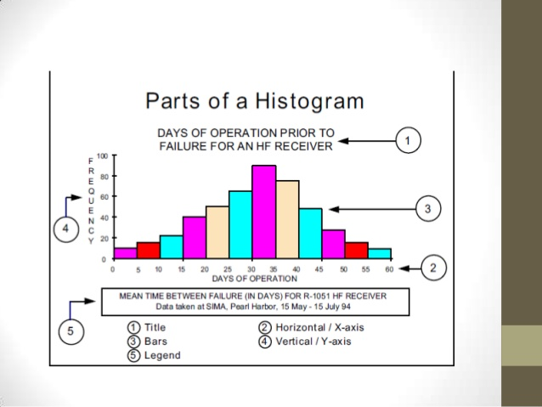

Slide 9
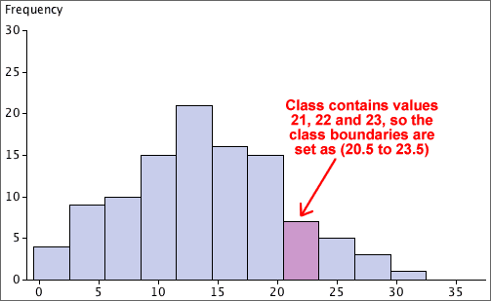

Slide 10
Class Work:
Let us assume that we have 20 workers, and they are installing different number of (let us say cars) weekly.
Each worker assemble different numbers.
Let us find the min-max numbers, range, width of the distribution.
The let us draw the the histogram of the distribution.

Slide 11
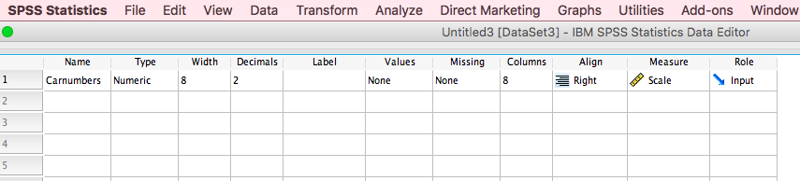

Slide 12
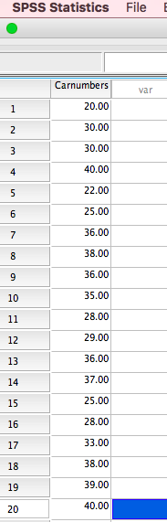

Slide 13
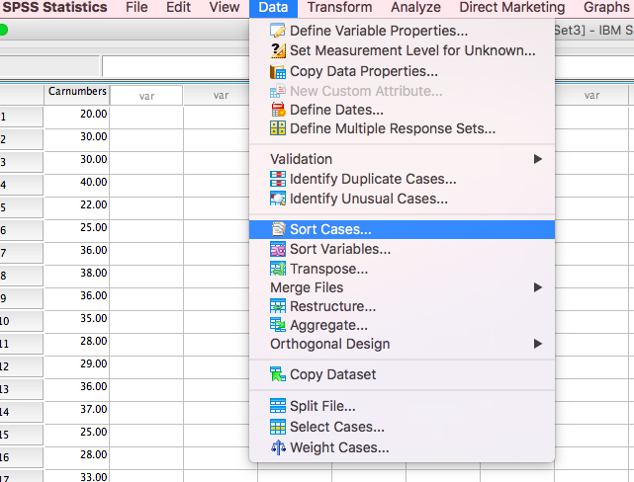

Slide 14
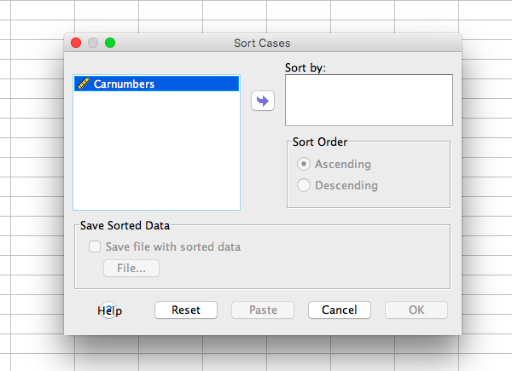

Slide 15
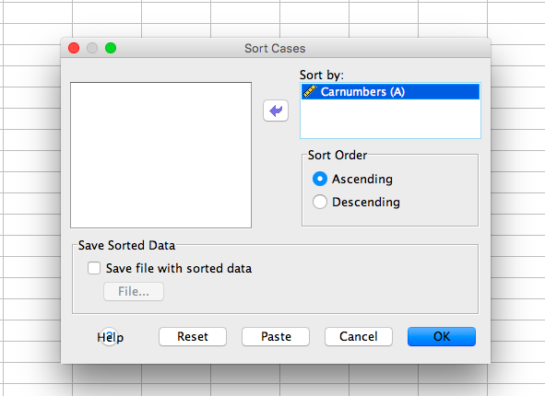

Slide 16
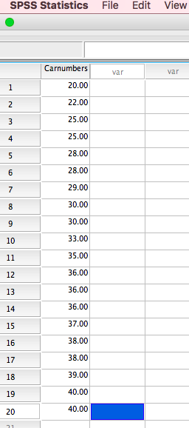

Slide 17
The minimum value is 20 cars, and the maximum value is 40 cars
Range=highest value – Lowest Value
Range is 40-20=20 into interval scale.
In order to find the width, we need to classify the observations

Slide 18
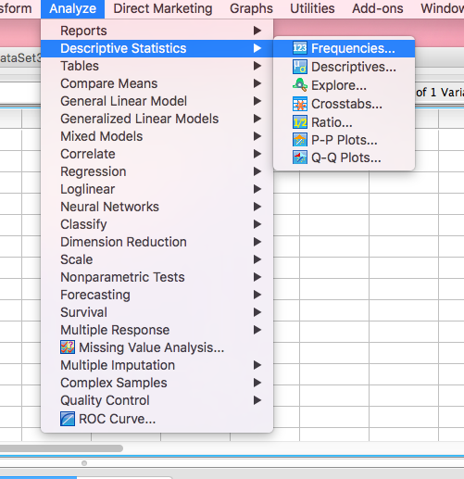

Slide 19
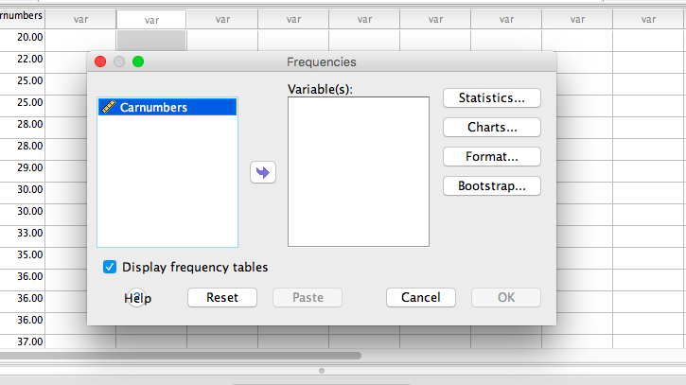

Slide 20
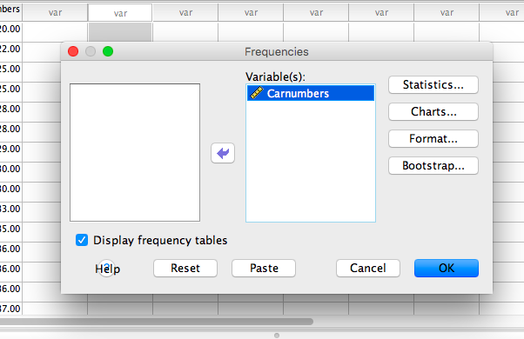

Slide 21
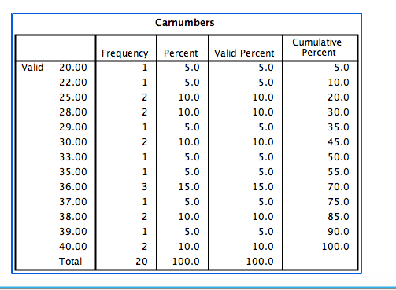

Slide 22
Number of Cars | Frequency
20-25 | 4
26-30 | 5
31-35 | 2
36-40 | 9
Total | 20

Slide 23
Width= Range/The Number of Classes
Width= 20/4= 5

Slide 24
The Percentage and Cumulative
Number of Cars | Frequency | Percentage | Cumulative
20-25 | 4 | 20 | 20
26-30 | 5 | 25 | 45
31-35 | 2 | 10 | 55
36-40 | 9 | 45 | 100
Total | 20 | 100 | --
Let us calculate The Weekly Average
We need the middle value for each classes
(20+25)/2=22,5
(26+30)/2=28
(31+35)/2=33
(36+40)/2=38

Slide 25
Number of Cars | Mid Classes | Frequency | Percentage | Cumulative
20-25 | 22,5 | 4 | 20 | 20
26-30 | 28 | 5 | 25 | 45
31-35 | 33 | 2 | 10 | 55
36-40 | 38 | 9 | 45 | 100
Total |  | 20 | 100 | --
(22,5x0.2)+(28x0.25)+(33x0.10)+(38x0.45) = 31.9 = 32 Cars

Slide 26
In order the lengths are:
1,1,1,4,4,5,5,5,6,7,8,8,8,9,9,9,9,9,9,10,10,11,12,12,13,14,14,15,15,16,16,16,16,17,17,17,18,18
The smallest value (the "minimum") is 1 cm
The largest value (the "maximum") is 18 cm
The range is 18−1 = 17 cm
Let us say we want about 5 groups.
Divide the range by 5: 17/5 = 3.4
Then round that up to 4
Pick a starting value that is less than or equal to the smallest value. Try to make it a multiple of the group size if you can.
In our case a start value of 0 makes the most sense

Slide 27
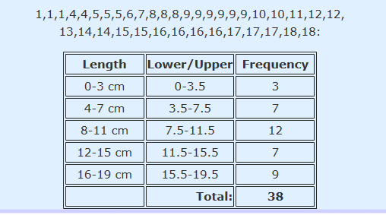
Starting at 0 and with a group size of 4 we get: 0, 4, 8, 12, 16
Write down the groups, include the end value of each group (must be less than the next group):
The last group goes to 19 which is greater than the largest value. That is OK: the main thing is that it must include the largest value.

Slide 28
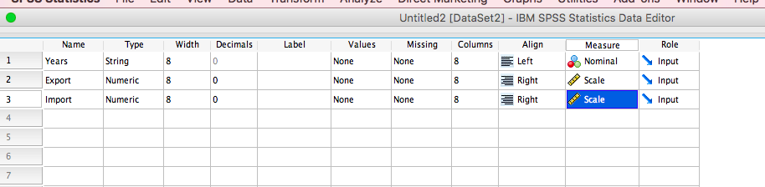
Line Graph With One Variable

Slide 29
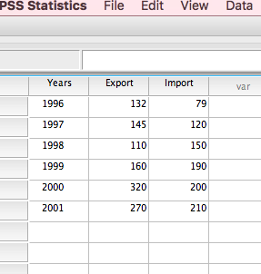

Slide 30
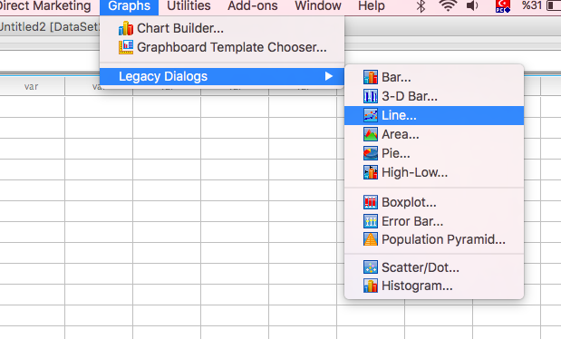

Slide 31
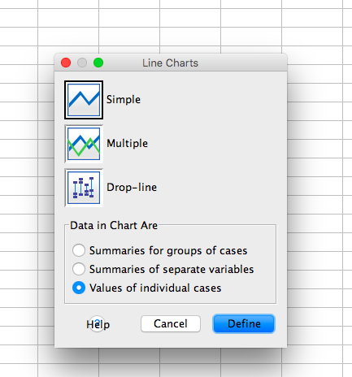

Slide 32
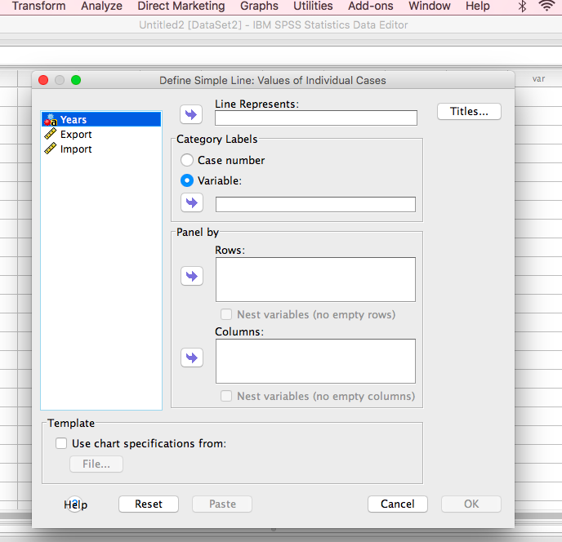

Slide 33
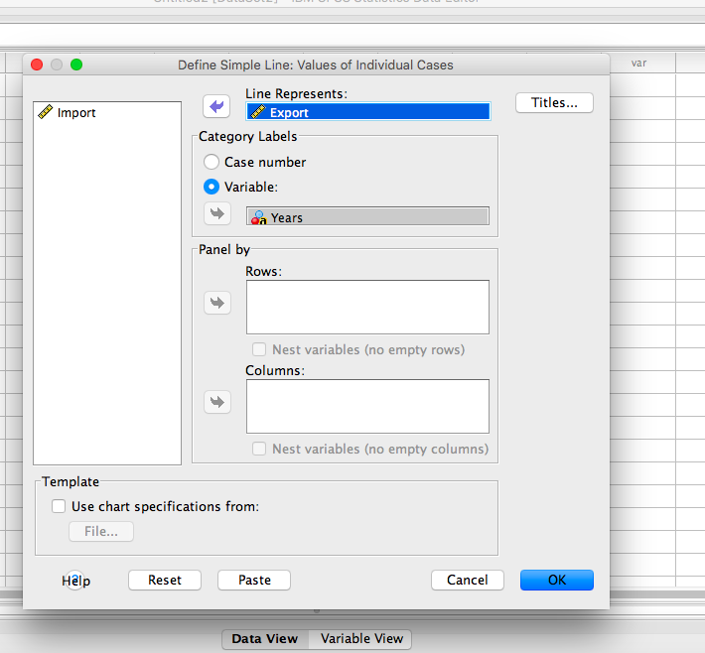

Slide 34
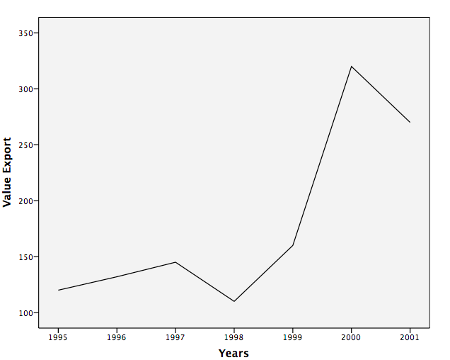

Slide 35
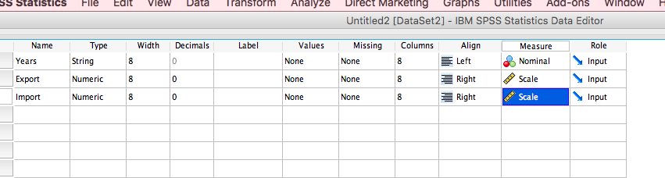
Line Graphs With two Variables

Slide 36
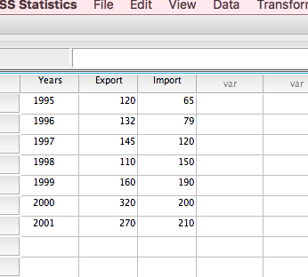

Slide 37
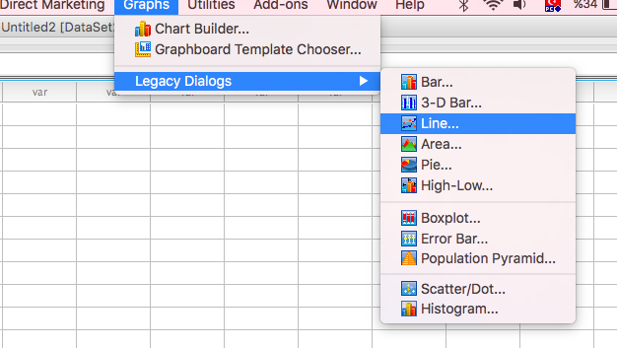

Slide 38
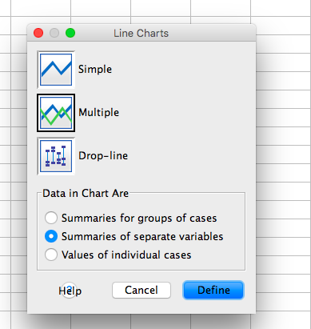

Slide 39
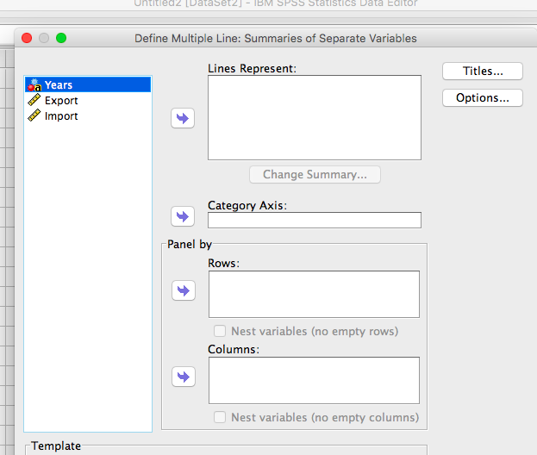

Slide 40
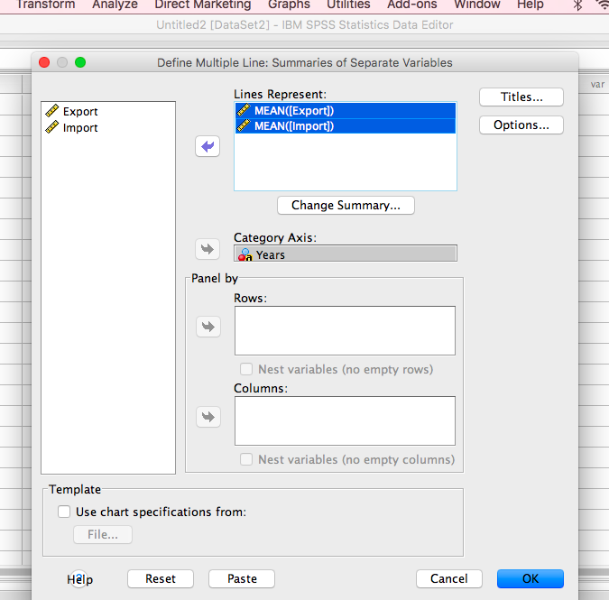

Slide 41
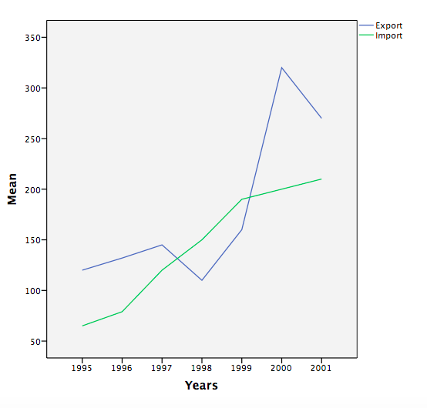
Notes:
Bar Graph

Slide 42
Bar chart (or graph):
A bar chart is a graph which uses parallel rectangular shapes to represent changes in the size, value, or rate of something or to compare the amount of something relating to several different countries or groups.

Slide 43
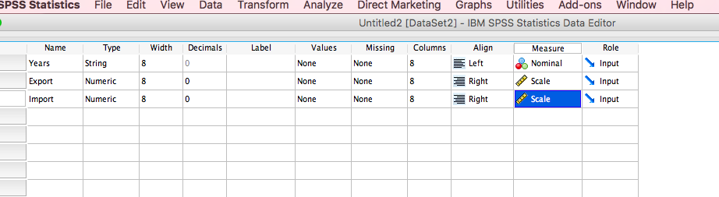
Bar Graph With One Variable

Slide 44
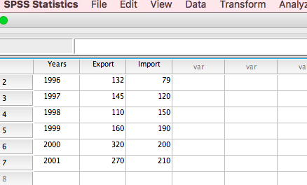

Slide 45
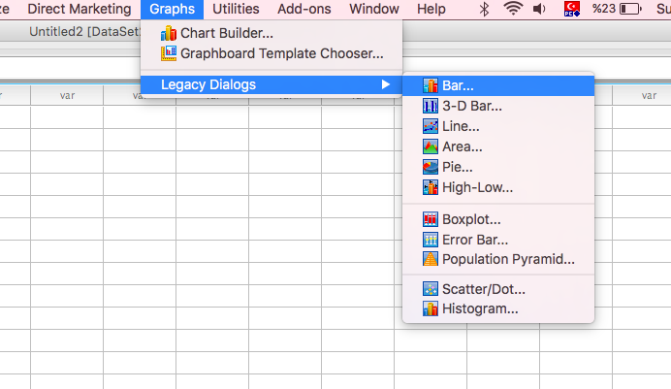

Slide 46
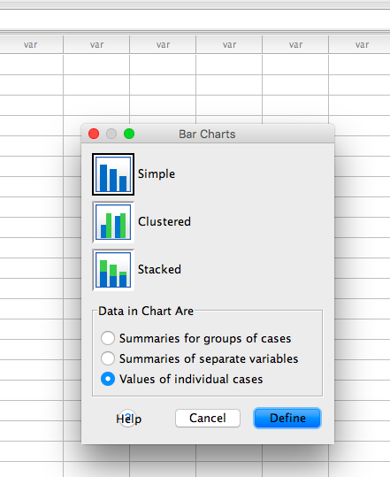

Slide 47
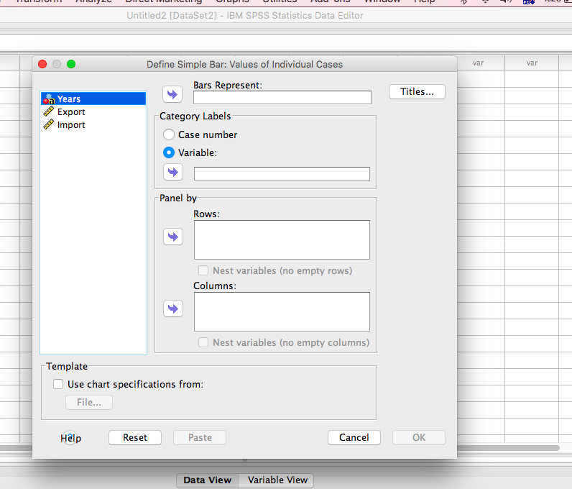

Slide 48
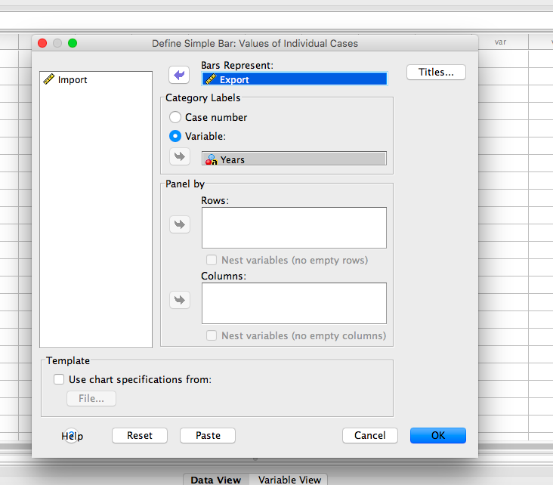

Slide 49
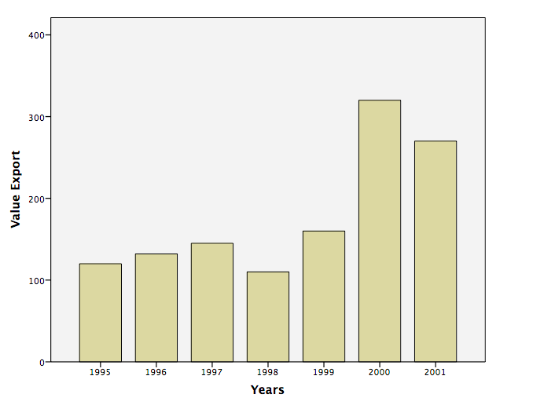

Slide 50
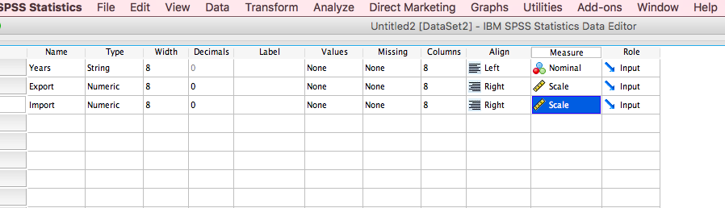
Bar Graph With Two Variables

Slide 51
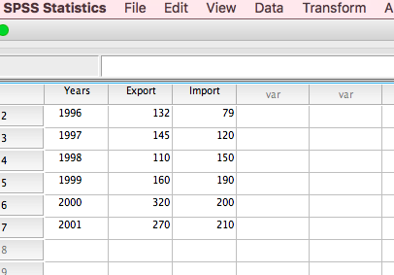

Slide 52
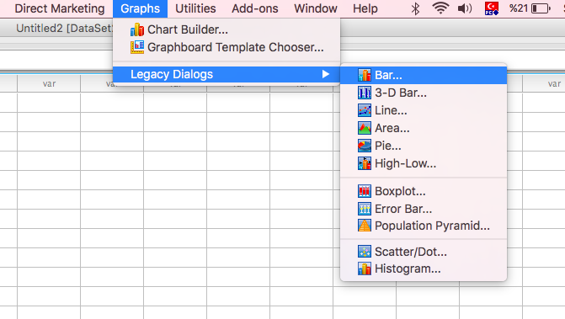

Slide 53
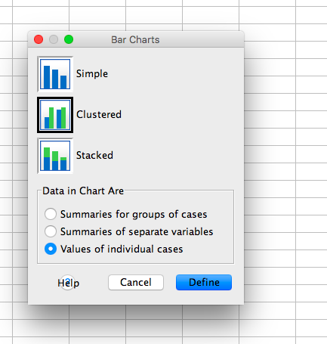

Slide 54
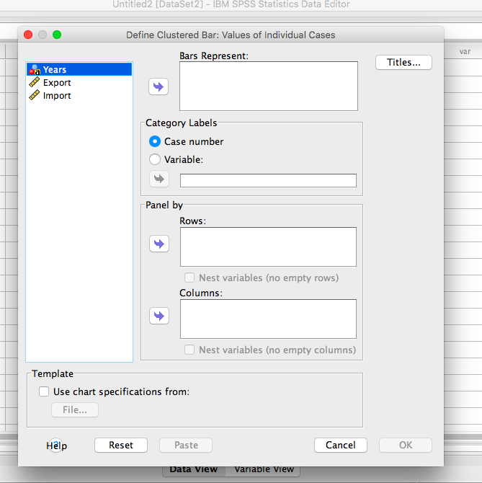

Slide 55
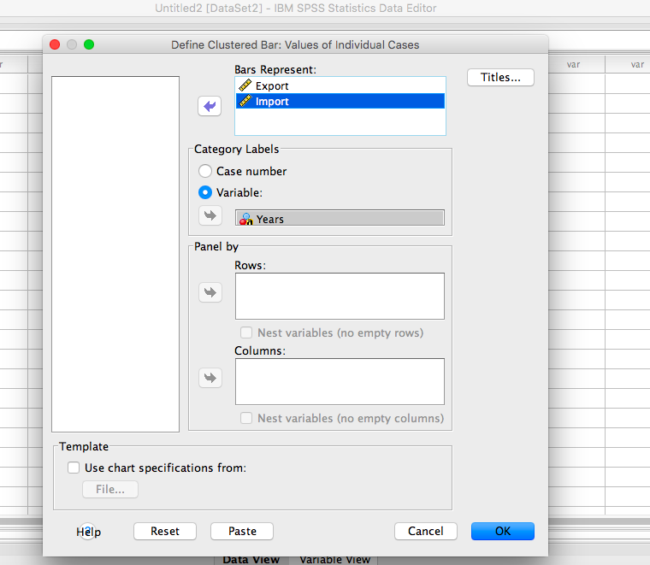

Slide 56
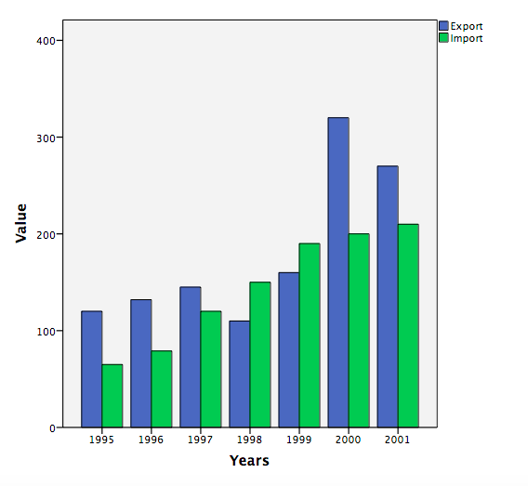

Slide 57
Pie Chart:
A pie chart (or a circle chart) is a circular statistical graphic which is divided into slices to illustrate numerical proportion.
In a pie chart, the arc length of each slice (and consequently its central angle and area), is proportional to the quantity it represents.

Slide 58
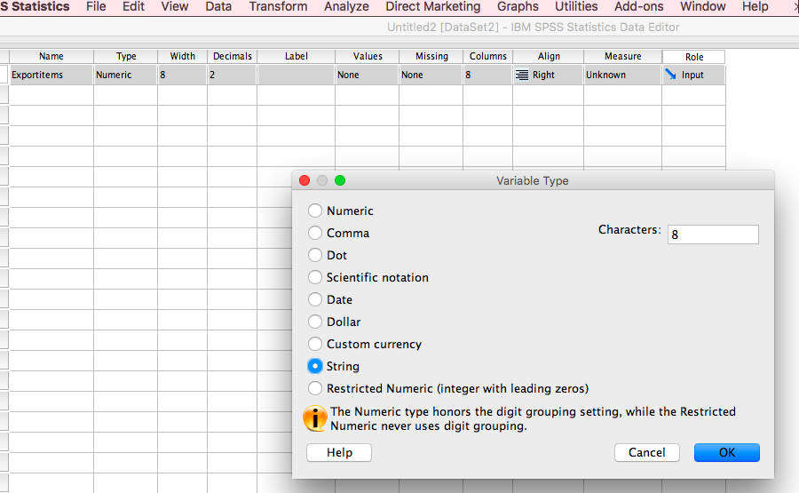

Slide 59
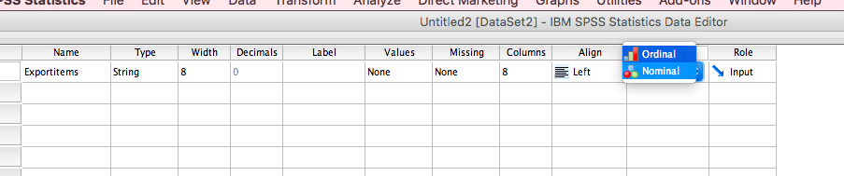

Slide 60
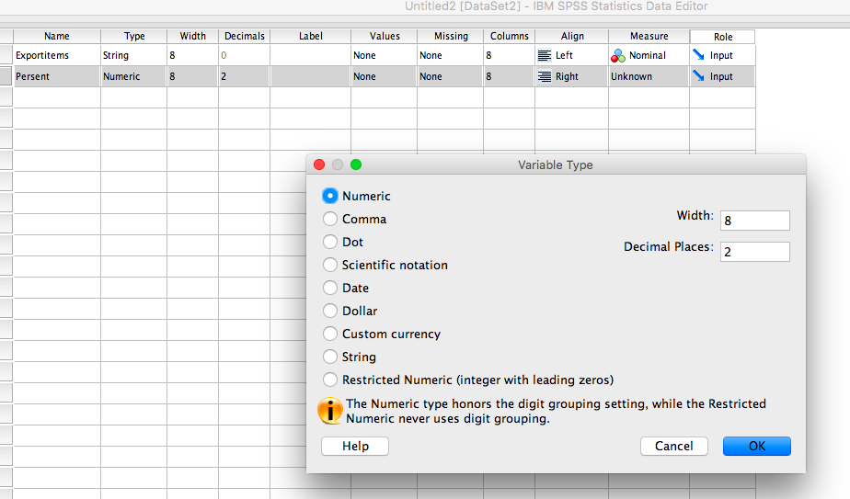

Slide 61
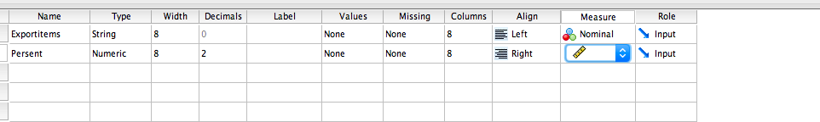

Slide 62
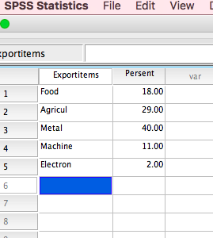

Slide 63
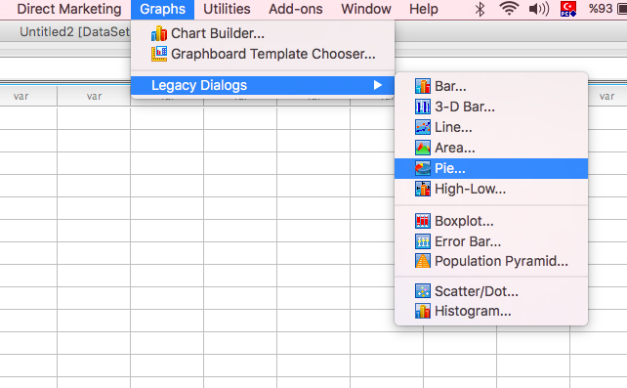

Slide 64


Slide 65


Slide 66
Static Relation Between Two Variables (Scatter Graph)

Slide 67

Scatter plots (also called scatter graphs) are like line graphs.
A line graph uses a line on an X-Y axis to plot a continuous function, while a scatter plot uses dots to represent individual pieces of data.
In statistics, these plots are useful to see if two variables are related to each other. For example, a scatter chart can suggest a linear relationship (i.e. a straight line).

Slide 68
Suppose we have 15 consumers; their monthly income and consumptions are given in the table

Slide 69


Slide 70


Slide 71


Slide 72


Slide 73


Slide 74

Strong estimation
Week estimation

Slide 75

EViews

Slide 76


Slide 78


Slide 79


Slide 80


Slide 82


Slide 84


Slide 85


Slide 86


Slide 87


Slide 88


