Slide 1
INTT 103
Chapter 3
Creating metric and non-metric variables by SPSS Package Program
Entering, Classifying and Comparing Data

Slide 2
Let’s assume that we have 20 costumers,and we collected some basic information about their gender, education, age and opinion about our service.
How can we design the database by using SPSS Package Program?

Slide 3
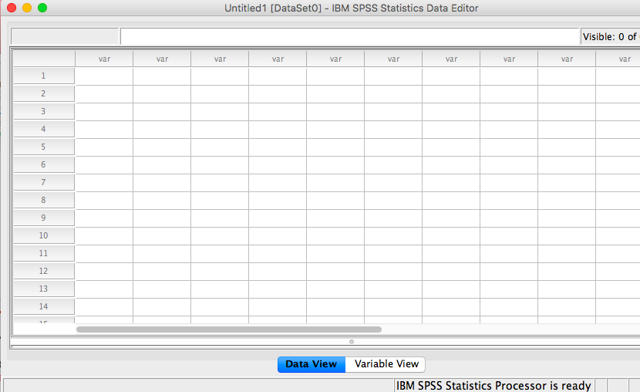

Slide 4
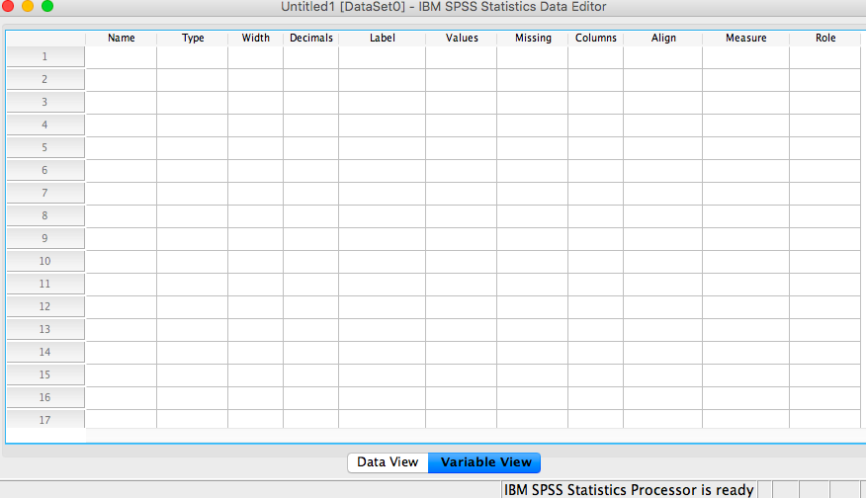

Slide 5
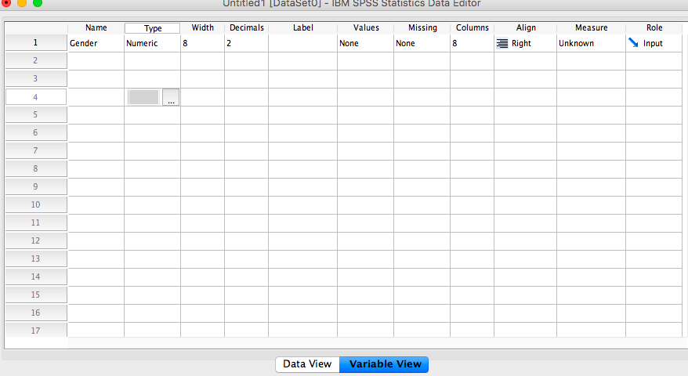

Slide 6
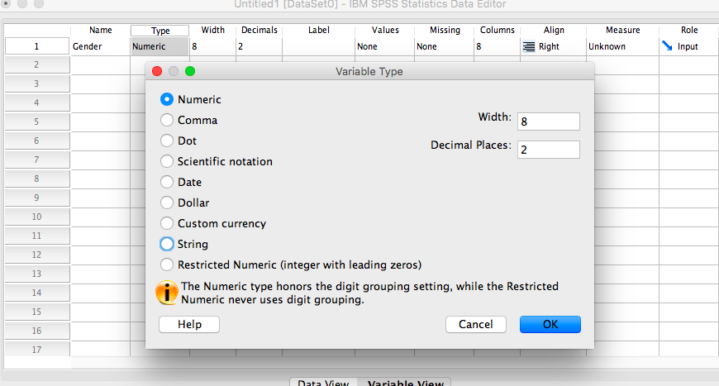

Slide 7
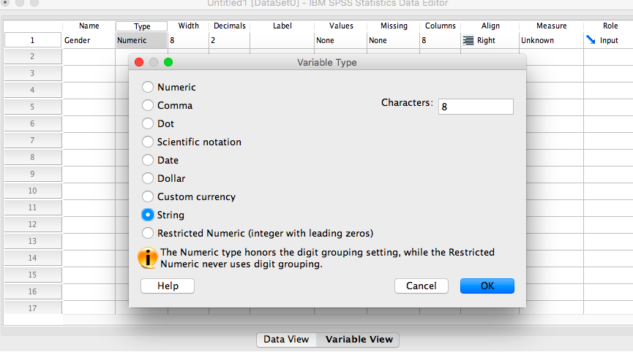

Slide 8
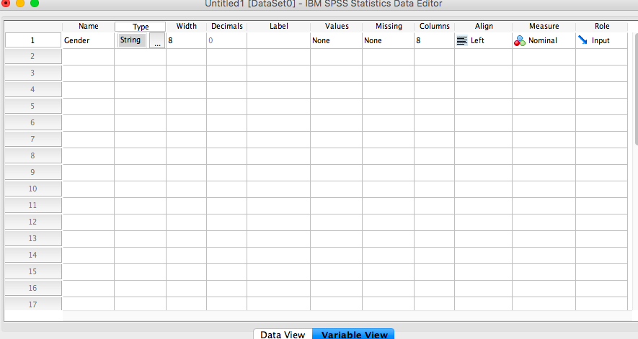

Slide 9
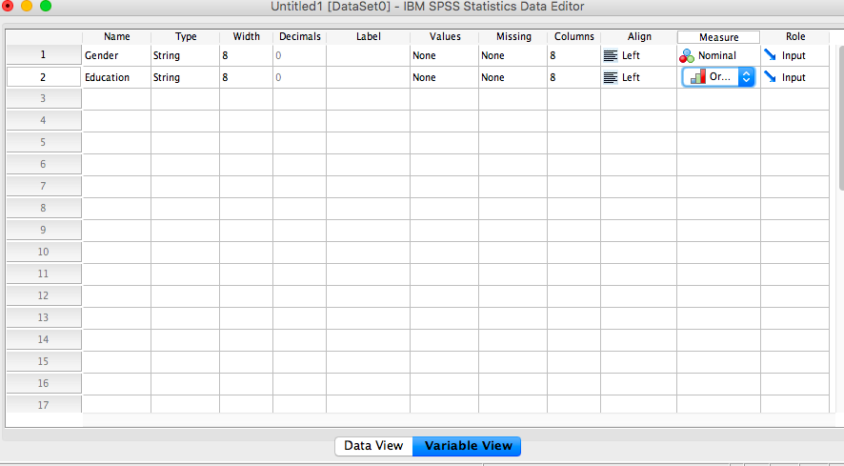

Slide 10
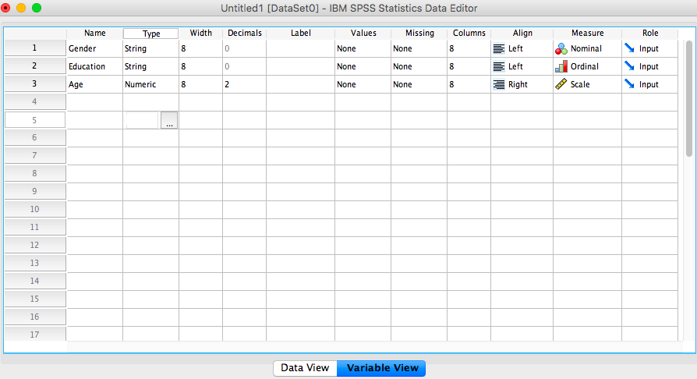

Slide 11
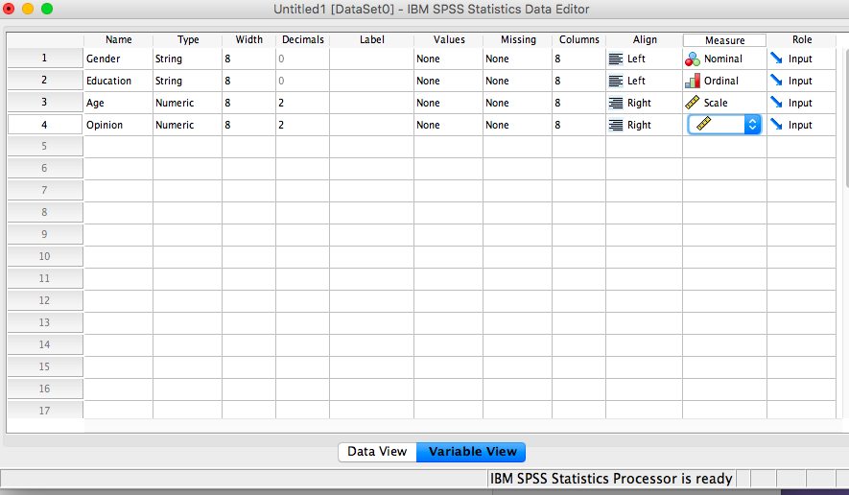

Slide 12
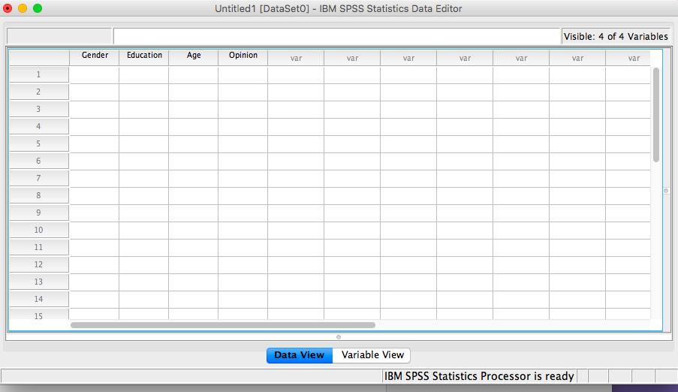

Slide 13
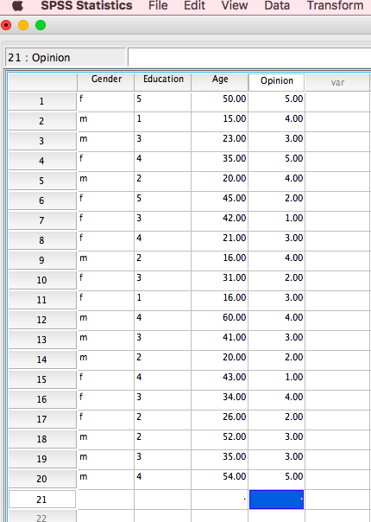

Slide 14
Classification of Gender
(Nominal Variable)

Slide 15
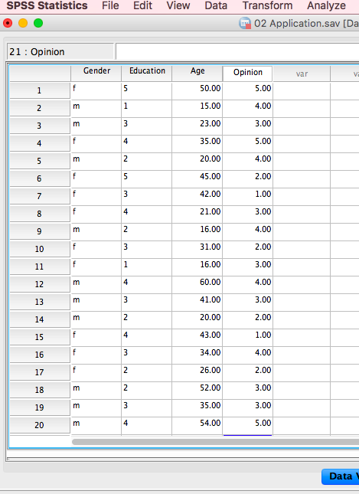
Female
Male

Slide 16
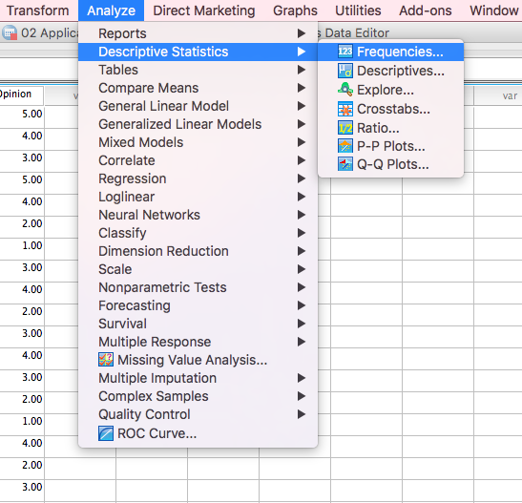

Slide 17
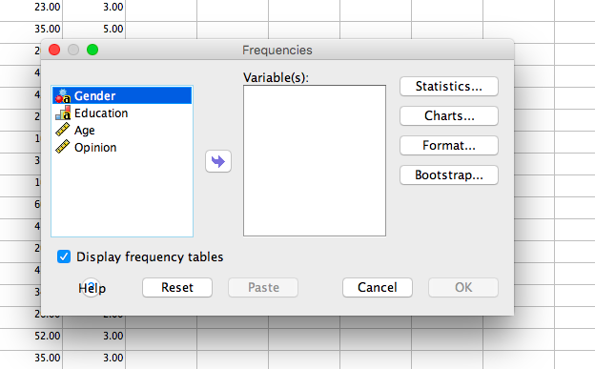

Slide 18
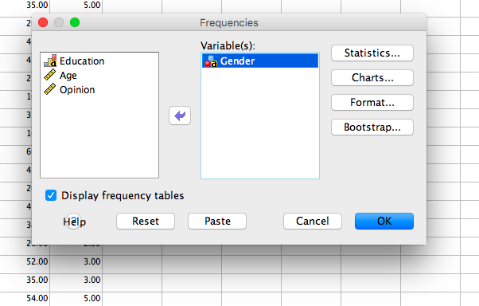

Slide 19
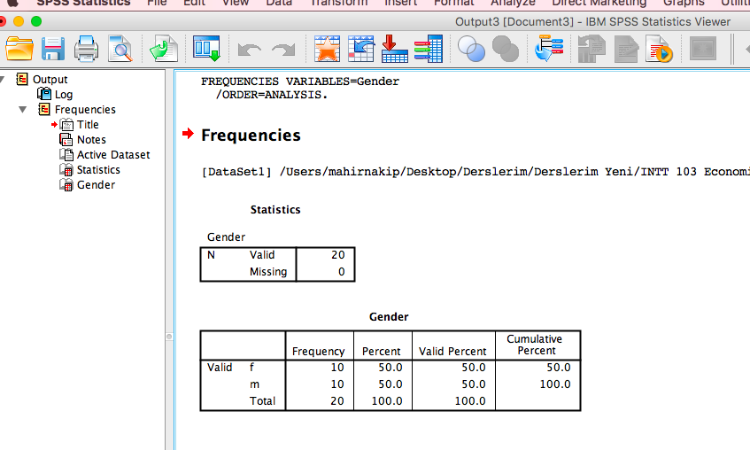

Slide 20
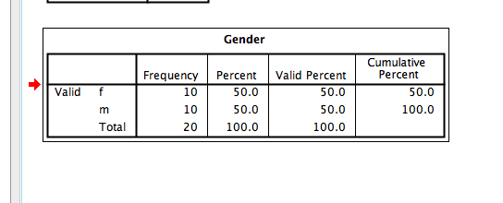

Slide 21
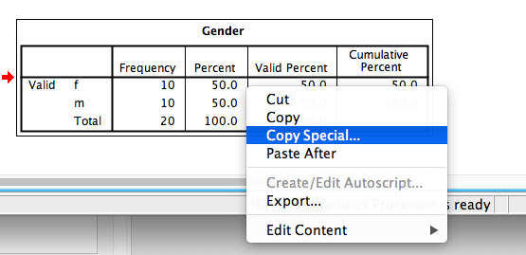

Slide 22
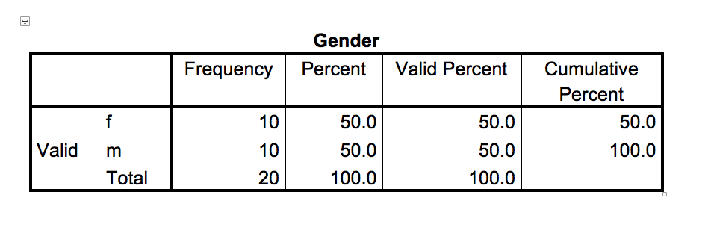

Slide 23
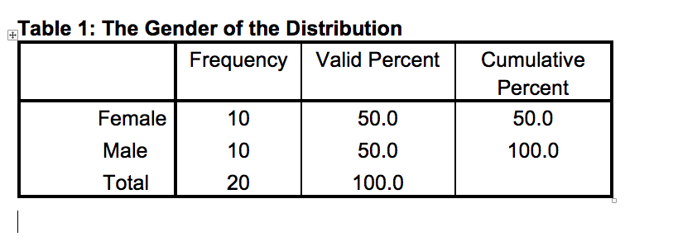

Slide 24
Classification of Education Levels
(Ordinal Variable)

Slide 25
Elementary
Middle
High
faculty
Master

Slide 27
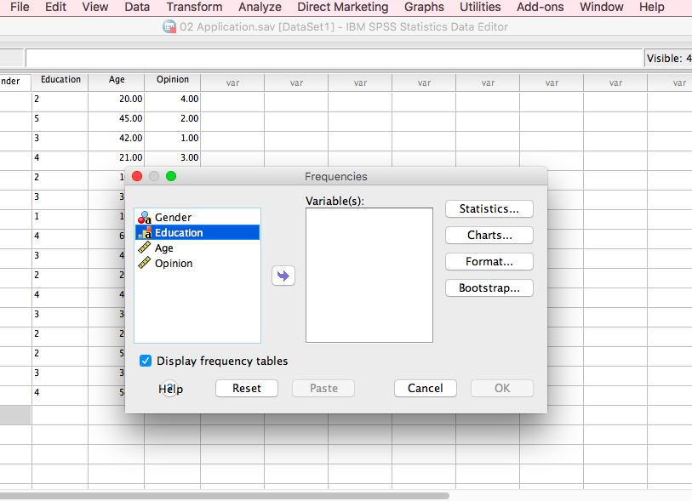

Slide 28
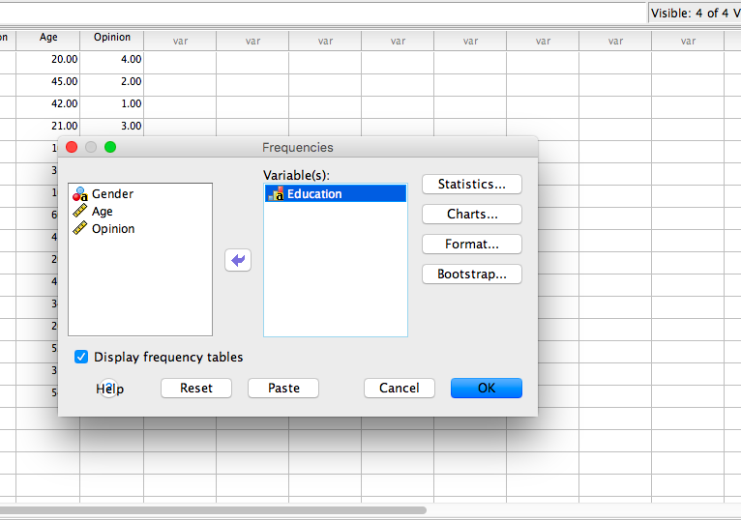

Slide 29
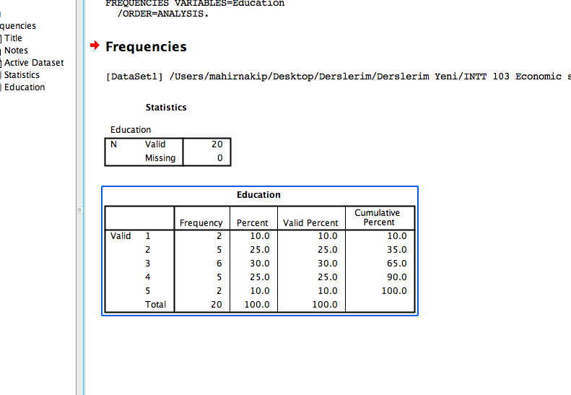

Slide 30
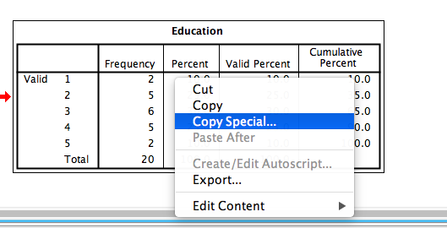

Slide 31
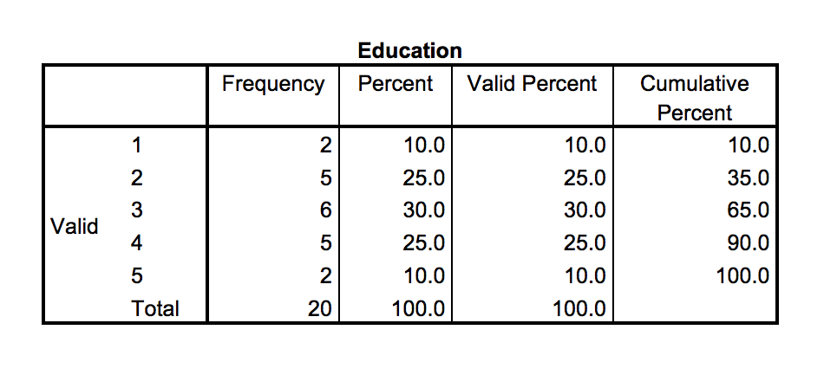

Slide 32
Education
 |  | Frequency | Percent | Valid Percent | Cumulative Percent
Valid | Elementary | 2 | 10,0 | 10,0 | 10,0
 | Middle | 5 | 25,0 | 25,0 | 35,0
 | High | 6 | 30,0 | 30,0 | 65,0
 | faculty | 5 | 25,0 | 25,0 | 90,0
 | Master | 2 | 10,0 | 10,0 | 100,0
 | Total | 20 | 100,0 | 100,0

Slide 33
Table 2: The Education Levels of the Population
Education
 | Frequency | Percent | Valid Percent | Cumulative Percent
Elemanty | 2 | 10,0 | 10,0 | 10,0
Middle | 5 | 25,0 | 25,0 | 35,0
High | 6 | 30,0 | 30,0 | 65,0
Faculty | 5 | 25,0 | 25,0 | 90,0
Master | 2 | 10,0 | 10,0 | 100,0
Total | 20 | 100,0 | 100,0

Slide 34
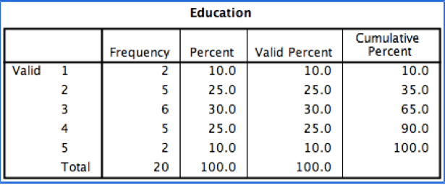
10% of the population is graduated from elementary school
25% of the population is graduated from middle school
30% of the population is graduated from high school
25% of the population has faculty diploma
10% of the population has master degree
35% of the population is graduated from middle or below school.
65% of the population is graduated from high or below school.
90% of the population is graduated from faculty or below

Slide 35
Classification of the age
(Ratio Variable)

Slide 38
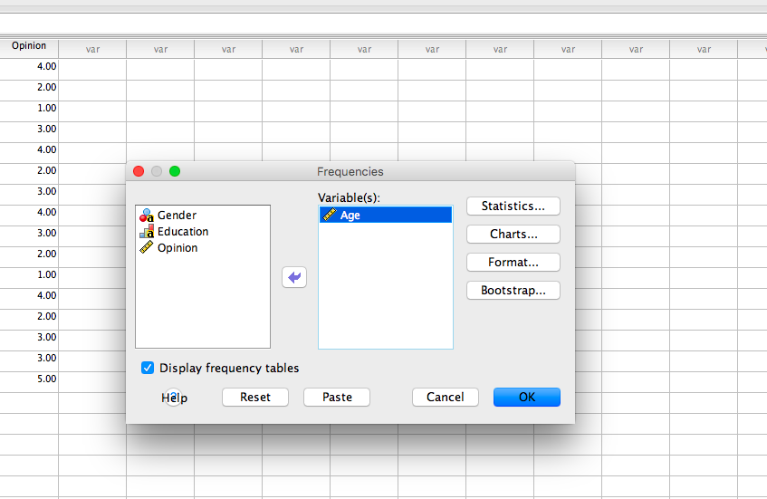

Slide 39
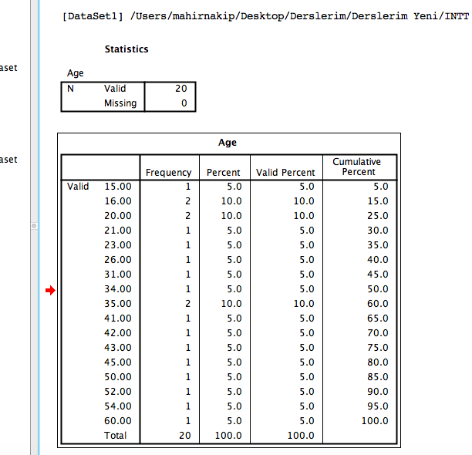

Slide 40
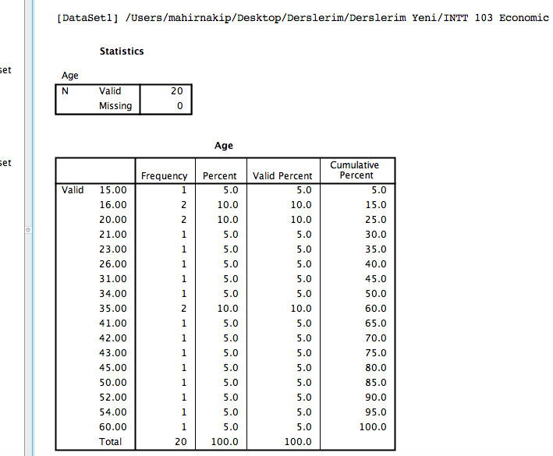
Age | Frequencies | Percentage | Cumulative
Under 20 | 3 | 15 | 15
20-30 | 5 | 25 | 40
31-40 | 4 | 20 | 60
41-50 | 5 | 25 | 85
51-60 | 3 | 15 | 100
Total | 20 | 100
The age of 15% of the population is under 20 years
The age of 40% of the population is under 30 years
The age of 60% of the population is under 40 years
The age of 85% of the population is under 50 years

Slide 41
Classification of the opinion
(Interval Variable)

Slide 42
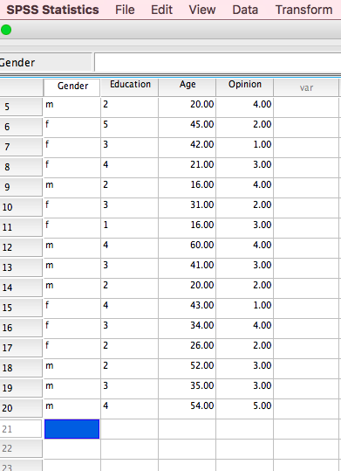
The economical situation in Turkey getting better
(5) Strongly agree
(4) Agree
(3) Neither agree nor disagree
(2) disagree
(1) Strongly disagree

Slide 43
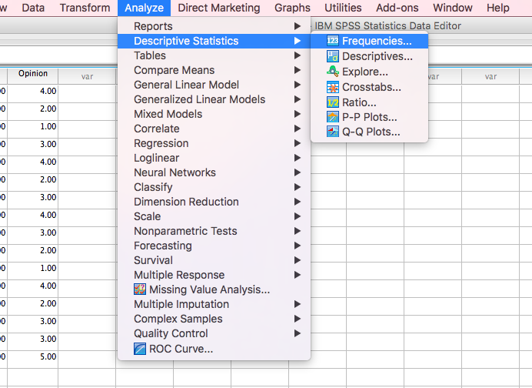

Slide 44
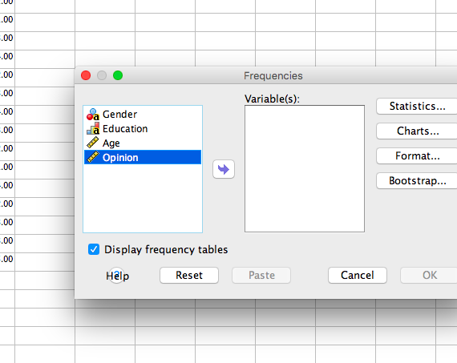

Slide 45
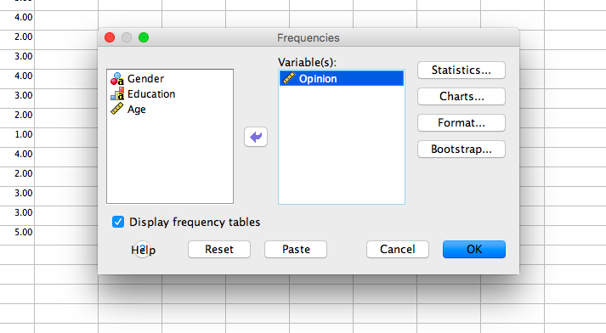

Slide 46
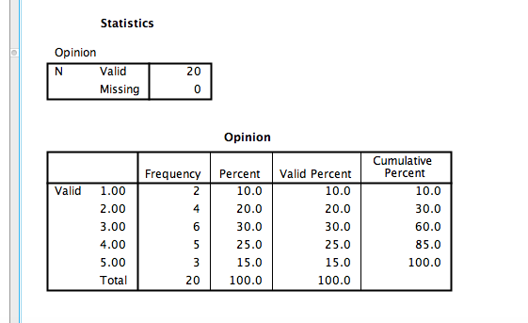
10% 0f the population is strongly disagreed
20% of the population is disagree
30% of the population has no opinion
25% of the population is agree
15% of the population is strongly agree
(10+20=) 30% of the population is disagree
(25+15=) 40% of the population is agree

Slide 47
Cross Tabulation

Slide 48
Comparing Gender With Education Levels

Slide 49
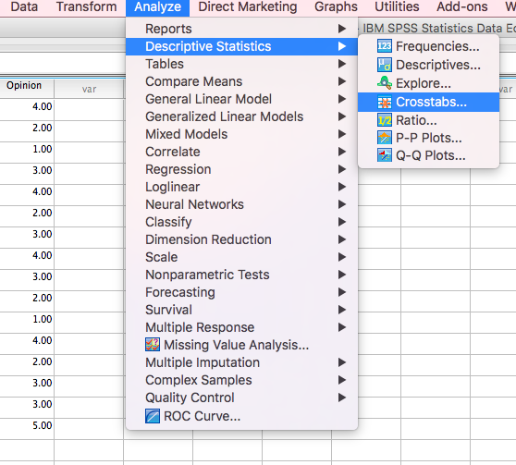

Slide 50
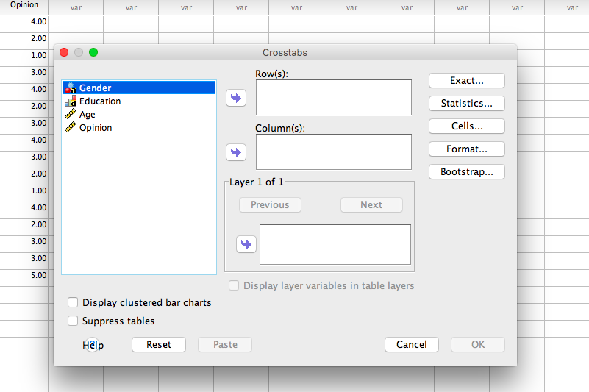

Slide 51
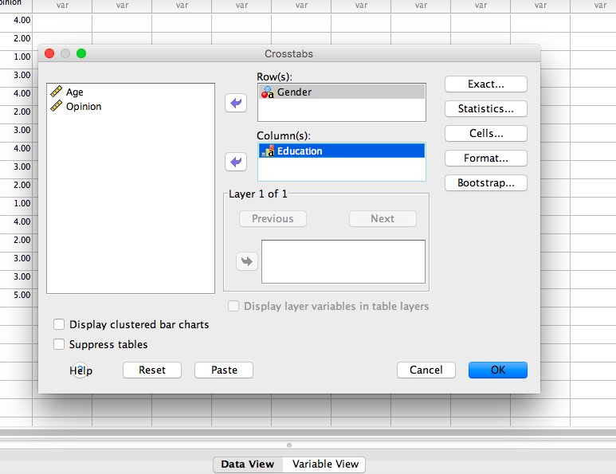

Slide 52
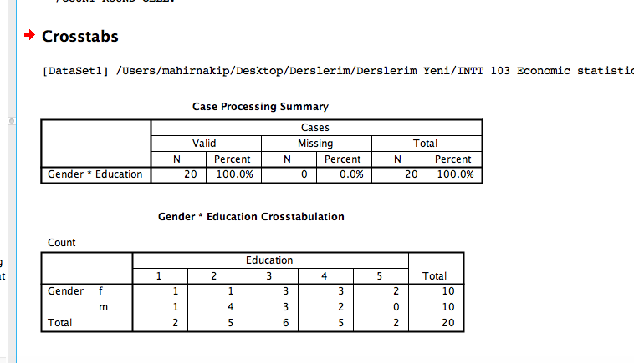

Slide 53
It is meaningless to compare gender with the other variable, such as education levels or opinions using only the observation numbers

Slide 54
Percentages can be used to compare the variables
There are three kinds of percentages:
Total percentage
Row percentage
Column percentage

Slide 55
Total Percentage

Slide 56
Comparing the Gender With Education levels
Total Percentage

Slide 57
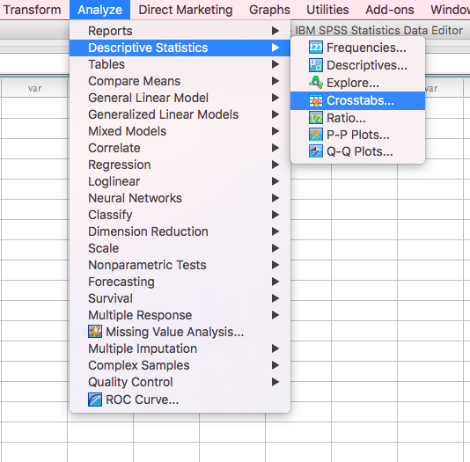

Slide 58
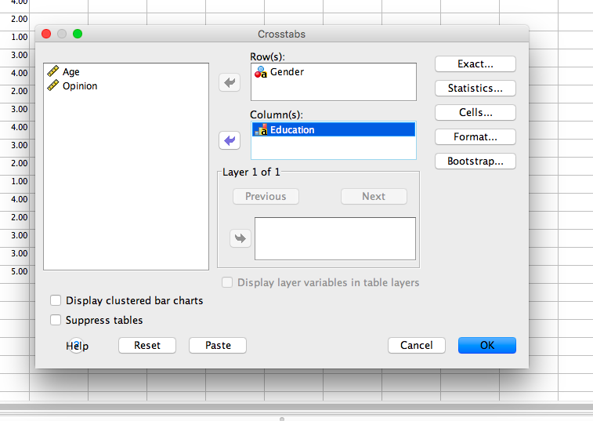

Slide 59
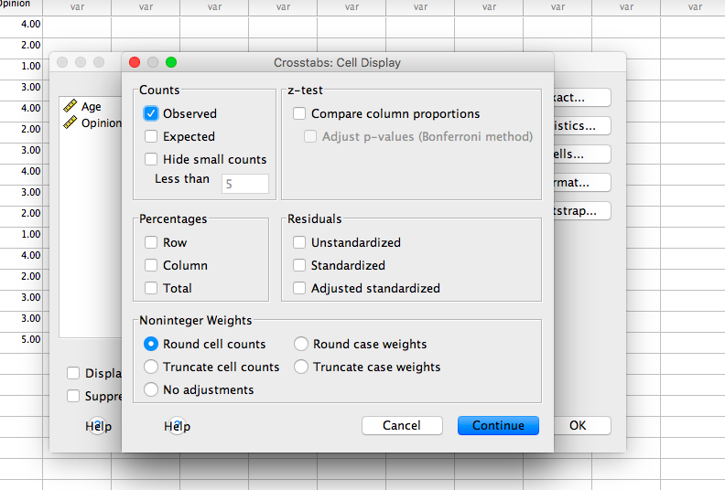

Slide 60
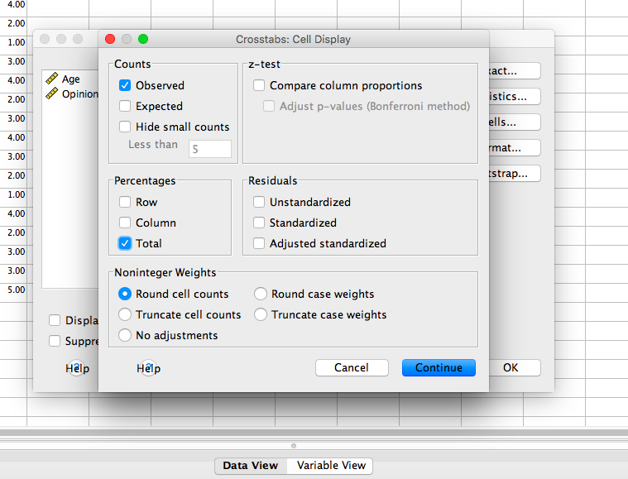

Slide 61
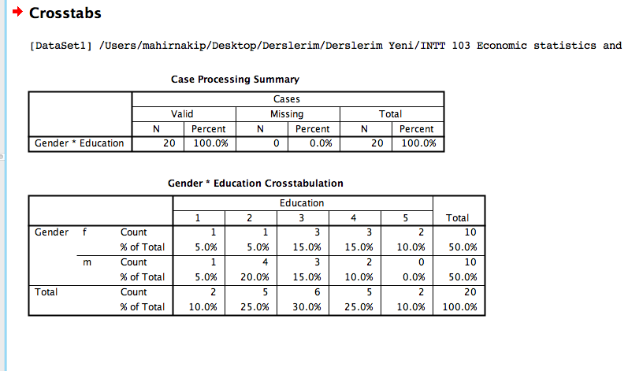

Slide 62
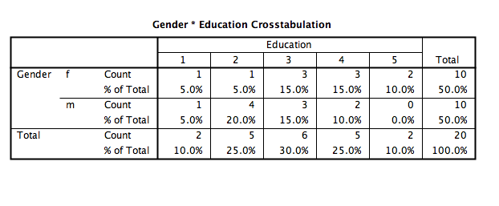
50% of the populating is female
30% of the population is graduated from high school
10% 0f the population has got master degree
15% of the population is female graduated from high school
10% of the population is male graduated from faculty

Slide 63
Comparing the Gender With the Opinion
Total Percentage

Slide 64
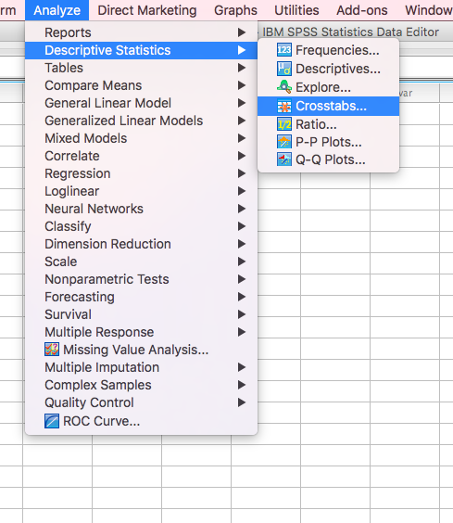

Slide 65
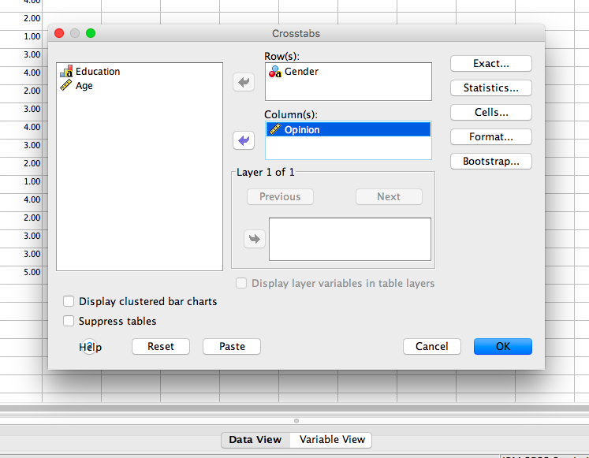

Slide 66
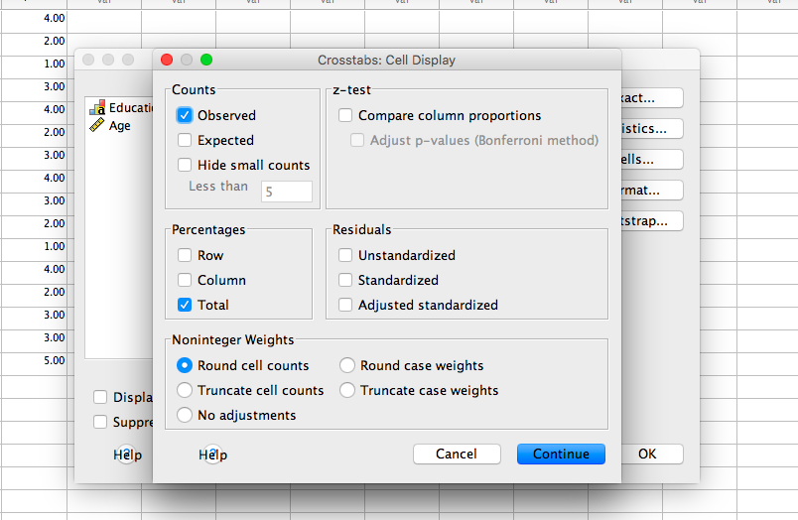

Slide 67
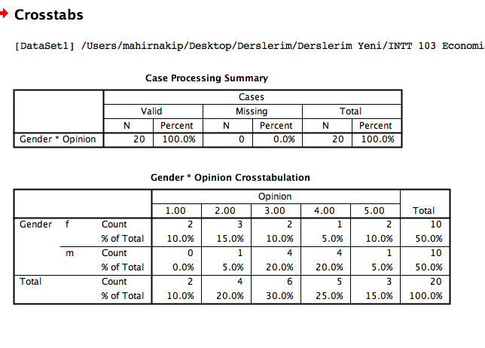

Slide 68
15% of the population is female who disagree..
10% of the population is female neither agree nor disagree…
0% of the population is male who strongly disagree..
20% of the population is male who agree…
10% of the population strongly disagree that the economical situation in Turkey is getting better
20% of the population disagree that the economical situation in Turkey is getting better
30% of the population neither agree nor disagree that the economical situation in Turkey is getting better
25% of the population agree that the economical situation in Turkey is getting better
15% of the population strongly agree that the economical situation in Turkey is getting better

Slide 69
Comparing the Gender With Education levels
Row Percentage

Slide 70
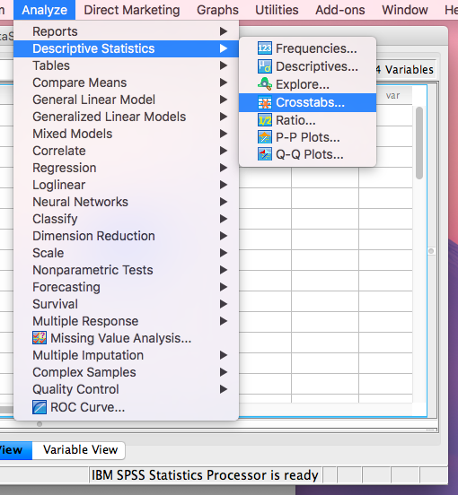

Slide 71
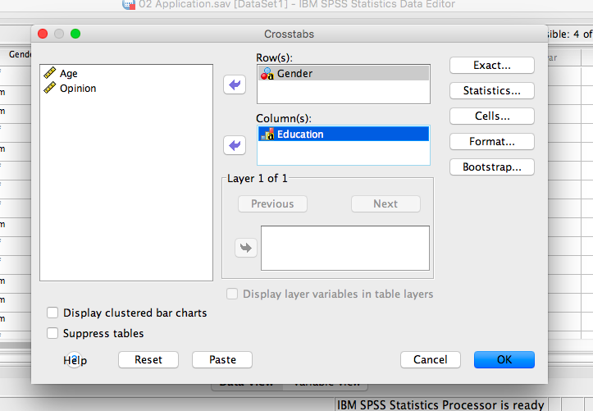

Slide 73
10% of the females are graduated from elementary school
40% of the males are graduated from middle school

Slide 74
Comparing the Gender With The Opinions
Row Percentage

Slide 78
30% of the females are disagree that…
10% of the males are strongly agree that...

Slide 79
Comparing the Gender With Education levels
Column Percentage

Slide 83
50% of the people who are graduated from elementary school are female
40% of the people who are graduated from faculty are male

Slide 84
Comparing the Gender With Opinion
Column Percentage

Slide 88
75% of the people who are disagree are females
33.3% of the people who are strongly agree are males

Slide 89
EVIEWS
Example 1

