Slide 1
INTT 103
Chapter 3
TYPES OF VARIABLES

Slide 2
What is Statistics?
In common usage people think of statistics as numerical data—the unemployment rate last month, total government expenditure last year, the number of impaired drivers charged during the recent holiday season, the crime rates of cities, and so forth. Although there is nothing wrong with viewing statistics in this way, we are going to take a deeper approach.
We will view statistics the way professional statisticians view it—as a methodology for collecting, classifying, summarizing, organizing, presenting, analyzing and interpreting numerical information.

Slide 3
Statistics is a branch of mathematics dealing with the collection, analysis, interpretation, presentation, and organization of data. In applying statistics to, e.g., a scientific, industrial, or social problem, it is conventional to begin with a statistical population or a statistical model process to be studied.
Populations can be diverse topics such as "all people living in a country" or "every atom composing a crystal." Statistics deals with all aspects of data including the planning of data collection in terms of the design of surveys and experiments.

Slide 4
In statistics, we generally want to study a population. You can think of a population as a collection of persons, things, or objects under study. To study the population, we select a sample. The idea of sampling is to select a portion (or subset) of the larger population and study that portion (the sample) to gain information about the population. Data are the result of sampling from a population.

Slide 5
Because it takes a lot of time and money to examine an entire population, sampling is a very practical technique. If you wished to compute the overall grade point average at your school, it would make sense to select a sample of students who attend the school. The data collected from the sample would be the students' grade point averages. In presidential elections, opinion poll samples of 1,000–2,000 people are taken. The opinion poll is supposed to represent the views of the people in the entire country.

Slide 6
From the sample data, we can calculate a statistic. A statistic is a number that represents a property of the sample. For example, if we consider one math class to be a sample of the population of all math classes, then the average number of points earned by students in that one math class at the end of the term is an example of a statistic.
The statistic is an estimate of a population parameter. A parameter is a number that is a property of the population. Since we considered all math classes to be the population, then the average number of points earned per student over all the math classes is an example of a parameter.

Slide 7
One of the main concerns in the field of statistics is how accurately a statistic estimates a parameter. The accuracy really depends on how well the sample represents the population.
The sample must contain the characteristics of the population in order to be a representative sample. We are interested in both the sample statistic and the population parameter in inferential statistics (çıkarımsal istatistik).

Slide 8
Descriptive and Inferential Statistics
The two major areas of statistics are known as descriptive statistics, which describes the properties of sample and population data, and inferential statistics, which uses those properties to test hypotheses and draw conclusions.
Descriptive statistics include mean (average), variance, skewness, and kurtosis. Inferential statistics include linear regression analysis, analysis of variance (ANOVA), logit/Probit models, and null hypothesis testing.

Slide 9
Statistics
Descriptive Statistics
Inferential Statistics

Slide 10
Descriptive Statistics
Descriptive statistics mostly focus on the central tendency, variability, and distribution of sample data. Central tendency means the estimate of the characteristics, a typical element of a sample or population. It includes descriptive statistics such as mean, median, and mode.
Variability refers to a set of statistics that show how much difference there is among the elements of a sample or population along the characteristics measured. It includes metrics such as range, variance, and standard deviation.

Slide 11
The distribution refers to the overall "shape" of the data, which can be depicted on a chart such as a histogram or a dot plot, and includes properties such as the probability distribution function, skewness, and kurtosis.
Descriptive statistics can also describe differences between observed characteristics of the elements of a data set. They can help us understand the collective properties of the elements of a data sample and form the basis for testing hypotheses and making predictions using inferential statistics.

Slide 12
Two words that come up often in statistics are mean and proportion.
If you were to take three exams in your math classes and obtain scores of 86, 75, and 92, you would calculate your mean score by adding the three exam scores and dividing by three (your mean score would be 84.3 to one decimal place).
If, in your math class, there are 40 students and 22 are men and 18 are women, then the proportion of men students is 22/40 and the proportion of women students is 18/40.

Slide 13
The words "mean" and "average" are often used interchangeably. The substitution of one word for the other is common practice. The technical term is "arithmetic mean," and "average" is technically a center location. However, in practice among non-statisticians, "average" is commonly accepted for "arithmetic mean."

Slide 14
Inferential Statistics
Inferential statistics are tools that statisticians use to draw conclusions about the characteristics of a population, drawn from the characteristics of a sample, and to determine how certain they can be of the reliability of those conclusions.
Based on the sample size and distribution, statisticians can calculate the probability that statistics, which measure the central tendency, variability, distribution, and relationships between characteristics within a data sample, provide an accurate picture of the corresponding parameters of the whole population from which the sample is drawn.

Slide 15
Inferential statistics are used to make generalizations about large groups, such as estimating average demand for a product by surveying a sample of consumers' buying habits or attempting to predict future events. This might mean projecting the future return of a security or asset class based on returns in a sample period.

Slide 16
Regression analysis is a widely used technique of statistical inference used to determine the strength and nature of the relationship (the correlation) between a dependent variable and one or more explanatory (independent) variables. The output of a regression model is often analyzed for statistical significance, which refers to the claim that a result from findings generated by testing or experimentation is not likely to have occurred randomly or by chance.

Slide 17
Q. Determine what the key terms refer to in the following study.
We want to know the average (mean) amount of money first year college students spend at ABC College on school supplies that do not include books. We randomly survey 100 first year students at the college. Three of those students spent $150, $200, and $225, respectively.
Answer
The population is all first year students attending ABC College this term.
The sample could be all students enrolled in one section of a beginning statistics course at ABC College (although this sample may not represent the entire population).
The parameter is the average (mean) amount of money spent (excluding books) by first year college students at ABC College this term.
The statistic is the average (mean) amount of money spent (excluding books) by first year college students in the sample.
The variable could be the amount of money spent (excluding books) by one first year student. Let X = the amount of money spent (excluding books) by one first year student attending ABC College.
The data are the dollar amounts spent by the first year students. Examples of the data are $150, $200, and $225.

Slide 18
Q. Determine what the key terms refer to in the following study.
We want to know the average (mean) amount of money spent on school uniforms each year by families with children at Knoll Academy. We randomly survey 100 families with children in the school. Three of the families spent $65, $75, and $95, respectively.
Answer
The population is all families with children attending Knoll Academy.
The sample is a random selection of 100 families with children attending Knoll Academy.
The parameter is the average (mean) amount of money spent on school uniforms by families with children at Knoll Academy.
The statistic is the average (mean) amount of money spent on school uniforms by families in the sample.
The variable is the amount of money spent by one family. Let X = the amount of money spent on school uniforms by one family with children attending Knoll Academy.
The data are the dollar amounts spent by the families. Examples of the data are $65, $75, and $95.

Slide 19
Q. Determine what the key terms refer to in the following study.
A study was conducted at a local college to analyze the average cumulative GPA’s of students who graduated last year. Fill in the letter of the phrase that best describes each of the items below.
1._____ Population 2._____ Statistic 3._____ Parameter 4._____ Sample 5._____ Variable 6._____ Data
a. all students who attended the college last year
b. the cumulative GPA of one student who graduated from the college last year
c. 3.65, 2.80, 1.50, 3.90
d. a group of students who graduated from the college last year, randomly selected
e. the average cumulative GPA of students who graduated from the college last year
f. all students who graduated from the college last year
g. the average cumulative GPA of students in the study who graduated from the college last year
Answer
1. f; 2. g; 3. e; 4. d; 5. b; 6. c

Slide 20
Q. Determine what the key terms refer to in the following study.
An insurance company would like to determine the proportion of all medical doctors who have been involved in one or more malpractice lawsuits. The company selects 500 doctors at random from a professional directory and determines the number in the sample who have been involved in a malpractice lawsuit.
Answer
The population is all medical doctors listed in the professional directory.
The parameter is the proportion of medical doctors who have been involved in one or more malpractice suits in the population.
The sample is the 500 doctors selected at random from the professional directory.
The statistic is the proportion of medical doctors who have been involved in one or more malpractice suits in the sample.
The variable X = the number of medical doctors who have been involved in one or more malpractice suits.
The data are either: yes, was involved in one or more malpractice lawsuits, or no, was not.

Slide 21
TYPES OF VARIABLES
There are two main types of variables. First, categorical-also called qualitative- variables are specific attributes that are often non-numeric. Examples of qualitative variables in statistics are gender, eye color, or city of birth. Qualitative data is most often used to determine what percentage of an outcome occurs for any given qualitative variable. Qualitative analysis often does not rely on numbers. For example, trying to determine what percentage of women own a business analyzes qualitative data.
Categorical variables consist of names and labels that divide data into specific categories. When you select your nationality or your race on a survey, those responses are categorical.

Slide 22
The second type of variable in statistics is Numerical—also called quantitative- variables. Quantitative variables are studied numerically and only have weight when they're about a non-numerical descriptor.
Numerical variables have values that can either be counted or measured. Discrete and continuous variables are specific types of numerical data.

Slide 23
Quantitative data can be recorded on a natural numerical scale. Examples are gross national product (measured in dollars) and the consumer price index (measured as a percentage of a base level).
Qualitative data cannot be measured on a naturally occurring numerical scale but can only be classified into one of a group of categories. An example is a series of records of whether or not the automobile accidents occurring over a given period resulted in criminal charges—the entries are simply yes or no.

Slide 25
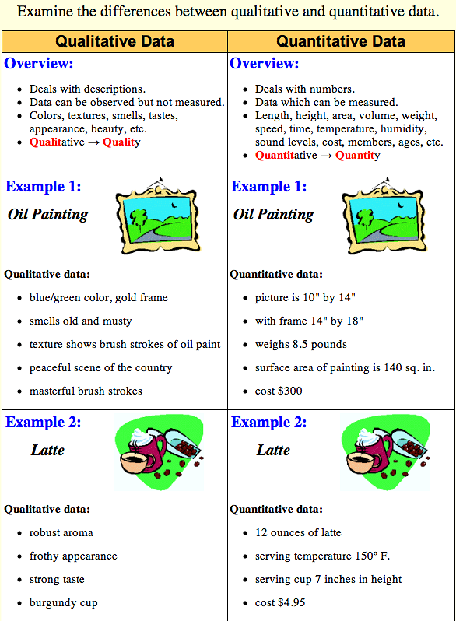

Slide 27
Numerical (Quantitative)
Continuous variable
Discrete variable
Continuous variables exist on a continuum, thus the term “continuous.” There are NOT discrete categories in a continuous variable but are an infinite number of responses along a number line.
A discrete variable is a variable that takes on distinct, countable values. In theory, you should always be able to count the values of a discrete variable.

Slide 28
What Is a Discrete Variable?
A discrete variable is a variable that takes on distinct, countable values. In theory, you should always be able to count the values of a discrete variable.
Examples of discrete variables include:
Years of schooling
Number of goals made in a soccer match
Number of red M&M’s in a candy jar
Votes for a particular politician
Number of times a coin lands on heads after ten coin tosses

Slide 29
The number of books you check out from the library.
The number of heads in a sequence of coin tosses.
The number of patients in a hospital.
The population of a country.
The number of product reviews
The number of tickets sold in a day
The number of students in your class
The number of employees in a company
The number of computers in each department
The number of customers who bought different items
The number of items you buy at the grocery store each week

Slide 30
What Is a Continuous Variable?
A continuous variable is a variable that can take on any value within a range. A continuous variable takes on an infinite number of possible values within a given range.
Examples of continuous variables include:
The time it takes sprinters to run 100 meters
The size of real estate lots in a city
The weight of baby elephants
The body temperature of patients with the flu
The deployment altitude of skydivers
Daily wind speed
Freezer temperature
Weight of newborn babies
Length of customer service calls
Product box measurements and weight

Slide 31
Statistical Levels of Measurement
There are several resulting levels of measurement after analyzing variables and outcomes. Statistics can quantify outcomes in four ways.
Nominal-level Measurement
Ordinal-level Measurement
Interval-level Measurement
Ratio-level Measurement

Slide 32
Nominal-Level Measurement (scale)
There's no numerical or quantitative value, and qualities are not ranked. Nominal-level measurements are instead simply labels or categories assigned to other variables. It's easiest to think of nominal-level measurements as non-numerical facts about a variable.
You can categorize your data by labelling them in mutually exclusive groups, but there is no order between the categories.
Example: The name of the President elected in 2020 was Joseph Robinette Biden, Jr.

Slide 33
When a nominal scale is used for the purpose of identification, there is a strict one-to-one correspondence between the numbers and the objects.
Each number is assigned to only one object, and each object has only one number assigned to it.

Slide 34
No matter which one is first or second

Slide 35
Common examples include student registration numbers at their college or university and numbers assigned to football players or jockeys in a horse race. In marketing research, nominal scales are used for identifying respondents, brands, attributes, banks and other objects.

Slide 36
Examples
Gender ( ) Female ( ) Male
Marital Status ( ) Married ( ) Single ( ) Divorced
Nationality ( ) Turk ( ) Arab ( ) Germen ( ) English

Slide 37
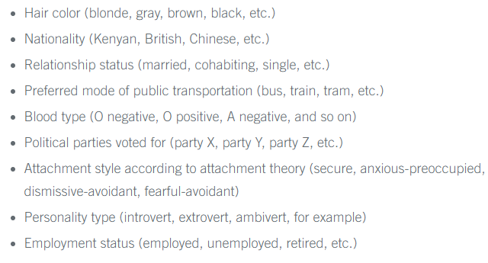
Examples of nominal scales
City of birth
Gender
Ethnicity
Car brands
Marital status

Slide 38
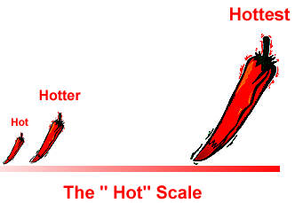
Ordinal-Level Measurement (scale)
An ordinal scale is a ranking scale in which numbers are assigned to objects to indicate the relative extent to which the objects possess some characteristic. An ordinal scale allows you to determine whether an object has more or less of a characteristic than some other object, but not how much more or less.

Slide 39
Thus, an ordinal scale indicates relative position, not the magnitude of the differences between the objects. The object ranked first has more of the characteristic as compared with the object ranked second, but whether the object ranked second is a close second or a poor second is not known.
You can categorize and rank your data in an order, but you cannot say anything about the intervals between the rankings.

Slide 40
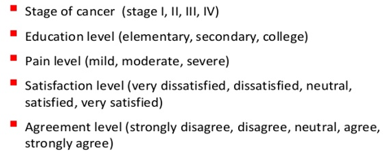
Common examples of ordinal scales include quality rankings, rankings of teams in a tournament and occupational status. In marketing research, ordinal scales are used to measure relative attitudes, opinions, perceptions and preferences.
Language ability (e.g., beginner, intermediate, fluent)
t-shirt size: 1=small 2=medium 3=large 4=extra large.
The professor explains things in an easy-to-understand manner. 1=strongly disagree 2=disagree 3=neutral 4=agree 5=strongly agree

Slide 41
Interval-level Measurement
Outcomes can be arranged in order but differences between data values may now have meaning. Two data points are often used to compare the passing of time or changing conditions within a data set. There is often no "starting point" for the range of data values, and calendar dates or temperatures may not have a meaningful essential zero value.
An interval variable has categories that are “real numbers” with common units of measurement, but there is NO TRUE ZERO.
You can categorize, rank, and infer equal intervals between neighboring data points, but there is no true zero point.

Slide 42
There is a constant or equal interval between scale values. The difference between 1 and 2 is the same as the difference between 2 and 3, which is the same as the difference between 5 and 6.
A common example in everyday life is a temperature scale. In marketing research, attitudinal data obtained from rating scales are often treated as interval data.
Example: Inflation hit 8.6% in May 2022. The last time inflation was this high was in December 1981.
Test scores (e.g., IQ or exams)
Personality inventories
Temperature in Fahrenheit or Celsius.

Slide 43
Let us assume that 200 students have answered the question above as follow….
Participation Degree | Frequency | %
5 Strongly agree | 75 | 37,5
4 | 64 | 32
3 | 38 | 19
2 | 18 | 9
1 Strongly disagree | 5 | 2,5
Total | 200 | 100
The weighted arithmetic means is?
(5x0,375)+(4x0,32)+(3x0,19)+(2x0,09)+(1x0,025)=3,93

Slide 44
Ratio-level Measurement
Outcomes can be arranged in order and differences between data values now have meaning. But there's a starting point or "zero value" that can be used to further provide value to a statistical value. The ratio between data values has meaning, including its distance away from zero.
Example: The lowest meteorological temperature recorded was -128.6 degrees Fahrenheit in Antarctica.
Height
Age
Weight
Temperature in Kelvin

Slide 47
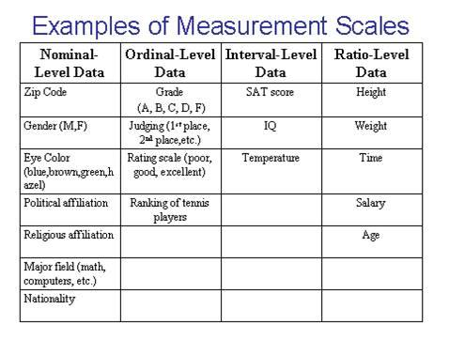

Slide 48
