Slide 1
INTT 103
Chapter 1
Data Collection

Slide 2
To analyze and make decisions about a certain business, sales, etc., data will be collected. This collected data will help in making some conclusions about the performance of a particular business.
Thus, data collection is essential to analyze the performance of a business unit, solving a problem and making assumptions about specific things when required.

Slide 3
In Statistics, data collection is a process of gathering information from all the relevant sources to find a solution to the research problem. It helps to evaluate the outcome of the problem.
The data collection methods allow a person to conclude an answer to the relevant question. Most of the organizations use data collection methods to make assumptions about future probabilities and trends.
Once the data is collected, it is necessary to undergo the data organization process.

Slide 4
The main sources of the data collections methods are “Data”.
Data can be classified into two types, namely primary data and secondary data. The primary importance of data collection in any research or business process is that it helps to determine many important things about the company, particularly the performance. So, the data collection process plays an important role in all the streams.
Depending on the type of data, the data collection method is divided into two categories namely,
Primary Data Collection methods
Secondary Data Collection methods

Slide 5
Secondary Data
Primary Data

Slide 6
Secondary Data
Secondary data is data collected by someone other than the actual user. It means that the information is already available, and someone analyses it. The secondary data includes magazines, newspapers, books, journals, etc. It may be either published data or unpublished data.

Slide 7
Examples of secondary data are research reports, government reports, censuses, weather reports, interviews, the Internet, reference books, organizational reports and accounting documents etc.

Slide 8
Common sources of existing secondary data include data collected by government public services departments, libraries, internet searches and censuses.
Companies use market research to draw on existing information from social media as a source of secondary data. Social media is becoming heavily favored in market research, as opinions are already available from millions of users on many topics and products.

Slide 9
Advantages of Secondary Data:
Ease of access
The secondary data sources are very easy to access. The Internet has changed the way secondary research works. Nowadays, you have so much information available just by clicking with the mouse.
Low cost or free
The majority of secondary sources are absolutely free for use or at very low costs. It saves not only your money but your efforts. In comparison with primary research where you have to design and conduct a whole primary study process from the beginning, secondary research allows you to gather data without having to put any money on the table.

Slide 10
Time-saving
As the above advantage suggests, you can perform secondary research in no time. Sometimes it is a matter of a few Google searches to find a source of data.
Allow you to generate new insights from previous analysis Reanalyzing old data can bring unexpected new understandings and points of view or even new relevant conclusions.

Slide 11
Longitudinal analysis
Secondary data allows you to perform a longitudinal analysis which means the studies are performed spanning over a large period of time. This can help you to determine different trends. In addition, you can find secondary data from many years back up to a couple of hours ago. It allows you to compare data over time.
Anyone can collect the data
Secondary data research can be performed by people that aren’t familiar with the different data collection methods. Practically, anyone can collect it.
A huge amount of secondary data with a wide variety of sources
It is the richest type of data available to you in a wide variety of sources and topics.

Slide 12
Disadvantages:
Might be not specific to your needs
Secondary data is not specific to the researcher’s needs due to the fact that it was collected in the past for another reason. That is why the secondary data might be unreliable for your current needs. Secondary data sources can give you a huge amount of information, but quantity does not always mean appropriateness.
You have no control over data quality
The secondary data might lack quality. The source of the information may be questionable, especially when you gather the data via the Internet. As you relying on secondary data for your data-driven decision-making, you must evaluate the reliability of the information by finding out how the information was collected and analyzed.

Slide 13
Biasness
As the secondary data is collected by someone else than you, typically the data is biased in favor of the person who gathered it. This might not cover your requirements as a researcher or marketer.
Not timely
Secondary data is collected in the past which means it might be out-of-date. This issue can be crucial in many different situations.
You are not the owner of the information
Generally, secondary data is not collected specifically for your company. Instead, it is available to many companies and people either for free or for a little fee. So, this is not exactly a “competitive advantage” for you. Your current and potential competitors also have access to the data.

Slide 14
ADVANTAGES OF SECONDARY DATA | DISADVANTAGES OF SECONDARY DATA
Ease of access | Might be not specific to your needs
Low cost or free | You have no control over data quality
Time-saving | Biasness
Allow you to generate new insights from previous analysis | Not timely
Longitudinal analysis | You are not the owner of the information
Anyone can collect the data
A huge amount of secondary data with a wide variety of sources

Slide 15
TYPES OF SECONDARY DATA
There are two types of secondary data, based on the data source:
Internal sources of data: information gathered within the researcher’s company or organization (examples – a database with customer details, sales reports, marketing analysis, your emails, your social media profiles, etc).
External sources of data: the data collected outside the organization (i.e. government statistics, mass media channels, newspapers, etc.)

Slide 16
Also, secondary data can be 2 types depending on the research strands:
Quantitative data – data that can be expressed as a number or can be quantified. Examples – the weight and height of a person, the number of working hours, the volume of sales per month, etc.
Qualitative data – the information that can’t be expressed as a number and can’t be measured. Qualitative data consist of words, pictures, observations, and symbols, not numbers. It is about qualities. Examples – colors of the eyes (brown, blue, green), your socioeconomic status, customer satisfaction, and etc.

Slide 17
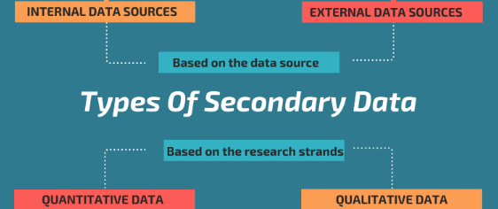

Slide 18
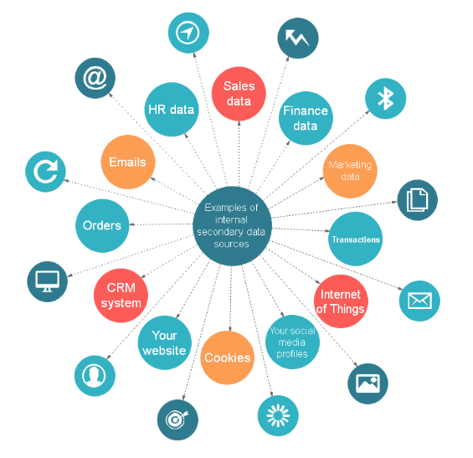
Internal Sources Of Secondary Data

Slide 19
Here is a list of some common and hidden sources of internal information:
1. Sales data
Sales are essential to a company’s profitability. Examples of sales data are revenue, profitability, price, distribution channels etc. This information can show you areas of strength and weakness, which will drive your future decisions.
2. Finance data
Collecting and analyzing your financial data is a way to maximize profits. Examples of financial data are overheads and production costs, cash flow reports, amounts spent to manufacture products, etc.

Slide 20
3. General marketing data
Marketing departments are a gold mine when it comes to secondary data sources. Examples of marketing data are reports on customer profiles, market segmentation, level of customer satisfaction, level of brand awareness, customer engagement through content marketing etc.
4. Human resource data
Human resource departments have information about the costs to recruit and train an employee, the productivity of an individual employee, etc. Human resource data can help you uncover the areas where a company needs to improve its HR processes to empower staff skills, talent, and achievements.

Slide 21
5. Customer relationship management system (CRM software)
Businesses can also collect and analyze data within their own CRM system. This system is a great source of secondary data such as clients’ company affiliations, regional or geographical details for customers, and etc.
6. Emails
The average office employee sends dozens of business emails per day and receives even more. Emails as sources of secondary data, provide important information such as product reviews, opinions, feedback and so on.

Slide 22
7. Your social media profiles
Social Media profiles on networks like Facebook, Tweeter, Linkedin are a great source of information that you can analyze to learn more about, for example, how people are talking about your business and how users share and engage with your content.
Some examples of secondary data that you can collect from social profiles include: likes, shares, mentions, impressions, new followers, comments, URL clicks.

Slide 23
8. Your website analytics
There’s a huge amount of valuable secondary data accessible to you through your website analytics platform. The most popular platform for insights into your website statistics is Google Analytics and Google Search Console.
Examples of data that you can gather from your website include: visitor’s location, patterns of visitor behavior, keywords used by visitors to find your site and business, visitor’s activities in the site, most popular content, etc.

Slide 24
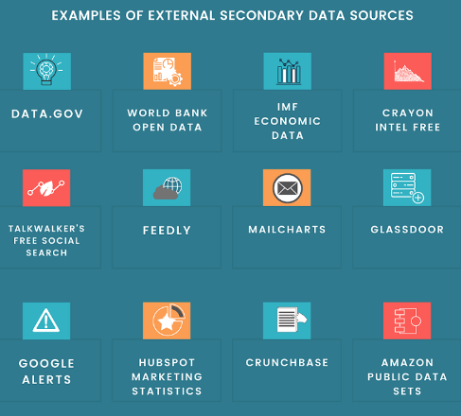
External Sources Of Secondary Data

Slide 25
External data are any data generated outside the boundaries of the company or organization.
There are many advantages of using external sources of secondary data, especially online ones. They offer endless information which you can acquire efficiently and quickly.
Today, external secondary data is a foundation for creating executive decisions wherever it is in business, in medicine, science, or in statistics.

Slide 26
Here are some key examples of external secondary data.
1. Data.gov
Data.gov provides over free 150,000 datasets available through federal, state, and local governments. They are free, and accessible online. Here, companies or students can find a ton of data, including information related to consumers, education, manufacturing, public safety, and much more.
2. World Bank Open Data
World Bank Open Data offer free and open access to global development data. Datasets provide population demographics and a vast number of economic indicators from across the world.

Slide 27
3. IMF Economic Data
The International Monetary Fund (IMF) is an organization of 189 countries. It provides data such as international financial statistics, regional economic reports, foreign exchange rates, debt rates, commodity prices, and investments.
4. Crayon Intel Free
Crayon Intel Free is one of the best free competitor analysis tools that can help you track, analyze, and act on many things that happen outside of your business.

Slide 28
5. Talkwalker’s Free Social Search
Talkwalker’s Free Social Search is a real-time free social media search engine that can provide you with unlimited searches across all major social networks. It allows you to find out what the internet is saying about you or your competitors in seconds.
6. Feedly
Feedly is a free news aggregator site that allows you to keep up with all the topics that matter to you. All in one place. With Feedly, you are able to monitor easily news about your products, your competitors, important posts, content, Tweets or even YouTube videos.

Slide 29
7. Mailcharts
Mailcharts is a quite powerful tool for email marketers as well as for those who want to spy on the competition. It collects emails from competing campaigns to help you develop your own. Mailcharts has a large library of emails from countless brands.
8. Glassdoor
Glassdoor is one of the world’s largest and most popular job and recruiting sites. It provides a free database with millions of company reviews, CEO approval ratings, interview reviews and questions, salary reports, benefits reviews, office photos, and more.
9. Google Alerts
Google Alerts is one of the most popular free alert services that allows you to follow mentions on the internet about practically anything you want – company, brand, customers, purchasing patterns, and so on.

Slide 30
10. HubSpot Marketing Statistics
HubSpot offers a large and very valuable free repository of marketing data. You could find the latest marketing statistics and trends in areas such as Organic Search, Conversion Rate Optimization (CRO), Mobile Search, and others.
11. Crunchbase
Crunchbase is one of the best and most innovative platforms for finding business information about private and public companies.
Crunchbase data include investments and funding information, news, and industry trends, individuals in leadership positions, mergers, and etc.

Slide 31
Evaluation of Secondary Data
Because of the above mentioned disadvantages of secondary data, we will lead to evaluation of secondary data. Evaluation means the following four requirements must be satisfied:
1. Availability- It has to be seen that the kind of data you want is available or not. If it is not available then you have to go for primary data.
2. Relevance- It should be meeting the requirements of the problem. For this we have two criterion:
a. Units of measurement should be the same.
b. Concepts used must be same and currency of data should not be outdated.
3. Accuracy- In order to find how accurate the data is, the following points must be considered:
a. Specification and methodology used;
b. Margin of error should be examined;
c. The dependability of the source must be seen.
4. Sufficiency- Adequate data should be available.

Slide 32
Primary data
Primary data are originated by a researcher for the specific purpose of addressing the problem at hand. Primary data is original data that is directly collected from first-hand sources for a specific research purpose.
The data collected by the researcher himself for finding the solution of a particular problem or situation, is known as primary data. This type of data is characterized by its originality as it is freshly collected. Various organizations conduct surveys, observations, interviews, etc. and as a result generate primary data.

Slide 33
Characteristics of primary data :
1) Collected for the First Time :
Since the primary data are collected for the first time with an objective, they are natural and available in raw stage. They are required to be analysed in systematic way to reach the conclusions.
2) Collected from the Source :
These are generated after personal interactions or observations of original sources or through deputed personnel for the task. These are obtained after certain experimental results, close study of sample cases, first hand encounters of the situations and selection of resources at free will, without following any sequence or particular methods.

Slide 34
3) Considered Prospective in Nature :
The data is generated from first adventure and provides some links on probable happenings in future.
4) Volume of Data :
The primary data is at raw stage and researchers need to do thorough study step-by-step and summarize it to use it efficiently.
5) Specific Research Objective :
Primary data is collected with specific objective and can be used to generate information which is reliable and effective to a large extent after extensive analysis and refinements.

Slide 35
Importance of Primary Data:
Importance of Primary data cannot be neglected. A research can be conducted without secondary data but a research based on only secondary data is least reliable and may have biases because secondary data has already been manipulated by human beings.
In statistical surveys it is necessary to get information from primary sources and work on primary data: for example, the statistical records of female population in a country cannot be based on newspaper, magazine and other printed sources. One such sources are old and secondly they contain limited information as well as they can be misleading and biased.

Slide 36
1. Validity: Validity is one of the major concerns in a research. Validity is the quality of a research that makes it trustworthy and scientific. Validity is the use of scientific methods in research to make it logical and acceptable. Using primary data in research can improves the validity of research. First hand information obtained from a sample that is representative of the target population will yield data that will be valid for the entire target population.

Slide 37
2. Authenticity (özgünlük):. Authenticity can be at stake if the researcher invests personal biases or uses misleading information in the research. Primary research tools and data can become more authentic if the methods chosen to analyze and interpret data are valid and reasonably suitable for the data type. Primary sources are more authentic because the facts have not been overdone. Primary source can be less authentic if the source hides information or alters facts due to some personal reasons. There are methods that can be employed to ensure factual yielding of data from the source.

Slide 38
3. Reliability: Reliability is the certainty that the research is enough true to be trusted on. For example, if a research study concludes that junk food consumption does not increase the risk of cancer and heart diseases. This conclusion should have to be drawn from a sample whose size, sampling technique and variability is not questionable. Reliability improves with using primary data. In the similar research mentioned above if the researcher uses experimental method and questionnaires the results will be highly reliable. On the other hand, if he relies on the data available in books and on internet he will collect information that does not represent the real facts.

Slide 39
Sources of Primary Data:
Primary data are collected during the course of doing experiments in an experimental research but in case we do research of the descriptive type and perform surveys, whether sample surveys or census surveys, we can obtain primary data either through observation or through direct communication with respondents in one form or another or through personal interviews. Thus, in other words, means that there are several methods of collecting primary date, particularly in surveys and descriptive researches. Important ones are :

Slide 40
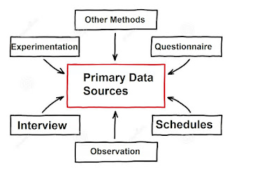

Slide 41
Major tools and techniques for collecting primary data are as follows :
1) Interview :
Interview is the exchange of ideas which takes place between two more people with the purpose of getting information from the respondent. In this method, the interviewer organizes a meeting with the respondent regarding an object or issue related to the research objective and asks some questions. The responses of the interviewee are recorded and compiled to get a better insight into the research problem. Interview can be conducted through various methods such is personal interview, telephonic interview, nail interview, panel interview, etc.

Slide 42
2) Questionnaire :
In order to collect the relevant information from the respondents by asking questions, it is necessary to design a questionnaire comprising of questions related to the research problem. Questionnaire is used to explore the unidentified facts and figures about a particular objective or issue. The responses of the individuals about the research problem are kept confidential. Questionnaires are the standardized and structured forms that are usually filled by the respondents. Questionnaires can be administered personally as well as through mail. When the questionnaire is filled by the researcher himself by asking questions from the respondents, it is called "schedule". With the help of questionnaires, researchers can gather real responses from the respondents, which enhance the effectiveness of data analysis.

Slide 43
3) Schedules :
Just like the questionnaire, a schedule is also a collection of questions. These questions are separated through different sub headings, as per the research problem. Questions are placed in a specific sequence, following the pattern of relevant topic. The researcher or the field worker describes the questions to the individuals and records the responses. The major difference between questionnaire and schedules that schedules are filled by the field worker or the enumerator specifically appointed for this purpose, whereas in questionnaire, respondents fill the form. Enumerator explains the purpose of the research and data collection to the respondents and collects their responses. By explaining the objective to the participants, enumerators help in easy understanding of the research topic.

Slide 44
4) Observation :
Another technique for gathering primary data is observation. When the researcher records information about a person, organization, or situation, without making any personal contact, it is known as "observation method". In this, the researcher or the field executive observes the activity of the concerned person or organization, to draw a pattern of behavior or response to a particular incident. Sometimes, an artificial environment is created to collect the actual responses of the participants..

Slide 45
5) Experimentation :
An important method to collect primary data is experimentation. In experimentation, the causal relationship is determined and analyzed between variables. Experimentation is carried-out with the objective, study effect on a dependent variable by causing a change in the independent variable. For example, a research can be conducted to analyze the influence on learning due to guidelines and instructions in schools.

Slide 46
6) Other Methods :
Other methods for collection of data are described below :
i) Warranty Cards :
Warranty cards are generally used by the dealers of consumer durable to get the feedback of products from their consumers. These are the postal sized cards placed within the package of product. These cards contain various questions regarding the performance of product and to know the needs of consumers. Customers are requested to fill and mail it back. It helps in new product development for the manufacturer.

Slide 47
ii) Auditing :
Auditing is a technique for assessing the performance and current position of any department or the organization. Sometimes, it is also used for understanding the market and buying behavior of customers. Distributors or manufacturers use this tool for gaining the competitive advantage and satisfying the need of customers.

Slide 48
iii) Mechanical Devices :
In present time, there are a lot of electric and magnetic devices present in the market. Some of the major mechanical devices psycho galvanometer, motion picture camera, voice recorders etc.
iv) Simulation :
Simulation is a quantitative technique for data collection. It is the creation of an artificial environment resembling a real life situation. This real life situation is simulated by using various mathematical equations and variables. Researchers can determine the relation between different variables by altering one of the variables and finding its effect on the others.

Slide 49
Advantages of Primary Data
More Accurate: Primary data is researched and developed by individuals giving personal attention to each of the questions they wanted to survey. People more often rely on themselves than relying on others’ data. Also, assessments could be made by individuals working on it. Therefore, making data more valid and accurate. Also, it is more reliable than secondary data.
Updated information: The data which is produced is first-hand data. No other person’s data has been used to develop information that makes the data updated and people rely on information that is more updated and recently been produced. Primary data generally is prepared through a questionnaire or personal contact thus information that is received is valid and updated.

Slide 50
More Control over data: Since the person who is surveying through questionnaires or any other design can manage the data, thus he has control over the whole survey. He can manipulate or make certain updates in the questionnaire to make it more meaningful. The expert sometimes also faces difficulty as a targeted group may not easily know or understand the motive of the survey, thus little manipulation can help them to obtain correct feedback.
Privacy is maintained: The expert who is maintaining all the survey work also maintains the secrecy of the data. It is pretty obvious that when few individuals maintain the whole survey work then mostly secrecy is maintained among them without leaking the ideas. Also, the feedback that they get is always private to surveyors.

Slide 51
The targeted problem is dealt with: People who are engaged in the collection of data prepare the questionnaire and sometimes take the interview from the targeted group to obtain data. Also, the problem is addressed so that after proper feedback it could be put in the limelight and can be resolved. In this way, the program can be made productive, and problems also can be easily handled.
Understanding of data is better: The data surveyed through different designs and methods are made simple and easy to understand so that the person who is interested in data can easily understand it with a glance. Also, it becomes more effective if the feedback obtained is accurate and valid.

Slide 52
Disadvantages of Primary Data
Time-consuming process: The organizer of the survey and method which is used may take a lot of time to collect the data from raw sources. In secondary data, we gather information from other sources. Therefore, it takes less time. Since it is time taking sometimes it delays addressing the problem going on in the surrounding.
Costly: The survey done is time-consuming as well as costly. For the collection of data, experts have to visit and use equipment that may cost very high. Also, after obtaining feedback proper documentation is required which is again needed to take care of and involve high cost.

Slide 53
Require more labor: The manpower requirement is more in the case of primary data as only one person cannot make a survey on his own or collect data single-handedly. Also, the number of men required is more and have to be paid after their work has been done.
The questionnaire must be easy and understandable: The questionnaire prepared must be easy to understand then only the researchers may get correct and valid feedback. The researchers have to make the set of sample questionnaires in such a way or use the method or technique that may help the people to interpret it easily if not the feedback which is produced will be wrong or inaccurate.

Slide 54
Feedback may be faulty: We have already learned that if the technique used by researchers will not be proper or accurate then the feedback also which is produced will be faulty or incorrect. Thus, proper action and maintenance must be done so that the feedback data which is produced should be authentic.
An experienced person is needed for the analysis: The method for collecting data, technique, and analysis must be done by an expert as only an expert can make the whole research meaningful by providing real facts and information. The analysis is mostly done by the researcher or an expert according to the problem found.

Slide 55
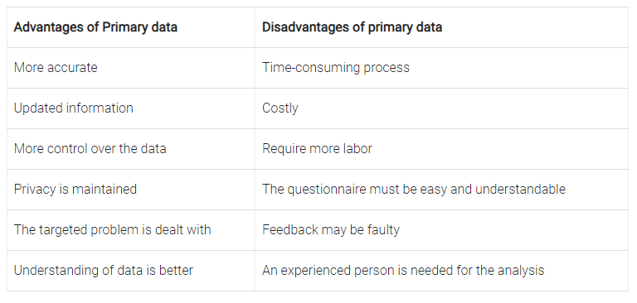

Slide 56
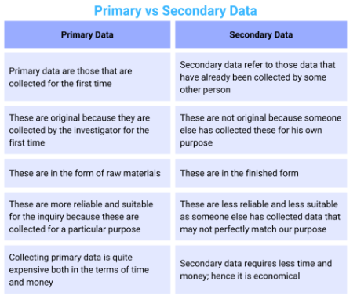

Slide 57
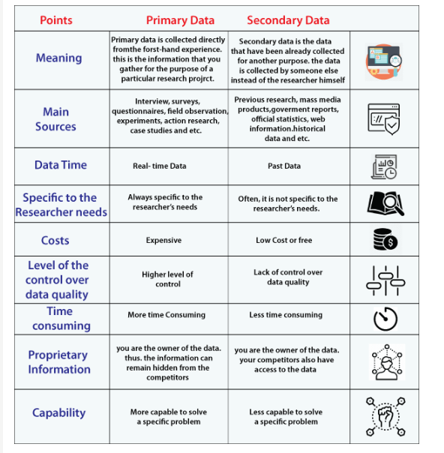

Slide 58
